Slide 1
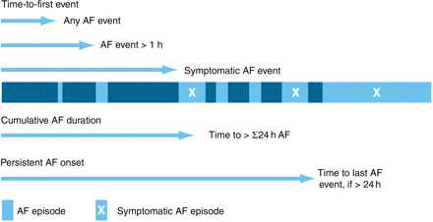
Figure 2 Relationship between time to first event and type of event.
Notes:
Figure 2 Relationship between time to first event and type of event.
Unless provided in the caption above, the following copyright applies to the content of this slide: Published on behalf of the European Society of Cardiology. All rights reserved. © The Author 2008. For permissions please email: journals.permissions@oxfordjournals.org

Slide 2
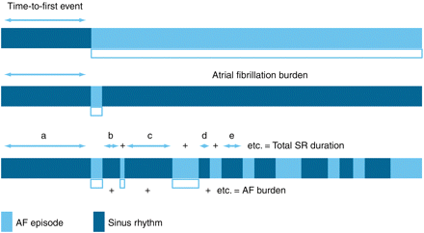
Figure 1 Relationship between time to first event and atrial fibrillation burden.
Notes:
Figure 1 Relationship between time to first event and atrial fibrillation burden.
Unless provided in the caption above, the following copyright applies to the content of this slide: Published on behalf of the European Society of Cardiology. All rights reserved. © The Author 2008. For permissions please email: journals.permissions@oxfordjournals.org

Slide 3
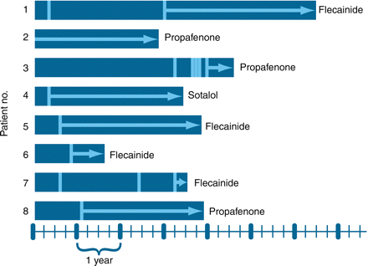
Figure 3 Inter-atrial fibrillation (AF) intervals following the start of antiarrhythmic drugs (AADs). Eight ...
Notes:
Figure 3 Inter-atrial fibrillation (AF) intervals following the start of antiarrhythmic drugs (AADs). Eight consecutive patients with follow-up periods subsequent to the initiation of an AAD for AF during which no dose adjustment for that AAD was made. The pattern of recurrence does not fit a Poisson distribution. The bars represent the total duration of follow-up for each patient; the vertical bands represent episodes of AF; the arrows represent the duration for which no recurrence was recorded since the patient's last episode.
Unless provided in the caption above, the following copyright applies to the content of this slide: Published on behalf of the European Society of Cardiology. All rights reserved. © The Author 2008. For permissions please email: journals.permissions@oxfordjournals.org

Slide 4
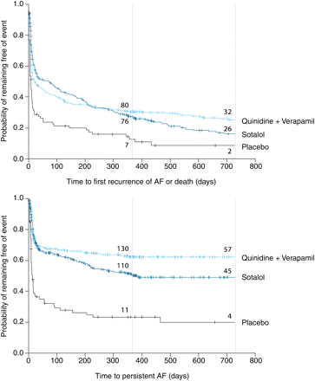
Figure 4 Differentiation of treatment effects according to endpoint in the PAFAC trial (survival analysis): time to ...
Notes:
Figure 4 Differentiation of treatment effects according to endpoint in the PAFAC trial (survival analysis): time to first recurrence of atrial fibrillation (AF) or death (primary endpoint) vs. time to persistent AF (secondary endpoint). The numbers of patients at risk are stated for 1 and 2 years of follow-up. Adapted from Fetsch et al.21
Unless provided in the caption above, the following copyright applies to the content of this slide: Published on behalf of the European Society of Cardiology. All rights reserved. © The Author 2008. For permissions please email: journals.permissions@oxfordjournals.org

Slide 5
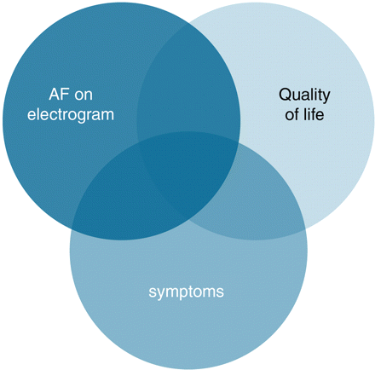
Figure 5 Potential overlap between ECG-documented presence of atrial fibrillation (AF), symptoms, and quality of life. ...
Notes:
Figure 5 Potential overlap between ECG-documented presence of atrial fibrillation (AF), symptoms, and quality of life. Quality of life may be impaired in the absence of symptoms or by symptoms related to concomitant disorders rather than AF. Adapted from: Grönefeld and Hohnloser.74
Unless provided in the caption above, the following copyright applies to the content of this slide: Published on behalf of the European Society of Cardiology. All rights reserved. © The Author 2008. For permissions please email: journals.permissions@oxfordjournals.org

