Slide 1
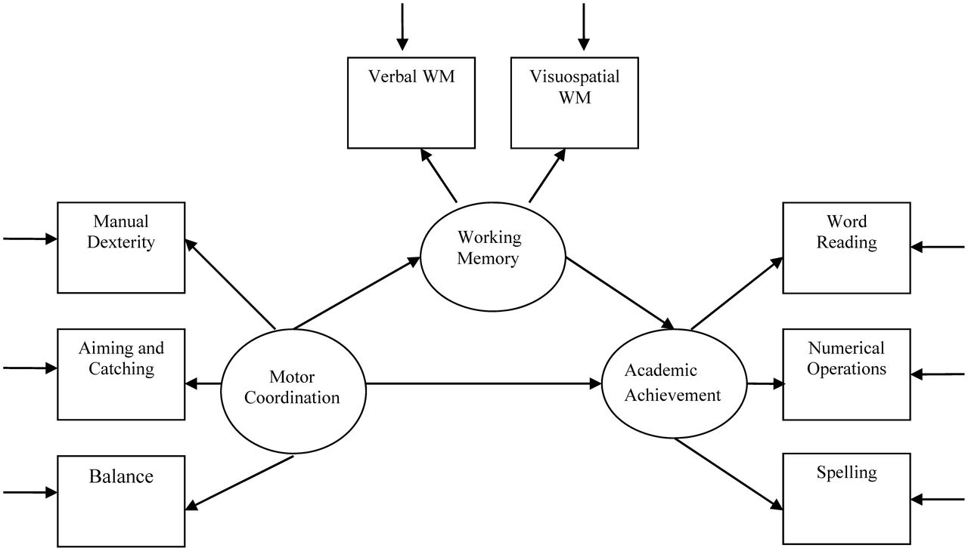
Fig. 1. Diagrammatic representation of the proposed mediating model.
Notes:
Fig. 1. Diagrammatic representation of the proposed mediating model.
Unless provided in the caption above, the following copyright applies to the content of this slide: © The Author 2012. Published by Oxford University Press. All rights reserved. For permissions, please e-mail: journals.permissions@oup.com.

Slide 2
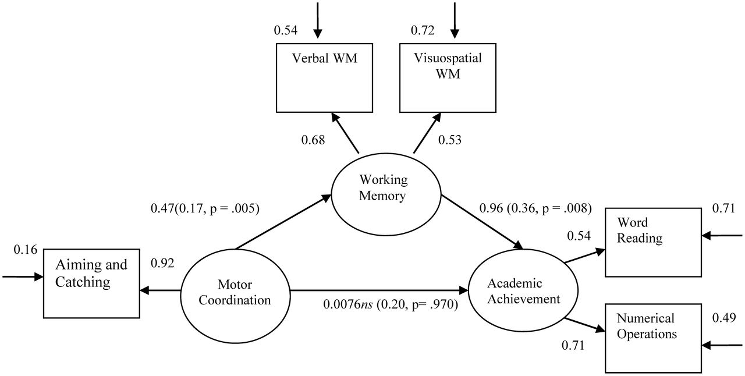
Fig. 2. Parameter estimates for the saturated model.
Notes:
Fig. 2. Parameter estimates for the saturated model.
Unless provided in the caption above, the following copyright applies to the content of this slide: © The Author 2012. Published by Oxford University Press. All rights reserved. For permissions, please e-mail: journals.permissions@oup.com.

Slide 3
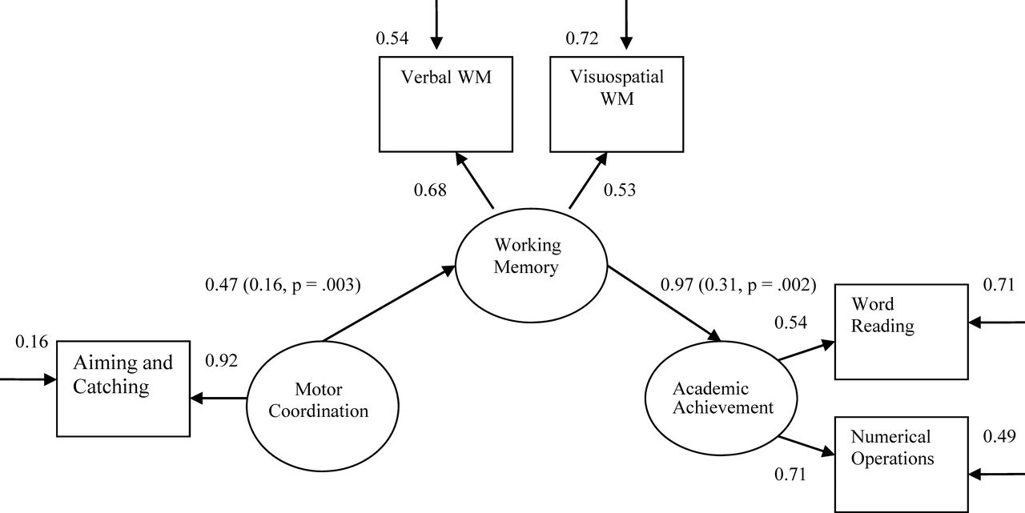
Fig. 3. Parameter estimates for the mediator model.
Notes:
Fig. 3. Parameter estimates for the mediator model.
Unless provided in the caption above, the following copyright applies to the content of this slide: © The Author 2012. Published by Oxford University Press. All rights reserved. For permissions, please e-mail: journals.permissions@oup.com.

