Slide 1
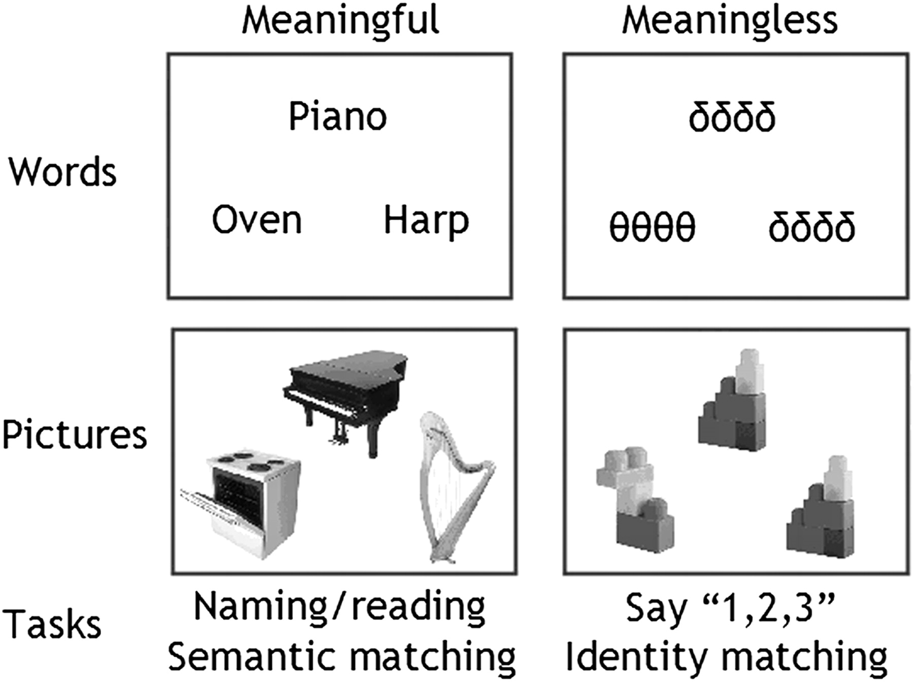
Figure 1. Paradigm. Our experimental paradigm was designed to tease apart activation related to word retrieval, word ...
Notes:
Figure 1. Paradigm. Our experimental paradigm was designed to tease apart activation related to word retrieval, word recognition, and articulation. In all trials, 3 stimuli were simultaneously presented as a “triad,” with 1 stimulus above and 2 stimuli below. Word retrieval was assessed during picture naming (condition 1) and reading aloud (condition 2). Articulation without word retrieval involved articulating “1,2,3” in response to pictures of unfamiliar nonobjects (condition 3) or unfamiliar (and meaningless) strings of Greek letters (condition 4). Word recognition and semantic processing were assessed during semantic decisions (e.g., matching Piano to Harp rather than Oven) on pictures (condition 5) or words (condition 6), using a finger press response. Perceptual processing was assessed during a physical identity match on the meaningless Greek letter strings (condition 7) or pictures of nonobjects (condition 8), using a finger press response.
Unless provided in the caption above, the following copyright applies to the content of this slide: © The Authors 2011. Published by Oxford University Press.This is an Open Access article distributed under the terms of the Creative Commons Attribution Non-Commercial License (http://creativecommons.org/licenses/by-nc/2.5), which permits unrestricted non-commercial use, distribution, and reproduction in any medium, provided the original work is properly cited.

Slide 2
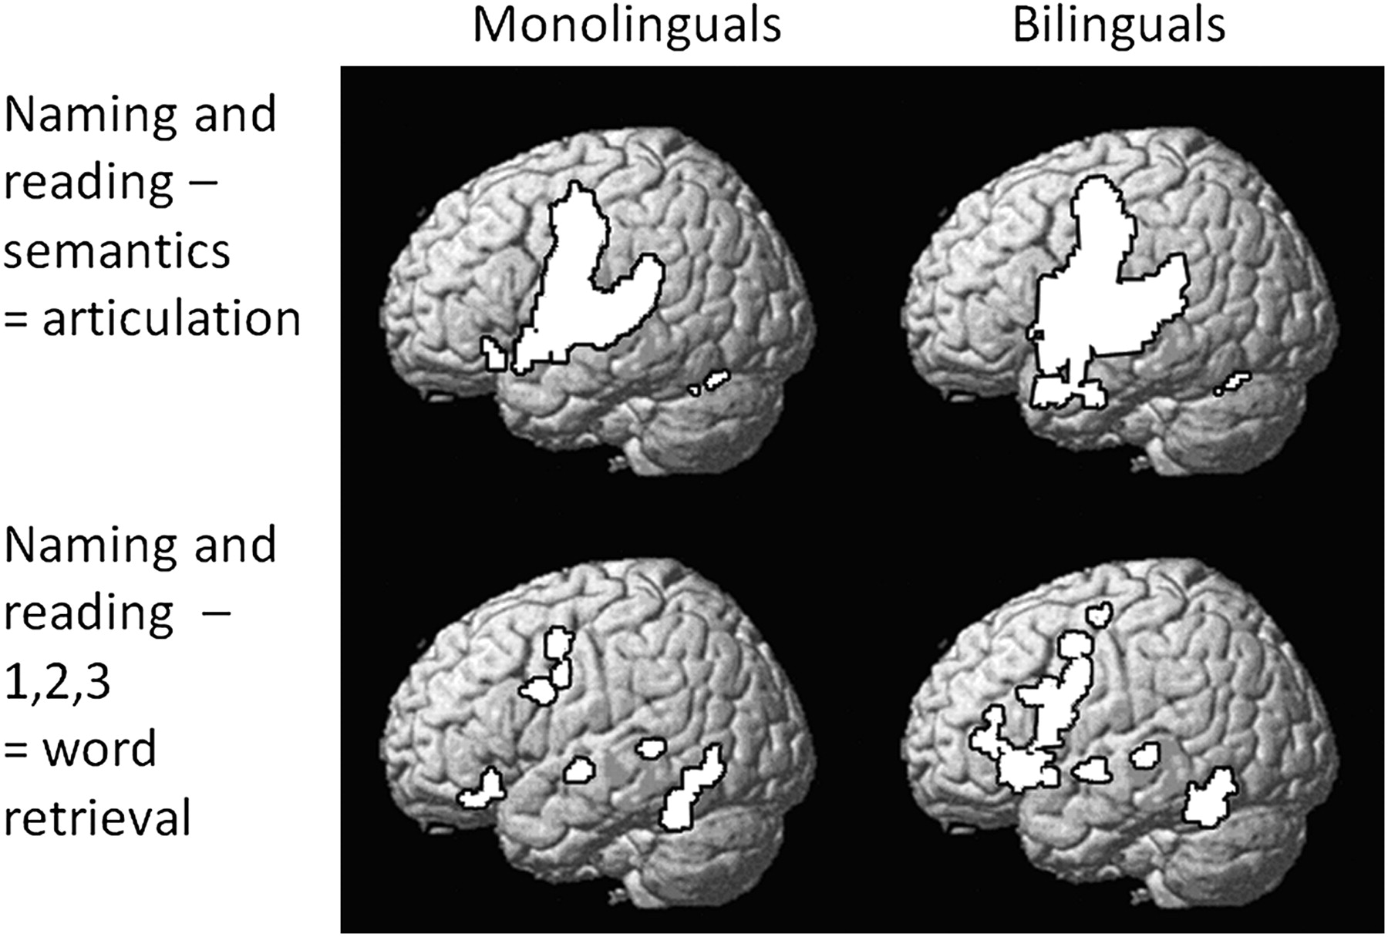
Figure 2. Task effects in monolinguals and bilingual separately. Greater activation for 1) naming and reading aloud ...
Notes:
Figure 2. Task effects in monolinguals and bilingual separately. Greater activation for 1) naming and reading aloud minus semantic conditions (Analysis 1) and 2) naming and reading aloud minus articulating “1,2,3” (Analysis 2). Threshold = P 30 voxels. After a correction for multiple comparison across the whole brain (P < 0.05 familywise error corrected), areas that were more activated by naming and reading aloud than by semantic decisions for monolinguals and bilinguals, included bilateral precentral and postcentral gyri, bilateral superior temporal cortices, bilateral cerebellum, the left thalamus, and the supplementary motor cortex. In contrast, areas that were more activated by naming and reading aloud than by articulation (monolinguals and bilinguals) included the left anterior fusiform, anterior cingulate, dorsal premotor cortex, left superior temporal gyrus, left frontal operculum, and bilateral cerebellum.
Unless provided in the caption above, the following copyright applies to the content of this slide: © The Authors 2011. Published by Oxford University Press.This is an Open Access article distributed under the terms of the Creative Commons Attribution Non-Commercial License (http://creativecommons.org/licenses/by-nc/2.5), which permits unrestricted non-commercial use, distribution, and reproduction in any medium, provided the original work is properly cited.

Slide 3
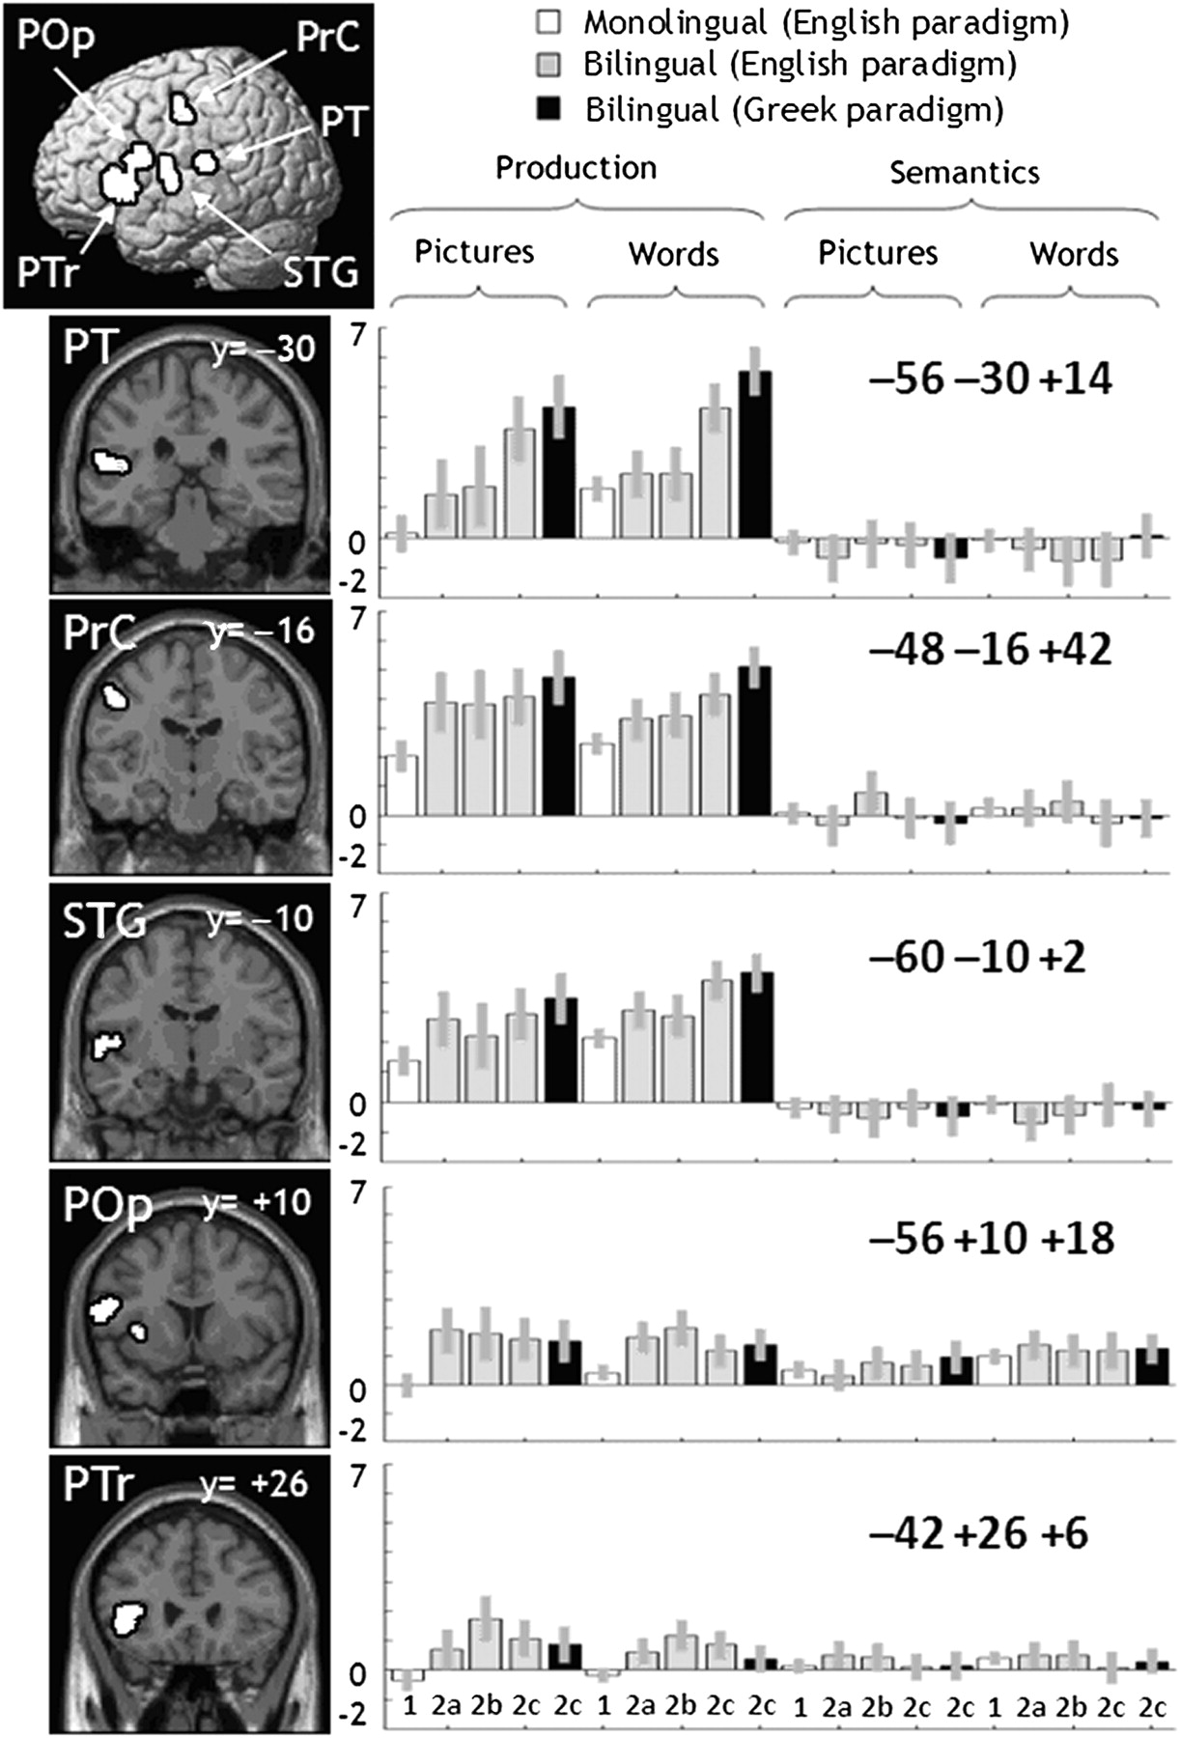
Figure 3. Main effect of Bilingualism. This is a visualization of Table 3. A sagittal rendering and coronal sections ...
Notes:
Figure 3. Main effect of Bilingualism. This is a visualization of Table 3. A sagittal rendering and coronal sections are given on the left. F-maps are on the right, with groups and conditions along the x-axis, and values along the y-axis (within the range [−2, 7]). Conditions are arranged into tasks (naming pictures, reading words aloud, matching semantically related pictures, matching alphabetic strings). Conditions are also colored white for monolinguals, gray for bilinguals in the English paradigm, and black for bilinguals in the Greek paradigm.
Unless provided in the caption above, the following copyright applies to the content of this slide: © The Authors 2011. Published by Oxford University Press.This is an Open Access article distributed under the terms of the Creative Commons Attribution Non-Commercial License (http://creativecommons.org/licenses/by-nc/2.5), which permits unrestricted non-commercial use, distribution, and reproduction in any medium, provided the original work is properly cited.

Slide 4
Figure 4. Effect of number of languages (Analysis 5). Parameter estimates for number of languages in 5 significant ...
Notes:
Figure 4. Effect of number of languages (Analysis 5). Parameter estimates for number of languages in 5 significant regions (from the whole brain analysis: PT, PrC, STG, POp, PTr/Ins). The x-axes are number of languages (1 = monolingual, 2 = exactly bilingual, 3+ = more than exactly bilingual). The y-axes are the estimated effect sizes; the variance is standard error.
Unless provided in the caption above, the following copyright applies to the content of this slide: © The Authors 2011. Published by Oxford University Press.This is an Open Access article distributed under the terms of the Creative Commons Attribution Non-Commercial License (http://creativecommons.org/licenses/by-nc/2.5), which permits unrestricted non-commercial use, distribution, and reproduction in any medium, provided the original work is properly cited.

