Slide 1
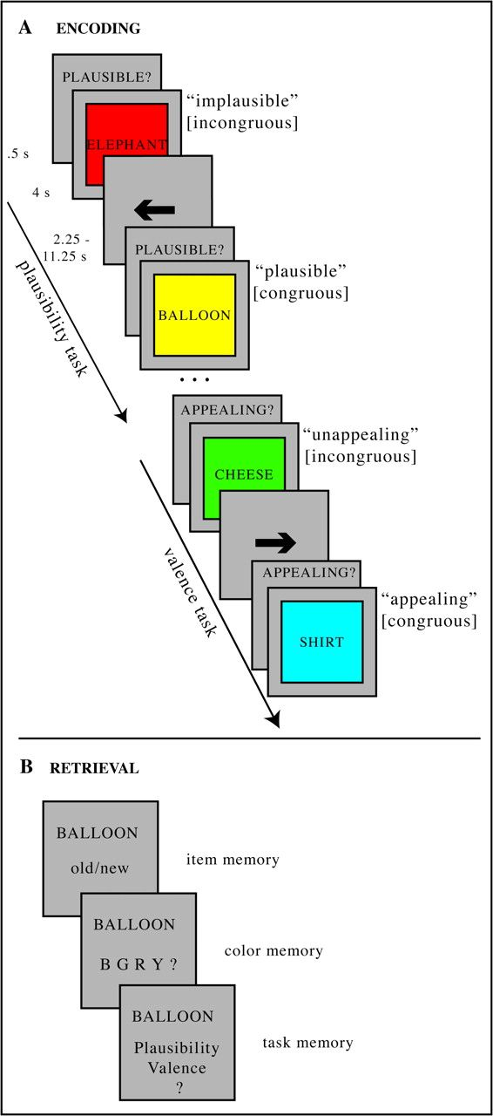
Figure 1. Design for Experiments 1 and 2. (A) During encoding (scanned with fMRI in Experiment 2), subjects were ...
Notes:
Figure 1. Design for Experiments 1 and 2. (A) During encoding (scanned with fMRI in Experiment 2), subjects were presented with word/color combinations in blocks of a plausibility task alternating with blocks of a valence task. For a given trial, subjects were asked to vividly imagine the referent of the noun in the given color and to either rate the plausibility of the given word/color combination to appear in real life/nature (plausible or implausible in the plausibility task) or the subjective aesthetic appeal of the word/color combination (appealing or unappealing in the valence task). Example trials show possible answers a subject may give for the given word/color combinations and (in brackets) the resulting classification of that event as congruous or incongruous. (B) The following 3-step surprise recognition memory test assessed item memory by asking subjects to make old/new judgments on previously seen or unseen words. If the response was old, relational/source memory was assessed by testing memory for 1) the associated color with which an item was presented and 2) the associated task context in which an item was encountered.
Unless provided in the caption above, the following copyright applies to the content of this slide: © The Author 2008. Published by Oxford University Press. All rights reserved. For permissions, please e-mail: journals.permissions@oxfordjournals.org

Slide 2
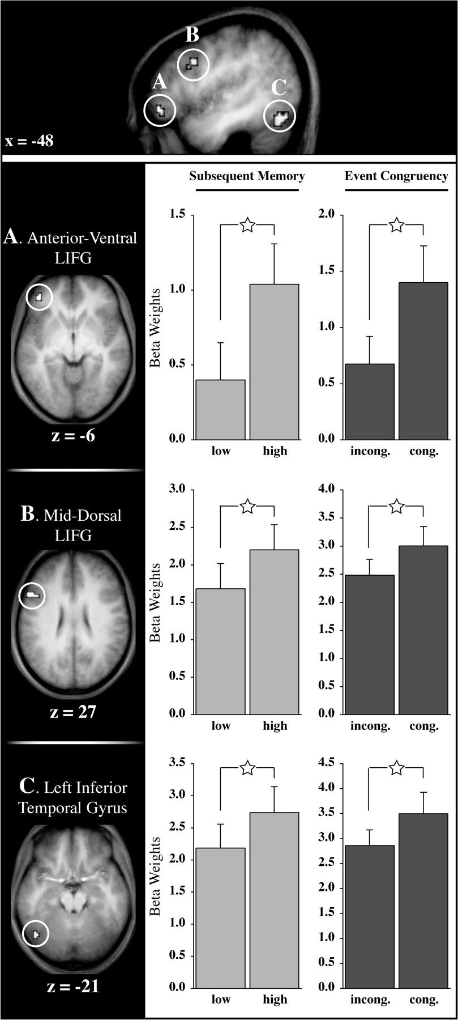
Figure 2. Brain regions underlying the cSME. Statistical parametric maps depict regions that show greater encoding ...
Notes:
Figure 2. Brain regions underlying the cSME. Statistical parametric maps depict regions that show greater encoding activation for (A) plausible compared with implausible trials, (B) appealing compared with unappealing trials, (C) successful compared with unsuccessful memory encoding during congruous events, and (D) successful compared with unsuccessful memory encoding during incongruous events, revealed via a quadruple conjunction analysis. Top: Resulting clusters displayed on a sagittal slice of the T1-weighted anatomical image averaged across subjects. Bottom: Individual clusters superimposed on horizontal slices of the T1-weighted anatomical image averaged across subjects. Bar graphs show the beta parameter estimates for each trial type averaged across subjects and across all voxels in a given cluster. Error bars represent the standard error of the mean. low, encoding trials later forgotten (misses) and encoding trials later recognized without memory for the correct color or the correct encoding task (item only recognition); high, encoding trials later recognized including memory for the correct color, the correct task or both; incong., incongruous encoding trials, entailing implausible (plausibility task) or unappealing (valence task) responses; cong., congruous encoding trials, entailing plausible (plausibility task) or appealing (valence task) responses; star symbols, pairwise comparison (t test) statistically significant at P<0.005.
Unless provided in the caption above, the following copyright applies to the content of this slide: © The Author 2008. Published by Oxford University Press. All rights reserved. For permissions, please e-mail: journals.permissions@oxfordjournals.org

Slide 3
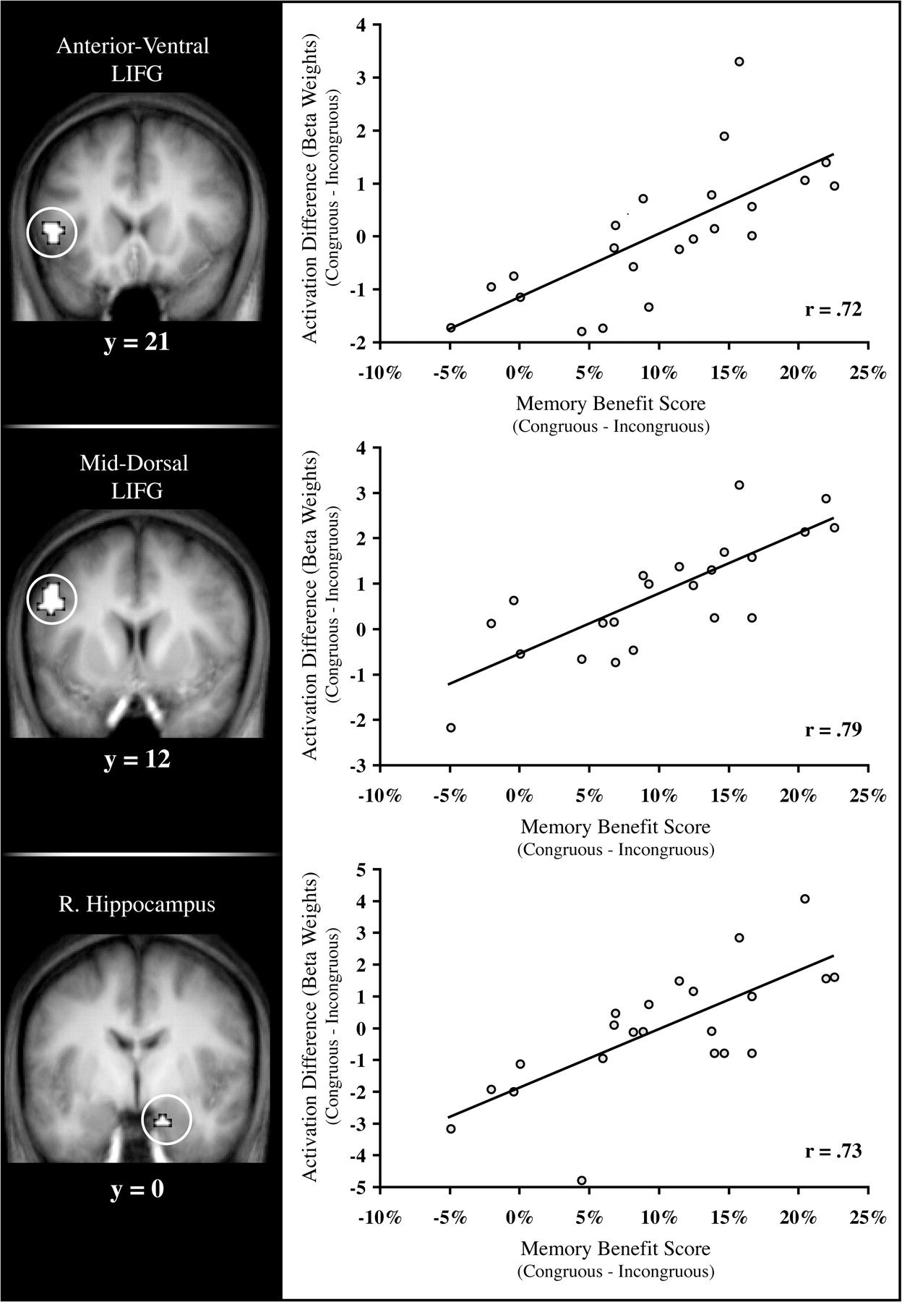
Figure 3. Correlation between differential brain activation and the behavioral memory benefit for congruous events ...
Notes:
Figure 3. Correlation between differential brain activation and the behavioral memory benefit for congruous events across subjects. Statistical parametric maps (superimposed on coronal slices of the T1-weighted anatomical image averaged across subjects) depict regions that show significant mapwise correlations between 1) differential brain activation between congruous and incongruous encoding events and 2) the behavioral mnemonic benefit for congruous relative to incongruous events.
Unless provided in the caption above, the following copyright applies to the content of this slide: © The Author 2008. Published by Oxford University Press. All rights reserved. For permissions, please e-mail: journals.permissions@oxfordjournals.org

