Slide 1
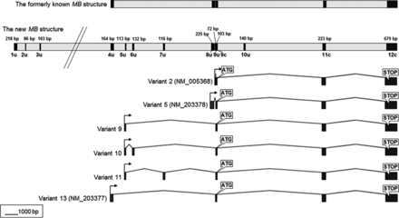
Figure 1. Revised exon-intron structure of the human MB gene and its former version (top). Exons are shown as dark ...
Notes:
Figure 1. Revised exon-intron structure of the human MB gene and its former version (top). Exons are shown as dark boxes with their sizes in bp written on top. Untranslated and CDS-encoding exons are tagged with a ‘u’ or ‘c’, respectively. The most prominent protein encoding splice variants from muscle (variants 2 and 5) and from cancer-related samples (variants 9–11, 13) are shown, including the start and stop codons of the MB-CDS.
Unless provided in the caption above, the following copyright applies to the content of this slide: © The Author 2013. Published by Oxford University Press. All rights reserved. For Permissions, please email: journals.permissions@oup.com

Slide 2
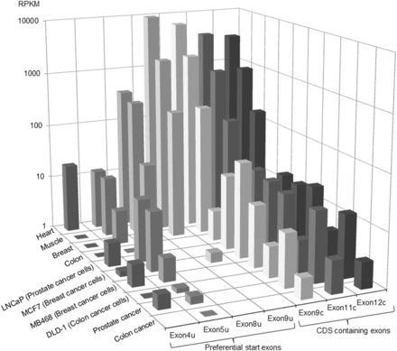
Figure 2. Quantification of MB start exon transcription in different human tissues by RNA-Seq read counting. Normalized ...
Notes:
Figure 2. Quantification of MB start exon transcription in different human tissues by RNA-Seq read counting. Normalized RPKM values [reads per exon size (in kb) per total reads of the data set (in Mio)] indicate the transcriptional representation of preferential start exon and CDS-containing exons.
Unless provided in the caption above, the following copyright applies to the content of this slide: © The Author 2013. Published by Oxford University Press. All rights reserved. For Permissions, please email: journals.permissions@oup.com

Slide 3
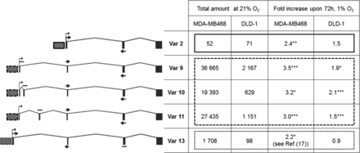
Figure 3. Expression analysis of MB splice variants in vitro in normoxic and hypoxic MDA-MB468 breast cancer and DLD-1 ...
Notes:
Figure 3. Expression analysis of MB splice variants in vitro in normoxic and hypoxic MDA-MB468 breast cancer and DLD-1 colon cancer cells. Numbers in the left half of the table show cDNA copy numbers determined by qRT–PCR, fold-changes in the right half of the table indicate hypoxic up-regulation (*P < 0.05; **P < 0.01; ***P < 0.001; n = 3). Primers which are able to distinguish between transcript variants 2, 9–11 and 13, are indicated by arrows above (forward) and underneath (reverse) their respective target exons. The solid, dashed and dotted lines that frame fields of the table indicate promoters common between the splice forms (also shown left to each transcript variant's graph).
Unless provided in the caption above, the following copyright applies to the content of this slide: © The Author 2013. Published by Oxford University Press. All rights reserved. For Permissions, please email: journals.permissions@oup.com

Slide 4
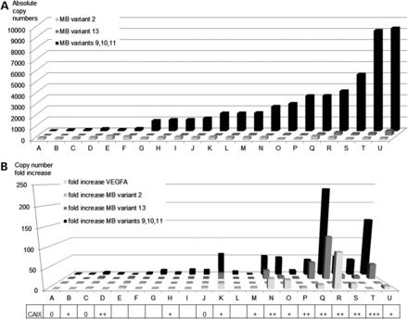
Figure 4. (A) Expression analysis of MB splice variants in breast cancer biopsies (named A to U). cDNA copy numbers ...
Notes:
Figure 4. (A) Expression analysis of MB splice variants in breast cancer biopsies (named A to U). cDNA copy numbers (per 10 ng cDNA) inferred by qRT–PCR are plotted on the y-axis (bars). Values for variants 9–11 have been summed up and are shown relative to expression of the minor cancer-associated transcript 13 and the muscle-typic variant 2. (B) Correlation between MB expression and hypoxia markers in breast tumor specimen. The fold-increase of MB variants and VEGFA mRNA expression (bars) in tumors versus normal tissue, inferred by qRT–PCR, is shown in relation to the intensity of CAIX immunostaining, as applied to the same tumor sections.
Unless provided in the caption above, the following copyright applies to the content of this slide: © The Author 2013. Published by Oxford University Press. All rights reserved. For Permissions, please email: journals.permissions@oup.com

Slide 5
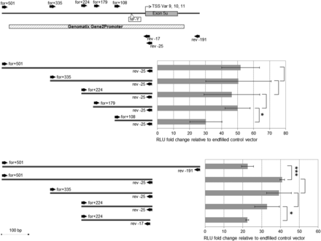
Figure 5. Functional analysis of the promoter section upstream of exon 5 u. DLRAs were conducted on promoter sections ...
Notes:
Figure 5. Functional analysis of the promoter section upstream of exon 5 u. DLRAs were conducted on promoter sections that were PCR-amplified from primer sites represented by black arrows. The numbers on the arrows indicate the bp distance to the transcription start site of the MB splice variants 9–11. An in silico-predicted promoter region and a commonly observed cis-acting promoter element (NF-Y box) are indicated. The average RLUs of each construct were plotted in the bar chart; standard deviations are indicated by error bars (*P < 0.05; ***P < 0.001; n = 3).
Unless provided in the caption above, the following copyright applies to the content of this slide: © The Author 2013. Published by Oxford University Press. All rights reserved. For Permissions, please email: journals.permissions@oup.com

Slide 6
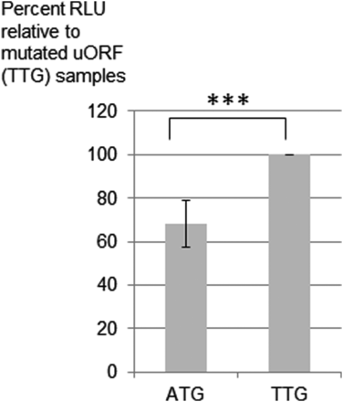
Figure 6. Functional analysis of a uORF in MB cassette exon 7 u. DLRA results, plotted as a bar chart, show ...
Notes:
Figure 6. Functional analysis of a uORF in MB cassette exon 7 u. DLRA results, plotted as a bar chart, show translational activity of the uORF-containing construct (ATG) and its point-mutated version TTG (c.-3067A > T) for comparison. Standard deviations are indicated by error bars (***P < 0.001; n = 5).
Unless provided in the caption above, the following copyright applies to the content of this slide: © The Author 2013. Published by Oxford University Press. All rights reserved. For Permissions, please email: journals.permissions@oup.com

