Slide 1
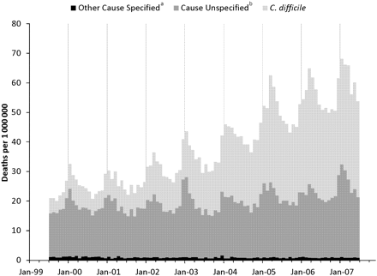
Figure 1. Cumulative annualized gastroenteritis mortality rates by International Classification of Diseases, 10th ...
Notes:
Figure 1. Cumulative annualized gastroenteritis mortality rates by International Classification of Diseases, 10th Revision (ICD-10) code and month, United States, July 1999–June 2007. A, Codes include specified viral (A08.0–A08.2), non–Clostridium difficile bacterial (A00.0–A04.6, A04.8–A05.9), and parasitic (A06.0–A07.9). B, Codes include presumed infectious (A09), presumed noninfective (K52.9), other or unspecified viral (A08.3–A08.5), and for children aged <5 years only, acute or unspecified vascular (K55.0, K55.9).
Unless provided in the caption above, the following copyright applies to the content of this slide: Published by Oxford University Press on behalf of the Infectious Diseases Society of America 2012.

Slide 2
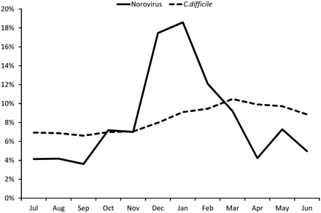
Figure 2. Percentage of average annual deaths associated with Clostridium difficile and norovirus by month, United ...
Notes:
Figure 2. Percentage of average annual deaths associated with Clostridium difficile and norovirus by month, United States, July 1999 through June 2007.
Unless provided in the caption above, the following copyright applies to the content of this slide: Published by Oxford University Press on behalf of the Infectious Diseases Society of America 2012.

Slide 3
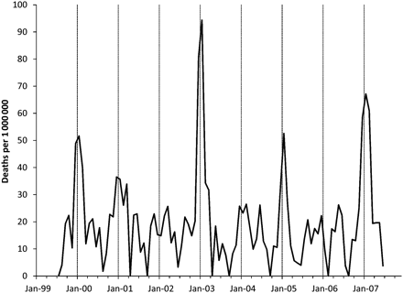
Figure 3. Annualized norovirus mortality rate by month among persons aged ≥65 years, United States, July 1999 through ...
Notes:
Figure 3. Annualized norovirus mortality rate by month among persons aged ≥65 years, United States, July 1999 through June 2007. Surges during 2002–2003 and 2006–2007 were contemporaneous with emergence of novel genogroup II type 4 (GII.4) norovirus strains [44].
Unless provided in the caption above, the following copyright applies to the content of this slide: Published by Oxford University Press on behalf of the Infectious Diseases Society of America 2012.

