Slide 1
Fig. 1. Mitochondrial morphology. Panel (A) shows the mitochondrial network (MitoTracker Red-stained) containing many ...
Notes:
Fig. 1. Mitochondrial morphology. Panel (A) shows the mitochondrial network (MitoTracker Red-stained) containing many mtDNA nucleoids (PicoGreen-stained) surrounding the nucleus (Hoescht-stained) of a human primary fibroblast (photo: Amanda Bess). Panels (B) and (C) show a transgenic strain of C. elegans that expresses a mitochondrial matrix-targeted green fluorescent protein in body wall muscle cells. The image in panel (B) is from a control nematode, and the image in panel (C) is from a nematode exposed to 1µM carbonyl cyanide m-chlorophenyl hydrazone, a potent ionophore and inhibitor of oxidative phosphorylation that leads to mitochondrial fragmentation; the mitochondrial matrix was visualized via expression of green fluorescent protein (photo: John Rooney).
Unless provided in the caption above, the following copyright applies to the content of this slide: © The Author 2013. Published by Oxford University Press on behalf of the Society of Toxicology.This is an Open Access article distributed under the terms of the Creative Commons Attribution Non-Commercial License (http://creativecommons.org/licenses/by-nc/3.0/), which permits non-commercial re-use, distribution, and reproduction in any medium, provided the original work is properly cited. For commercial re-use, please contact journals.permissions@oup.com.

Slide 2
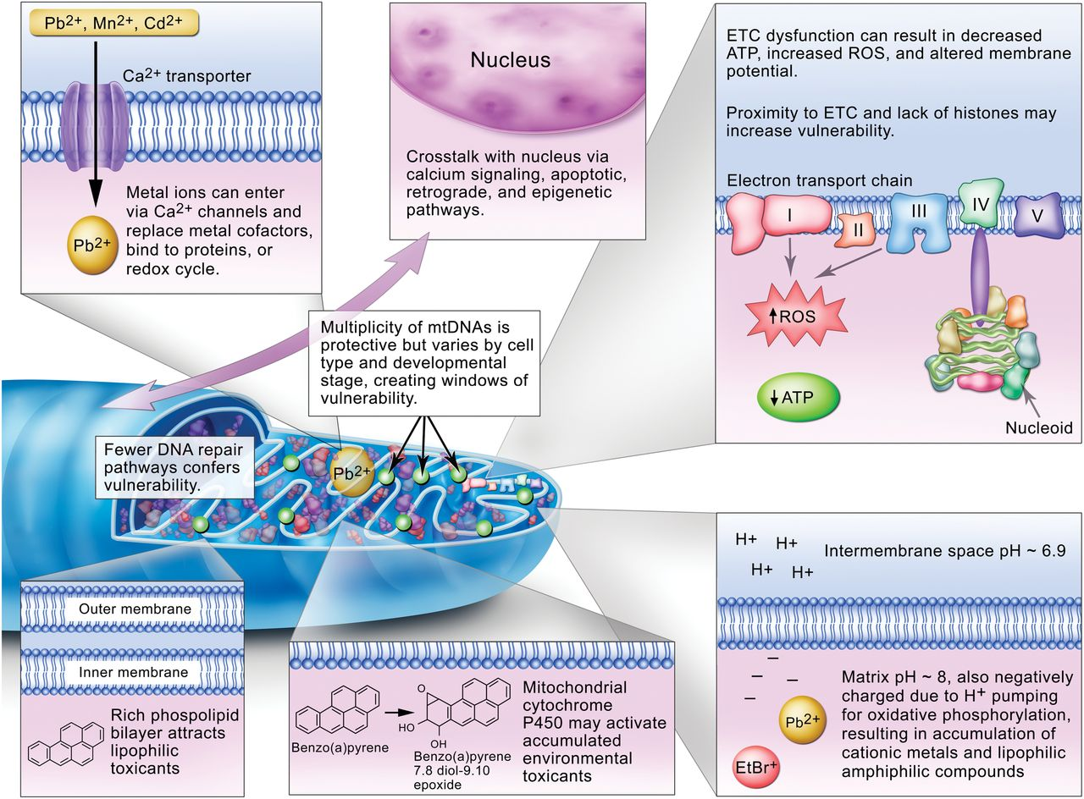
Fig. 2. Factors that affect mitochondrial vulnerability to environmental toxicants, as discussed in the text.
Notes:
Fig. 2. Factors that affect mitochondrial vulnerability to environmental toxicants, as discussed in the text.
Unless provided in the caption above, the following copyright applies to the content of this slide: © The Author 2013. Published by Oxford University Press on behalf of the Society of Toxicology.This is an Open Access article distributed under the terms of the Creative Commons Attribution Non-Commercial License (http://creativecommons.org/licenses/by-nc/3.0/), which permits non-commercial re-use, distribution, and reproduction in any medium, provided the original work is properly cited. For commercial re-use, please contact journals.permissions@oup.com.

