Slide 1
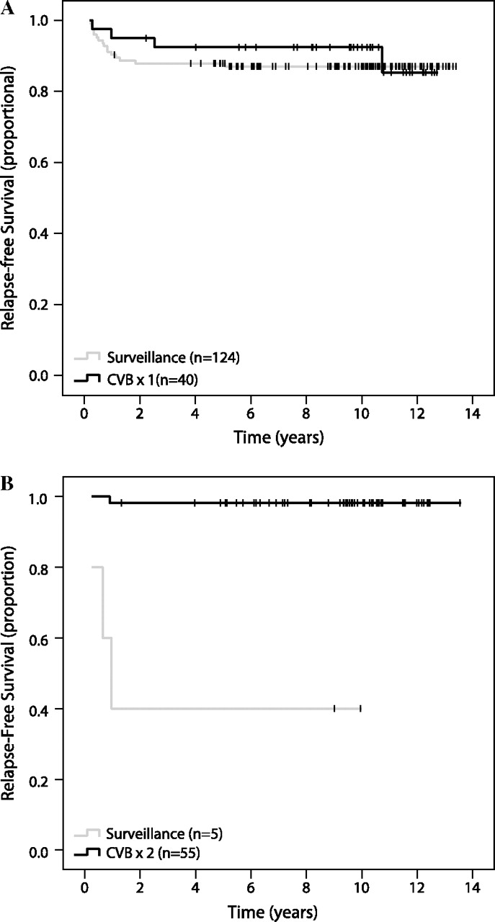
Figure 1. Kaplan–Meier curves for relapse-free survival for (A) patients without vascular invasion (P = 0.592) and (B) ...
Notes:
Figure 1. Kaplan–Meier curves for relapse-free survival for (A) patients without vascular invasion (P = 0.592) and (B) patients with vascular invasion (P < 0.000).
Unless provided in the caption above, the following copyright applies to the content of this slide: © The Author 2010. Published by Oxford University Press on behalf of the European Society for Medical Oncology. All rights reserved. For permissions, please email: journals.permissions@oxfordjournals.org

