Slide 1
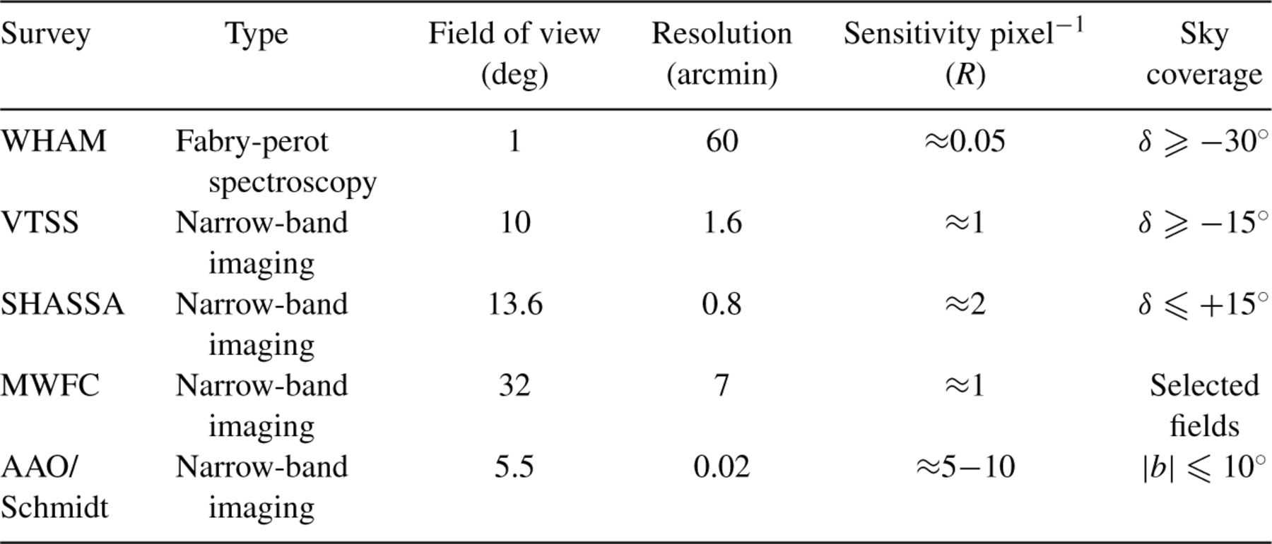
Table 1. Current H± surveys relevant to CMB observations.
Notes:
Table 1. Current H± surveys relevant to CMB observations.
Unless provided in the caption above, the following copyright applies to the content of this slide: © 2003 RAS

Slide 2
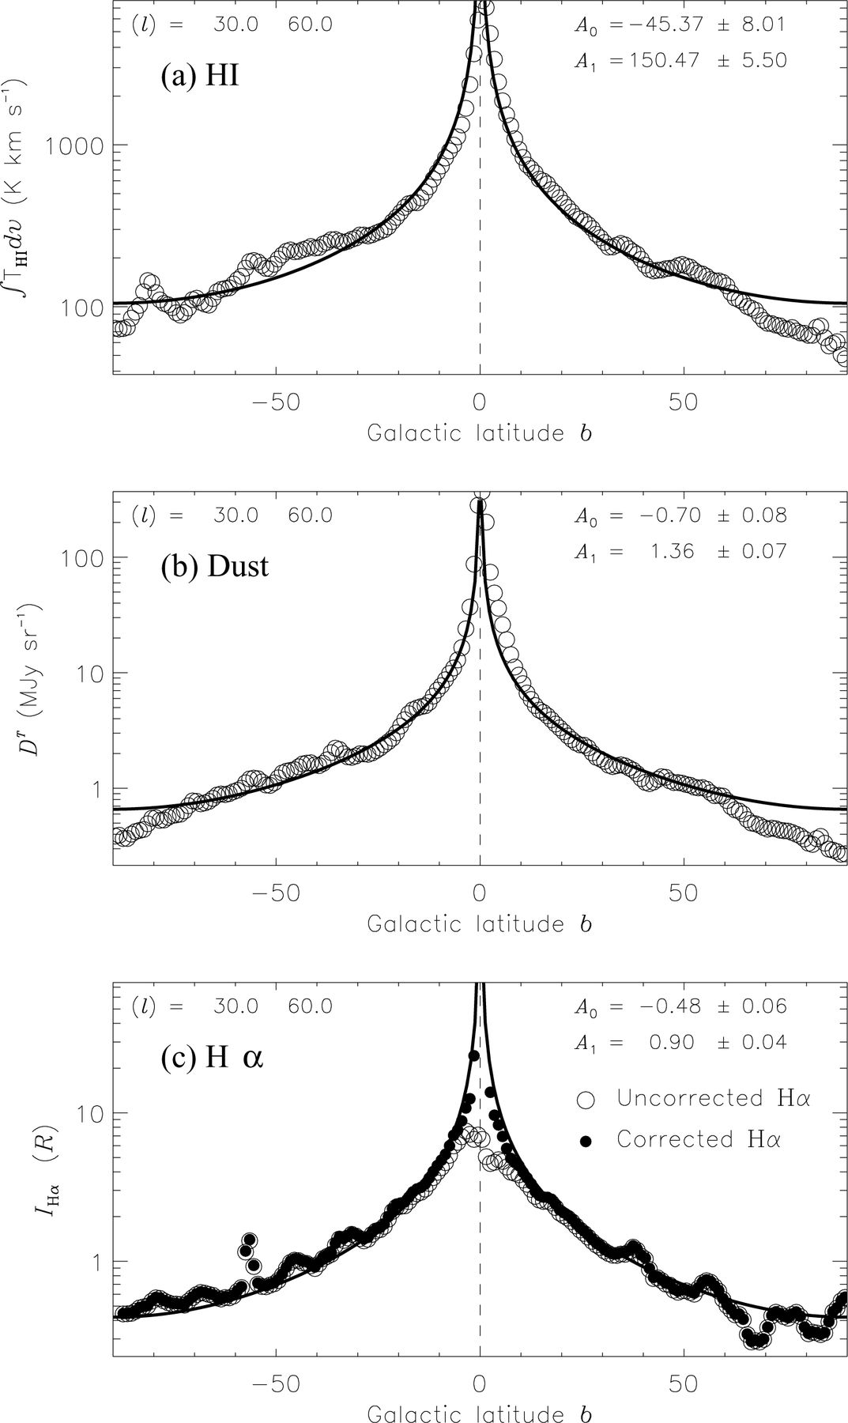
Figure 1. Galactic latitude scans for the longitude range l= 30°–60°. (a) H i from Leiden–Dwingeloo survey data. (b) ...
Notes:
Figure 1. Galactic latitude scans for the longitude range l= 30°–60°. (a) H i from Leiden–Dwingeloo survey data. (b) Dust emissivity at 100 μ m from the SFD98 DT template. (c) Hα data from the WHAM survey. In (c) the Hα data corrected for dust absorption (fd= 0.33) are shown as filled circles while the uncorrected data are open circles. The best-fitting cosecant law is shown for each distribution (see the text). Note the logarithmic scale on the vertical axes.
Unless provided in the caption above, the following copyright applies to the content of this slide: © 2003 RAS

Slide 3
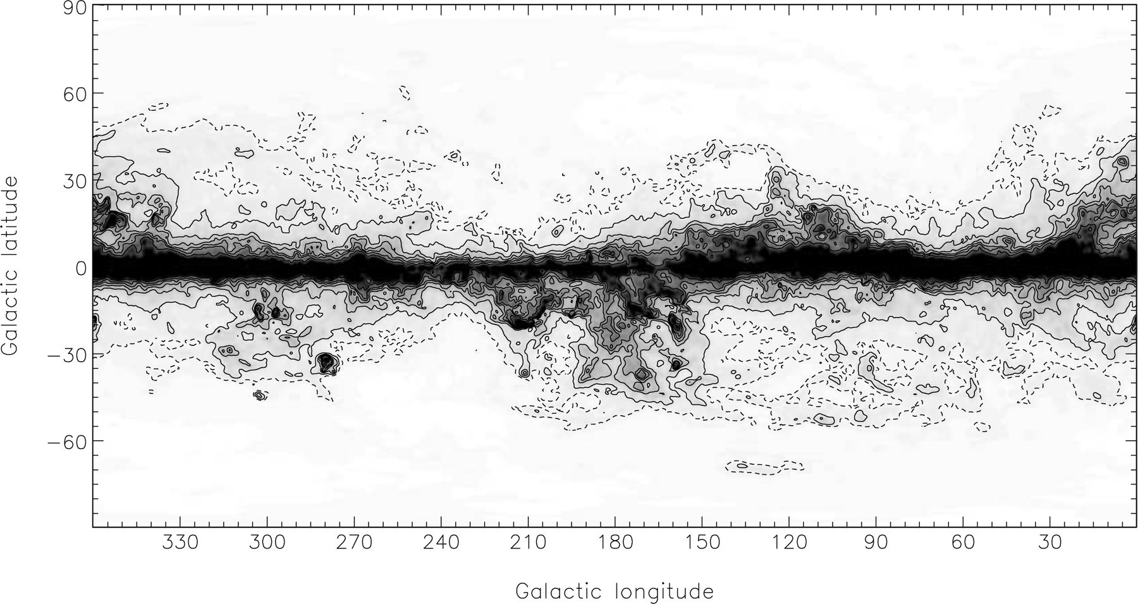
Figure 2. The absorption template to be applied to the Galactic Hα emission. This assumes an absorbing dust-fraction of ...
Notes:
Figure 2. The absorption template to be applied to the Galactic Hα emission. This assumes an absorbing dust-fraction of fd= 0.33, as derived in Section 2.4, and the total extragalactic value A(Hα) given in equation (1). Linear grey-scale and contours show absorption in magnitudes. Contours are given at 0.05 (dot-dashed), 0.1, 0.2, 0.3, 0.4, 0.5 and 0.7 mag. Absorption above 1 mag is black on the grey-scale.
Unless provided in the caption above, the following copyright applies to the content of this slide: © 2003 RAS

Slide 4
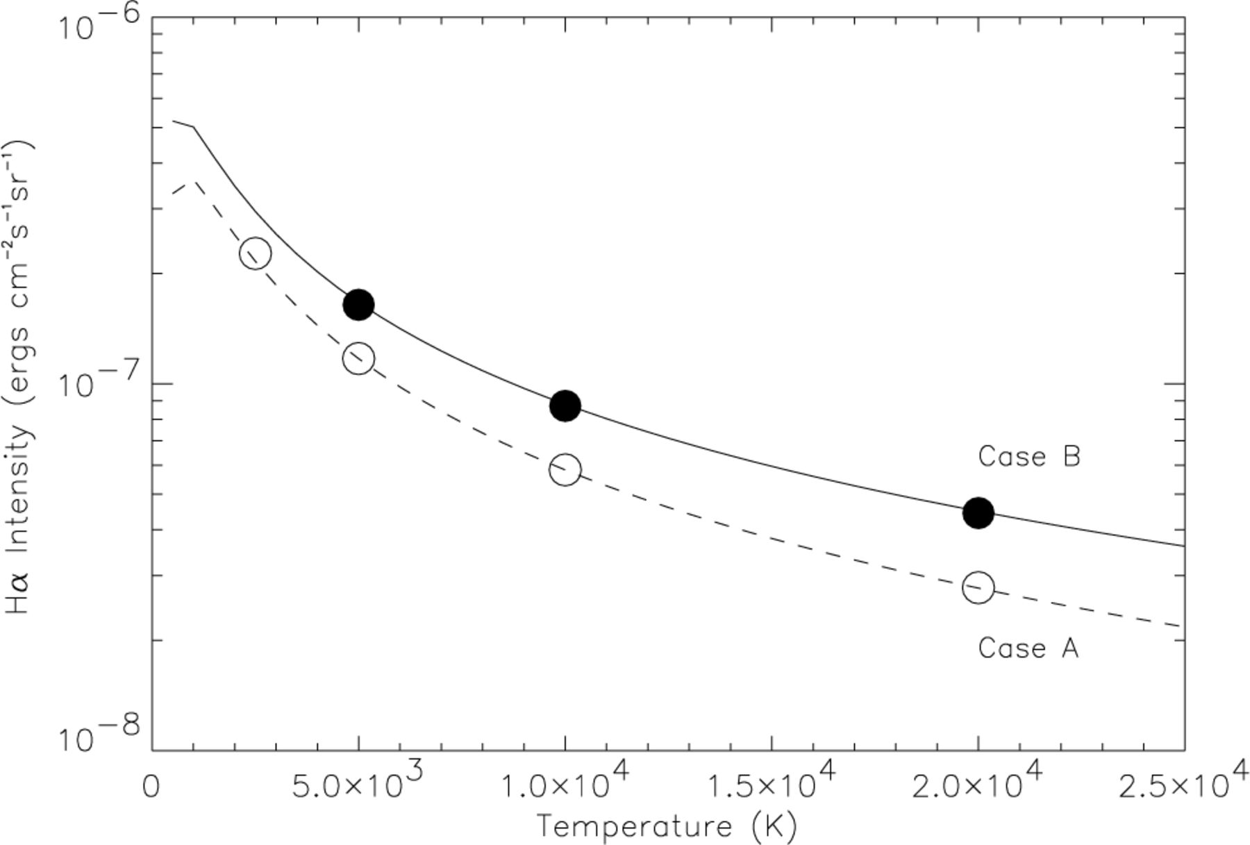
Figure 3. Hα emission per unit emission measure as a function of T_{e} for case A (optically thin to Lyman ...
Notes:
Figure 3. Hα emission per unit emission measure as a function of Te for case A (optically thin to Lyman photons) and case B (optically thick to Lyman photons) for ne= 102 cm−3. The circles represent the values calculated by theory given by Hummer & Storey (1987). The curves are the expressions given by Valls-Gabaud (1998); case B is given in equation (4).
Unless provided in the caption above, the following copyright applies to the content of this slide: © 2003 RAS

Slide 5
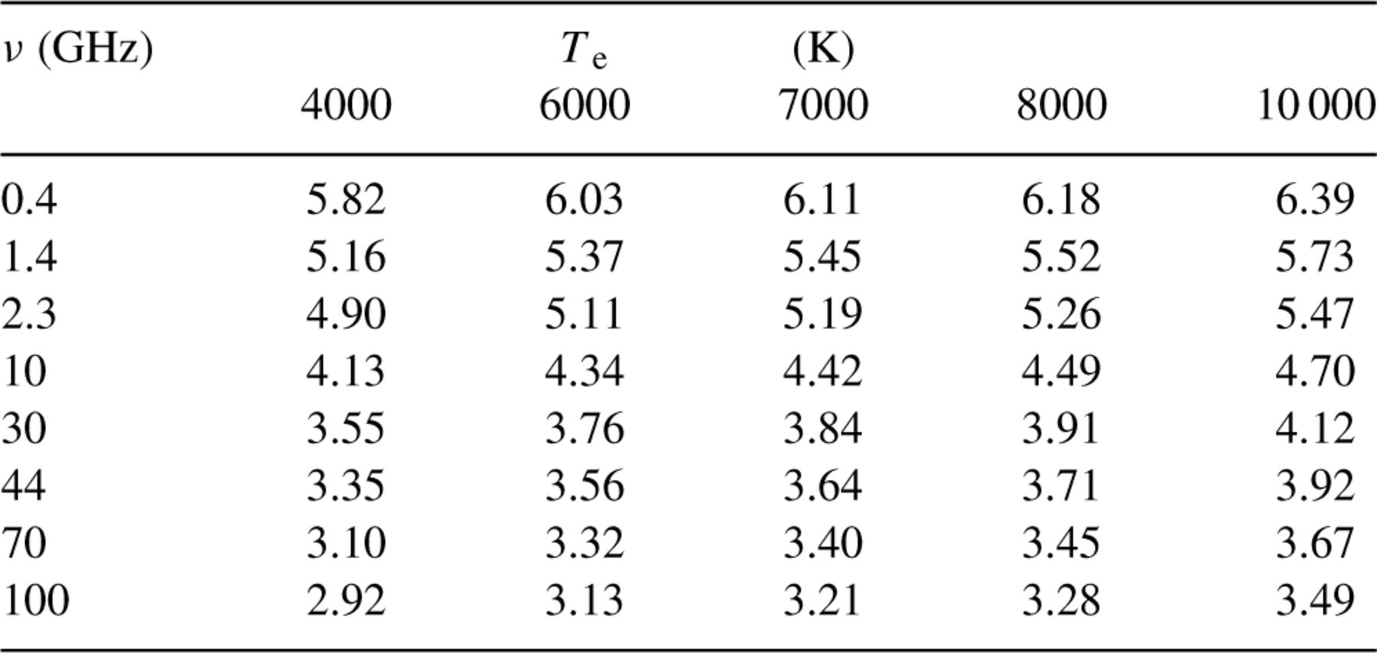
Table 2. Gaunt factors for relevant frequencies and electron temperatures calculated from Hummer (1988) and accurate ...
Notes:
Table 2. Gaunt factors for relevant frequencies and electron temperatures calculated from Hummer (1988) and accurate to 0.7 per cent.
Unless provided in the caption above, the following copyright applies to the content of this slide: © 2003 RAS

Slide 6
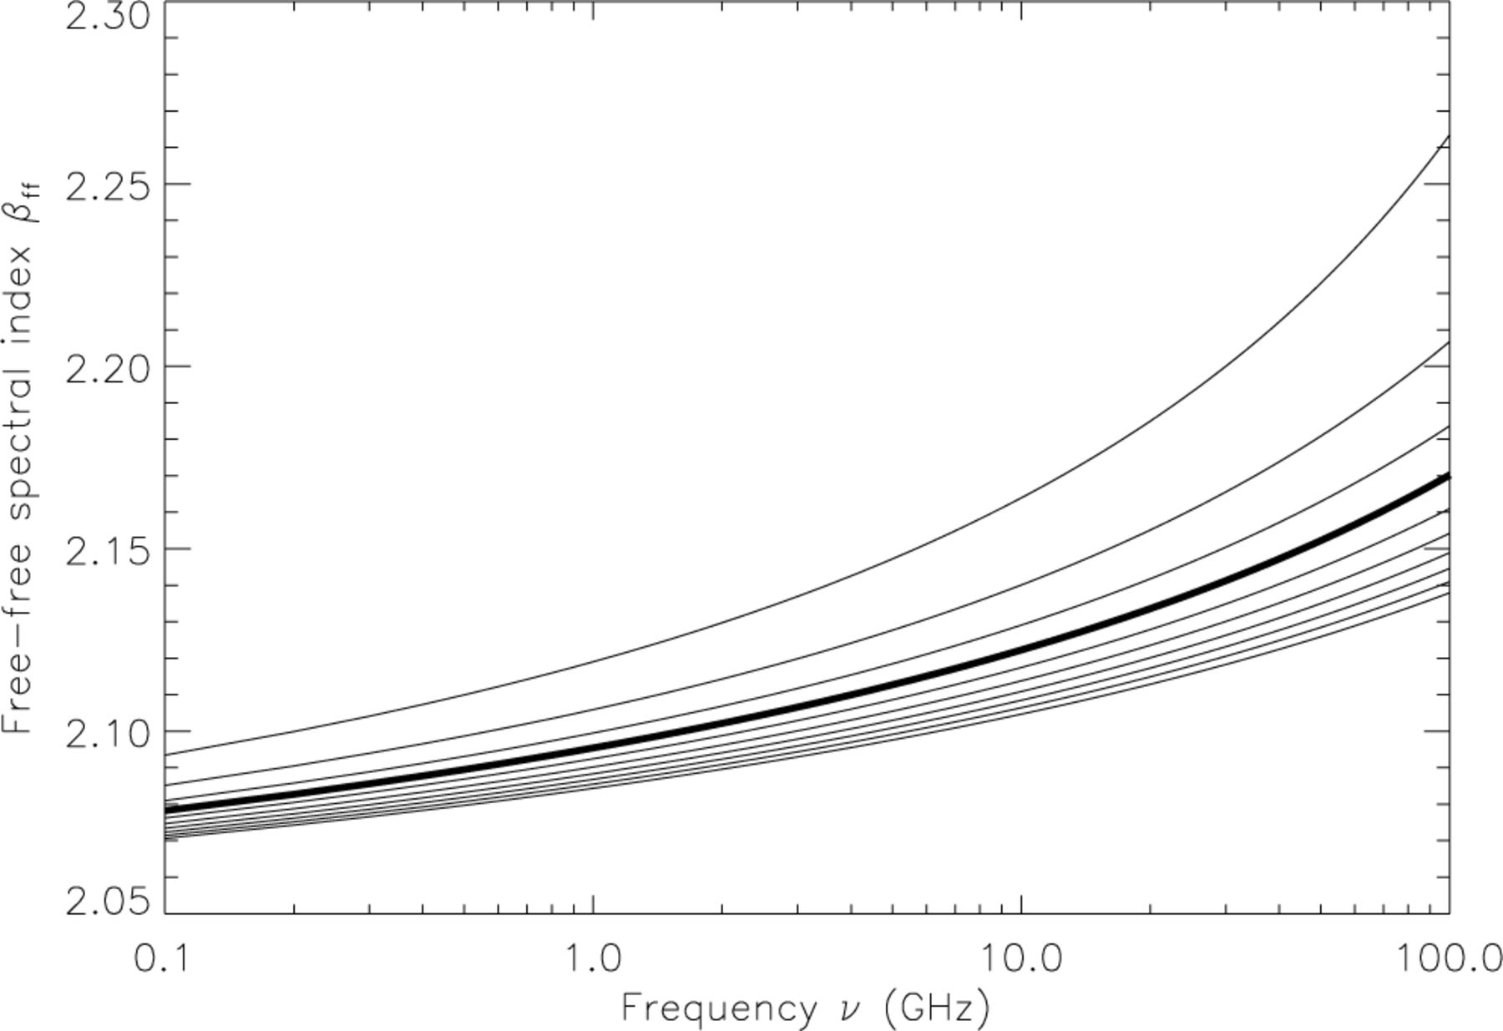
Figure 4. The local free–free spectral index as a function of frequency and electron temperature; given by equation (3) ...
Notes:
Figure 4. The local free–free spectral index as a function of frequency and electron temperature; given by equation (3) of Bennett et al. (1992). The curves from top to bottom are for temperatures Te= (2, 4, 6, 8 (heavy), 10, 12, 14, 16, 18, 20) × 103 K.
Unless provided in the caption above, the following copyright applies to the content of this slide: © 2003 RAS

Slide 7
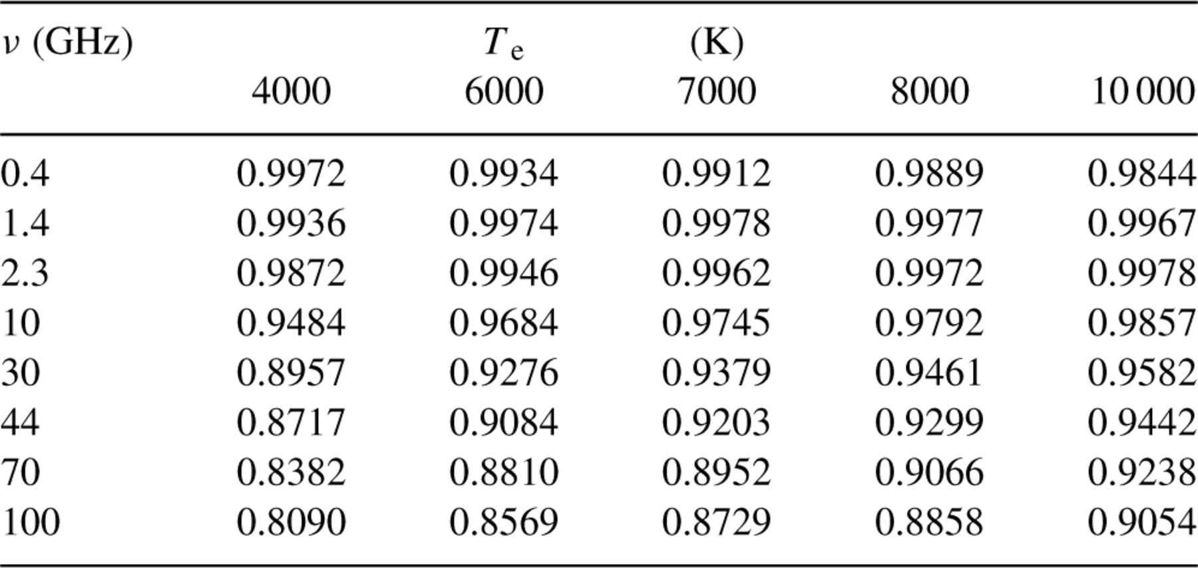
Table 3. The factor a = τ_{c} (Oster)/τ_{c} (AMWW) for relevant frequencies and temperatures using ...
Notes:
Table 3. The factor a = τc (Oster)/τc (AMWW) for relevant frequencies and temperatures using equation (8)
Unless provided in the caption above, the following copyright applies to the content of this slide: © 2003 RAS

Slide 8
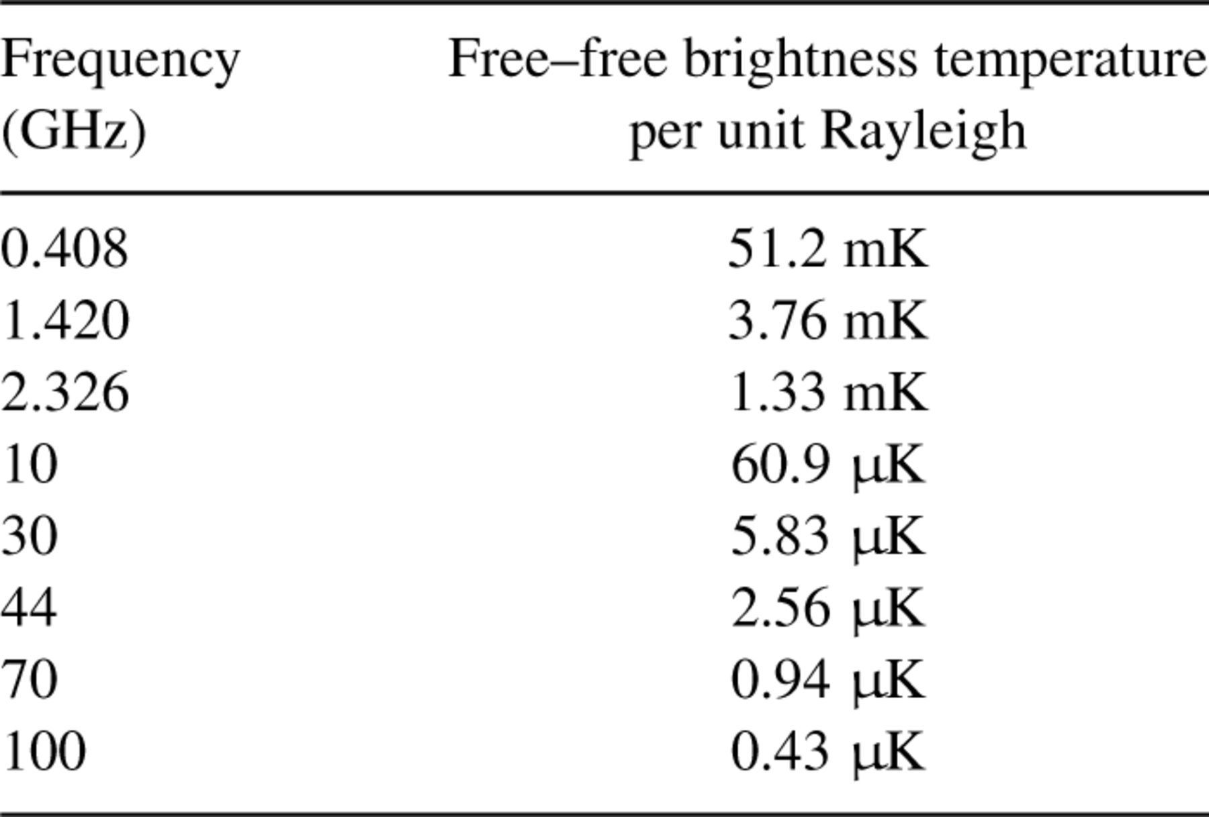
Table 4. Free-free brightness temperatures per unit Rayleigh for a range of frequencies assuming T_{e} = 7000 ...
Notes:
Table 4. Free-free brightness temperatures per unit Rayleigh for a range of frequencies assuming Te = 7000 K.
Unless provided in the caption above, the following copyright applies to the content of this slide: © 2003 RAS

Slide 9
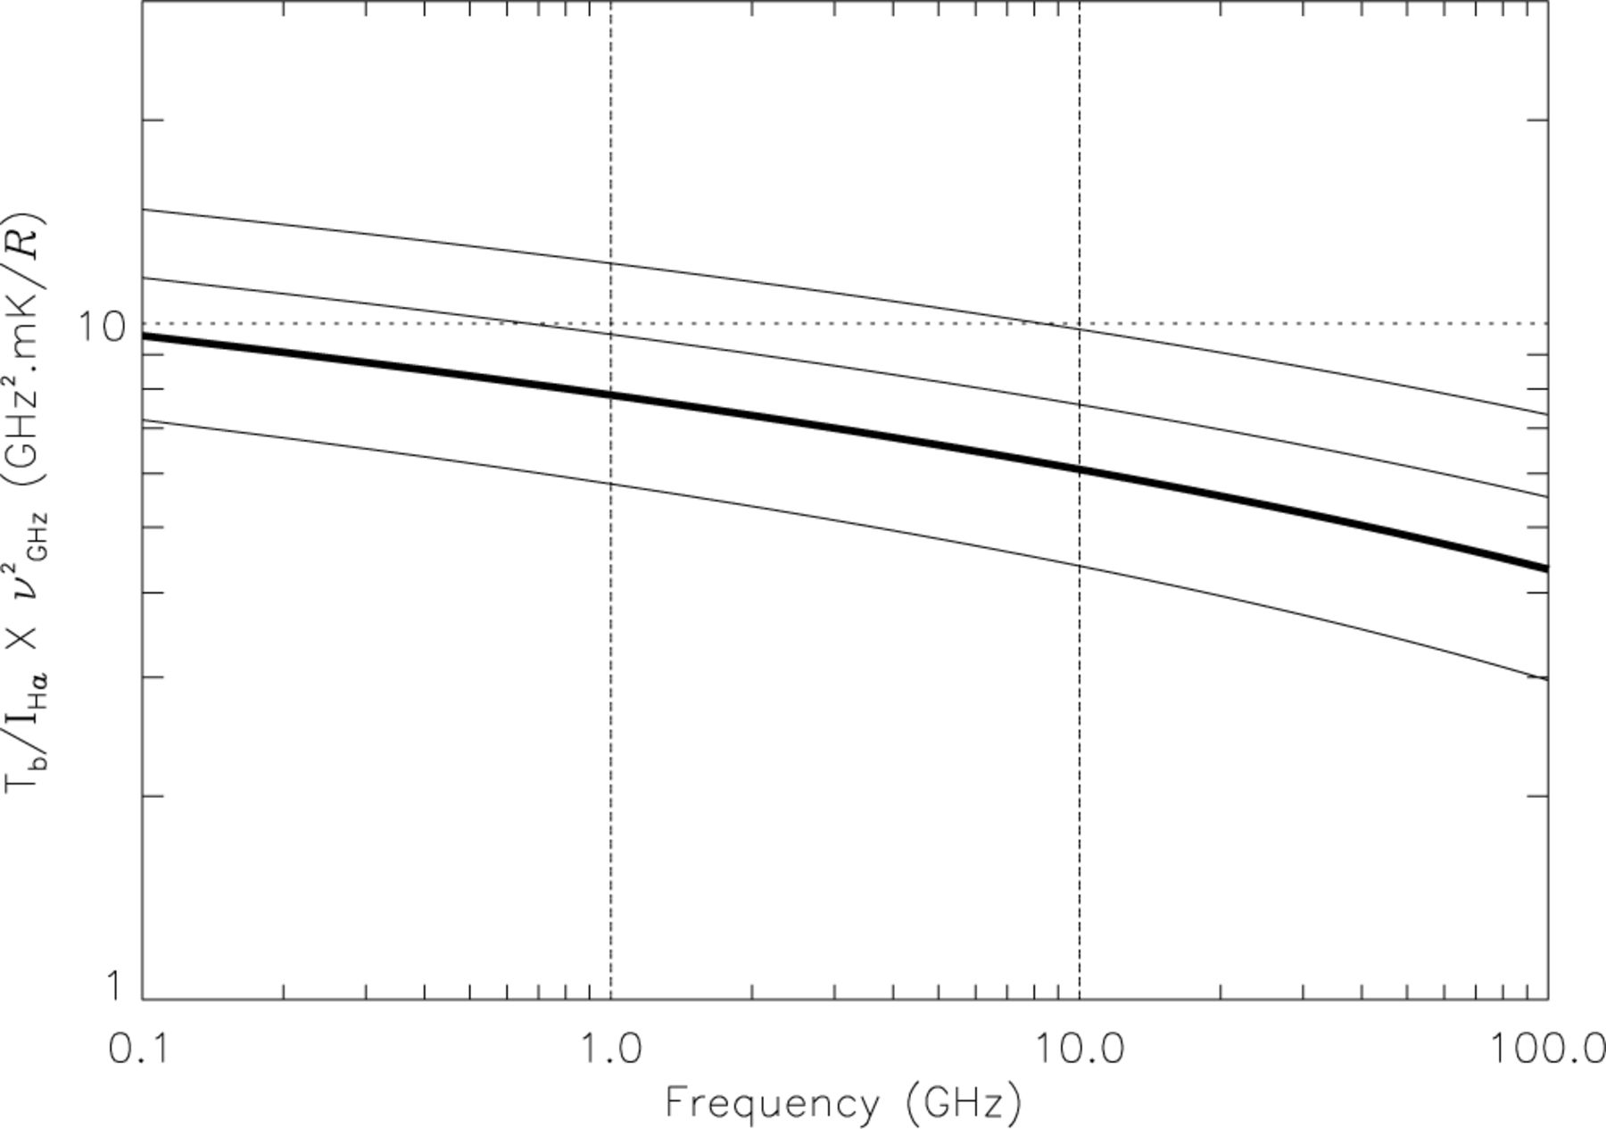
Figure 5. Ratio of radio brightness temperature to Hα intensity multiplied by ν²_{<sub ...}
Notes:
Figure 5. Ratio of radio brightness temperature to Hα intensity multiplied by ν2GHz as a function of frequency. Curves are for T= 4000, 7000 (heavy), 10 000 and 15 000 K, which is the likely temperature range corresponding to a factor ∼2.4 in the ratio. The curvature in each curve reflects the frequency dependence of the Gaunt factor.
Unless provided in the caption above, the following copyright applies to the content of this slide: © 2003 RAS

Slide 10
Table 5. Comparison of the observed brightness temperature T_{b} from RRL data with the predicted brightness ...
Notes:
Table 5. Comparison of the observed brightness temperature Tb from RRL data with the predicted brightness temperature THa from Ha data using equation (11). The first three positions are in Barnard's Arc (Gaylard 1984) and the next three are in the Gum Nebula (Woermann et al. 2000). Using the dust column density DT and electron temperature Te, the fraction of ƒd dust causing absorption of Ha emission is calculated for each observation.
Unless provided in the caption above, the following copyright applies to the content of this slide: © 2003 RAS

Slide 11
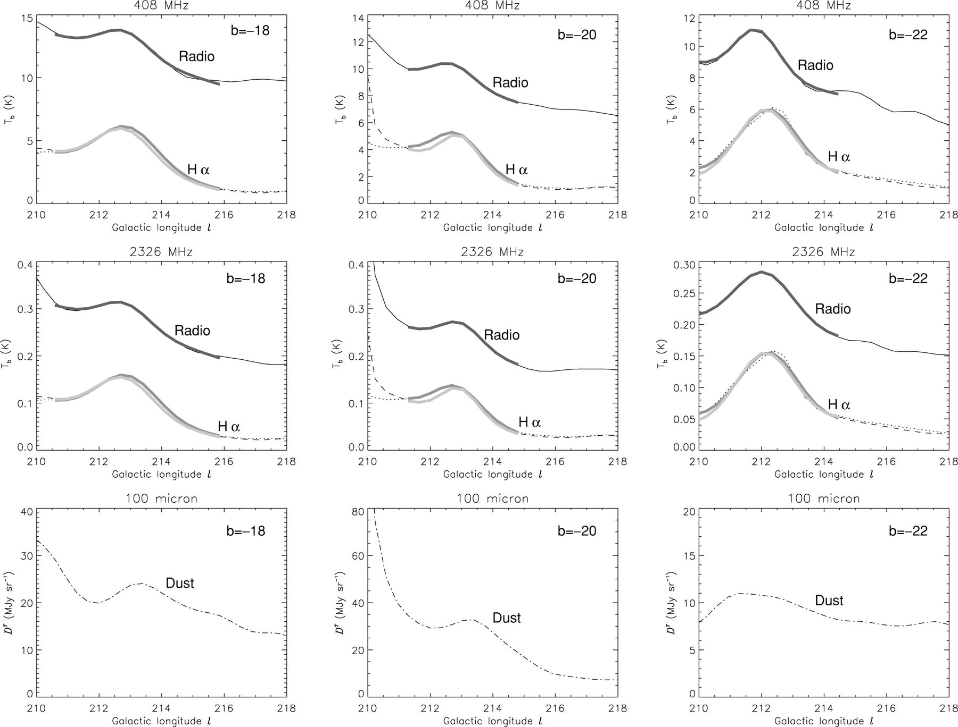
Figure 6. 408 and 2326 MHz scans across Barnard's Arc at constant b=−18° (left), −20° (middle) and −22° (right). The ...
Notes:
Figure 6. 408 and 2326 MHz scans across Barnard's Arc at constant b=−18° (left), −20° (middle) and −22° (right). The top panels show the 408-MHz scan and the prediction from Hα; both WHAM and SHASSA are shown for each. WHAM is the dotted line and SHASSA is the dashed line. The best-fitting Gaussian plus a linear baseline is shown as a heavy line; WHAM is the heavier line and SHASSA is the lighter line. The middle panels show 2326-MHz data and the same predictions as above for Hα. The bottom panel is the scan for DT (SFD98).
Unless provided in the caption above, the following copyright applies to the content of this slide: © 2003 RAS

Slide 12
Table 6. Comparison of the observed radio brightness temperature T_{b} with the prediction from Ha data, ...
Notes:
Table 6. Comparison of the observed radio brightness temperature Tb with the prediction from Ha data, THa, for three scans across Barnard's Arc at frequencies of 408 and 2326 MHz. The Ha intensity IHa and dust column density DT are also listed. The expected brightness temperature THa and the associated dust fraction actually absorbing ƒd are calculated for Te= 7000 K (columns 7 and 8), and for Te= 5100 K (columns 9 and 10) (see the text).
Unless provided in the caption above, the following copyright applies to the content of this slide: © 2003 RAS

Slide 13
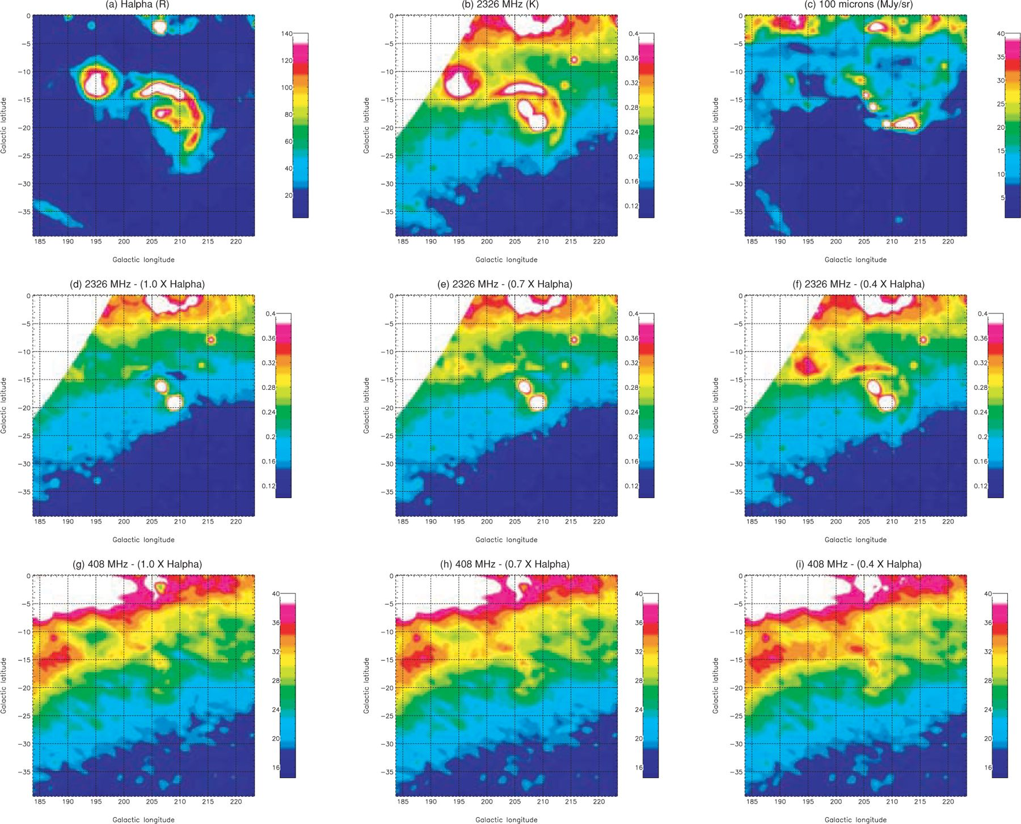
Figure 7. Morphology of the free–free component in the Orion region. (a) Hα data from WHAM clearly shows Barnard's Arc ...
Notes:
Figure 7. Morphology of the free–free component in the Orion region. (a) Hα data from WHAM clearly shows Barnard's Arc and λ-Orionis. (b) 2326-MHz data from Jonas et al. (1998) showing a similar morphology. (c) 100-μ m DT map from SFD98 shows some correlation but not a one-to-one correlation. Panels (d, e, f) show the 2326-MHz map with varying levels (1.0, 0.7 and 0.4 multiplied by the conversions given in Table 4) of free–free emission subtracted as predicted by the Hα data. Panels (g, h, i) are the same for the 408-MHz map from Haslam et al. (1982). The electron temperature is assumed to be Te= 7000 K. The best subtraction occurs when the factor is ∼0.7. Note that no correction has been made for dust in this illustration and that the full-beam brightness temperature correction has not been applied (see the text).
Unless provided in the caption above, the following copyright applies to the content of this slide: © 2003 RAS

Slide 14
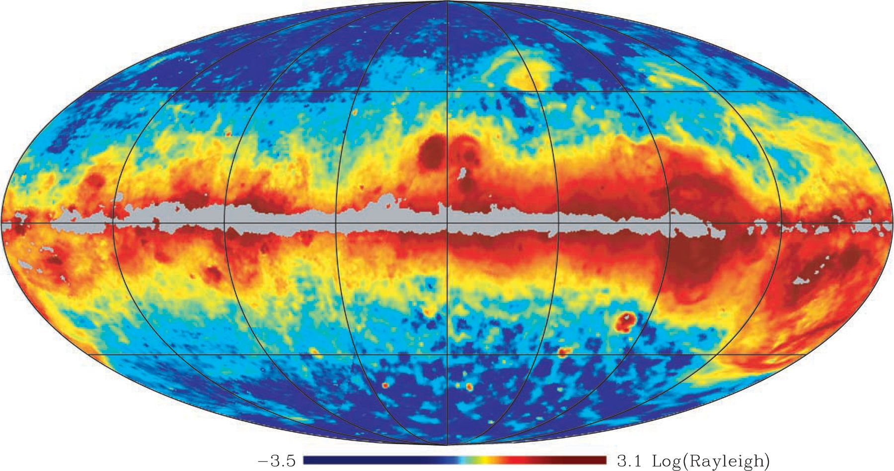
Figure 8. Full-sky dust-corrected Hα map in Mollweide projection. The map has been repixelated into the healpix ...
Notes:
Figure 8. Full-sky dust-corrected Hα map in Mollweide projection. The map has been repixelated into the healpix representation (Górski, Hivon & Wandelt 1999). The colour scale has been histogram-equalized. Longitude l= 0° is in the centre and increasing to the left. Units are log(R). The composite map uses data from the WHAM survey (north) and the SHASSA survey (south) smoothed to a resolution of 1°. Data from WHAM is used in regions where data overlap for declinations > −15°. The data are corrected for dust extinction up to a 1 mag of absorption assuming fd= 0.33 derived in Section 2.4. Absorption above 1 mag is masked off as grey and depicts regions where the true Hα absorption is uncertain. Baseline uncertainties are evident at high Galactic latitudes.
Unless provided in the caption above, the following copyright applies to the content of this slide: © 2003 RAS

Slide 15
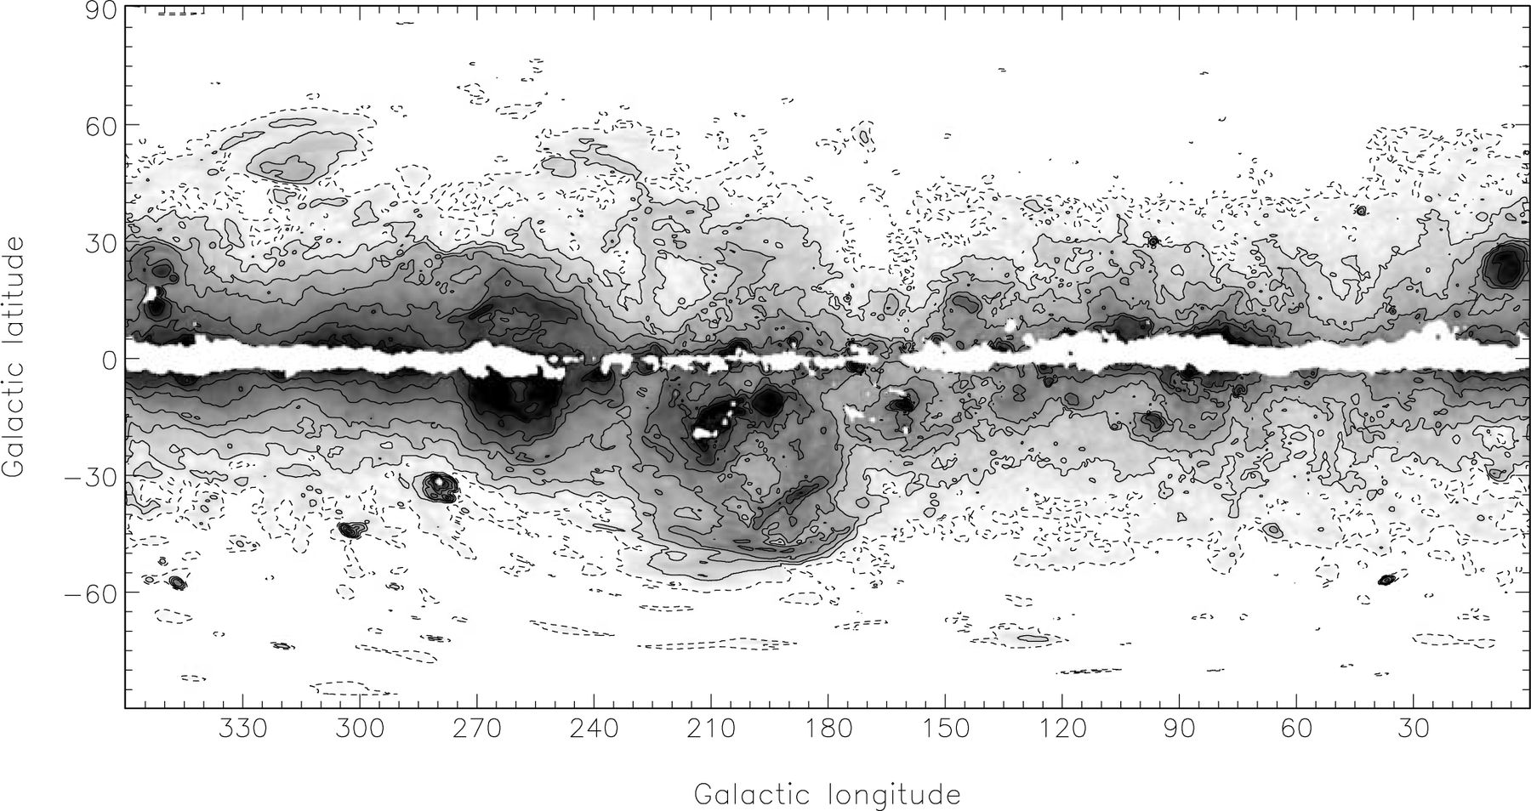
Figure 9. Free–free brightness temperature template at 30 GHz with 1° resolution. Grey-scale is logarithmic from 5 to ...
Notes:
Figure 9. Free–free brightness temperature template at 30 GHz with 1° resolution. Grey-scale is logarithmic from 5 to 1000 μ K. Regions where the template is unreliable are masked white. Contours are given at 5 (dot-dashed), 10, 20, 40, 100, 200 and 500 μ K.
Unless provided in the caption above, the following copyright applies to the content of this slide: © 2003 RAS

Slide 16
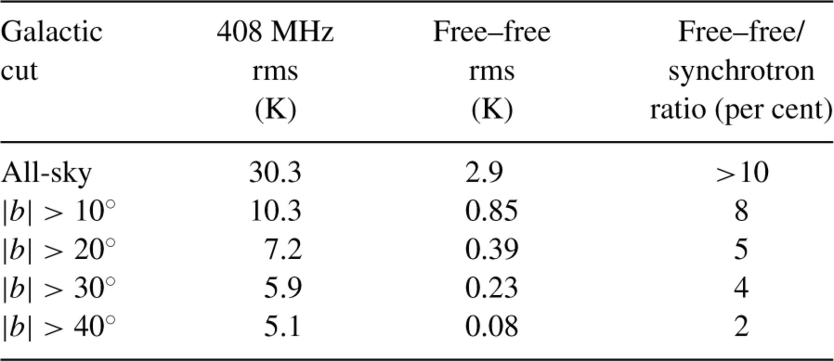
Table 7. Comparison of the rms fluctuations at 1° resolution of 408-MHz data and the free-free template for different ...
Notes:
Table 7. Comparison of the rms fluctuations at 1° resolution of 408-MHz data and the free-free template for different Galactic latitude cuts. The all-sky value will be a lower limit since the corrections for dust are uncertain near the Galactic plane (ǀbǀ < 5°).
Unless provided in the caption above, the following copyright applies to the content of this slide: © 2003 RAS

Slide 17
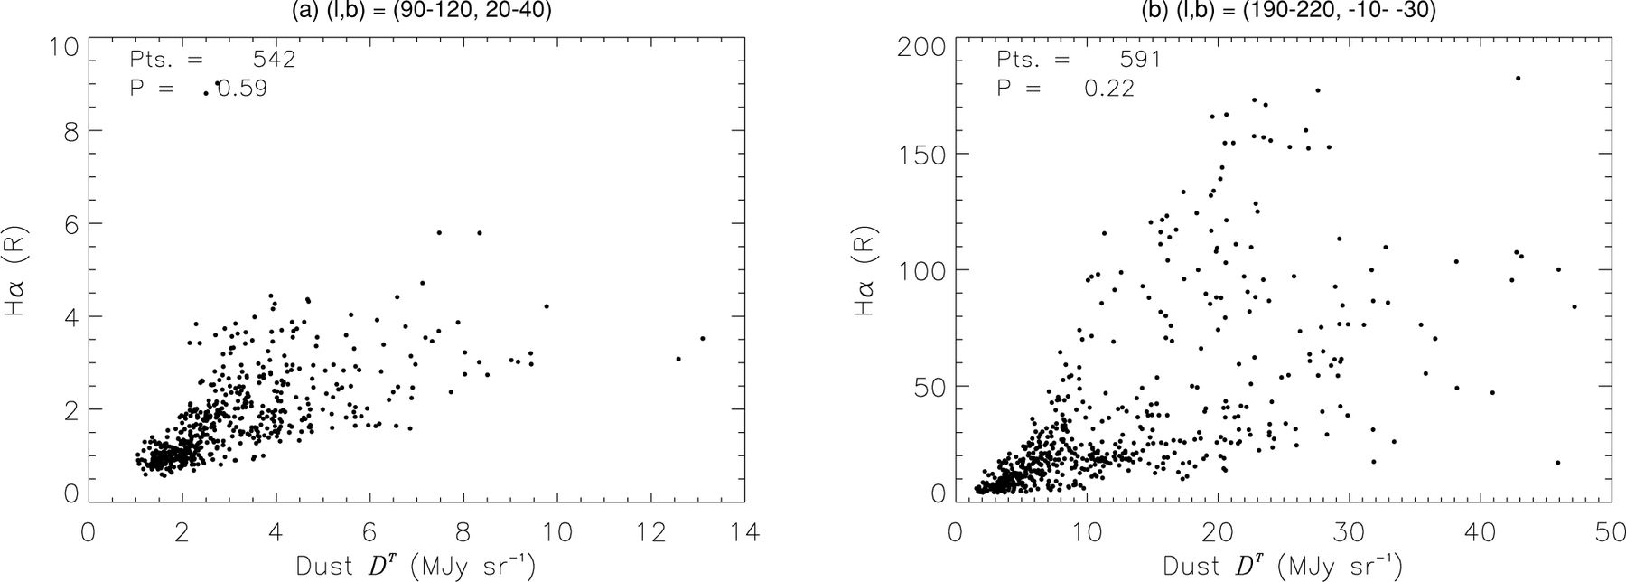
Figure 10. Correlation plots between Hα and dust at a resolution of 1° for two regions (a) l= (90°–120°), b= (20°–40°) ...
Notes:
Figure 10. Correlation plots between Hα and dust at a resolution of 1° for two regions (a) l= (90°–120°), b= (20°–40°) and (b) l= (180°–210°), b= (−20° to −40°). There is an overall positive correlation with considerable scatter. The Orion region (b) is brighter and shows a much larger scatter. The Pearson's correlation coefficients are 0.59 and 0.22, respectively.
Unless provided in the caption above, the following copyright applies to the content of this slide: © 2003 RAS

Slide 18
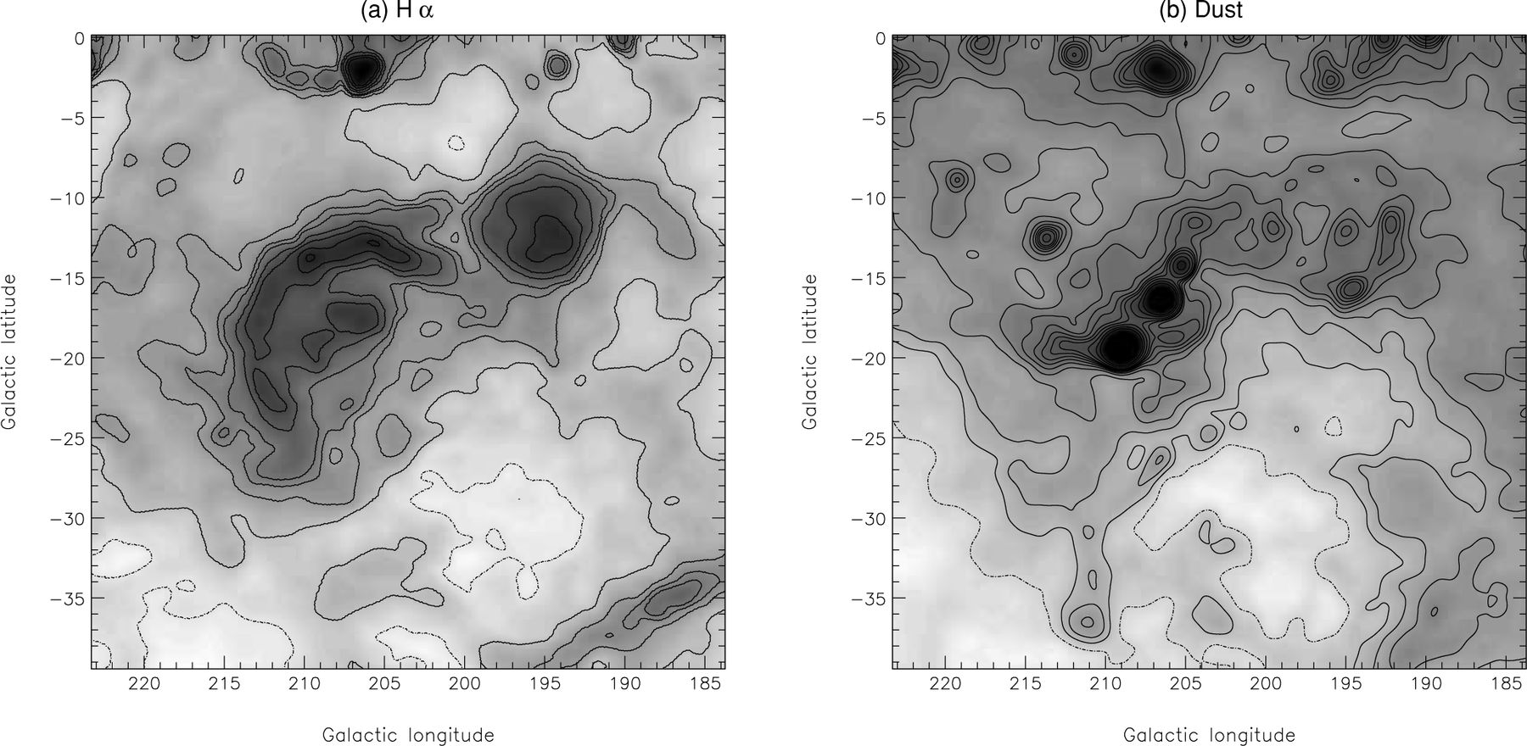
Figure 11. Correlations between Hα and dust in the Orion region. (a) Hα data from WHAM shown as a logarithmic grey-scale ...
Notes:
Figure 11. Correlations between Hα and dust in the Orion region. (a) Hα data from WHAM shown as a logarithmic grey-scale from 3 to 380R and contoured at 5 (dot-dashed), 10, 20, 30, 40, 70, 100, 150 and 200 R. (b) 100-μ m data from SFD98 depicting the dust in a logarithmic grey-scale from 0.1 to 200 MJy sr−1 and contoured at 3 (dot-dashed), 5, 7, 10, 15, 20, 25, 30, 35, 40, 50, 70 and 100 MJy sr−1. There is an overall correlation between Hα and dust but it is not one-to-one.
Unless provided in the caption above, the following copyright applies to the content of this slide: © 2003 RAS

