Slide 1
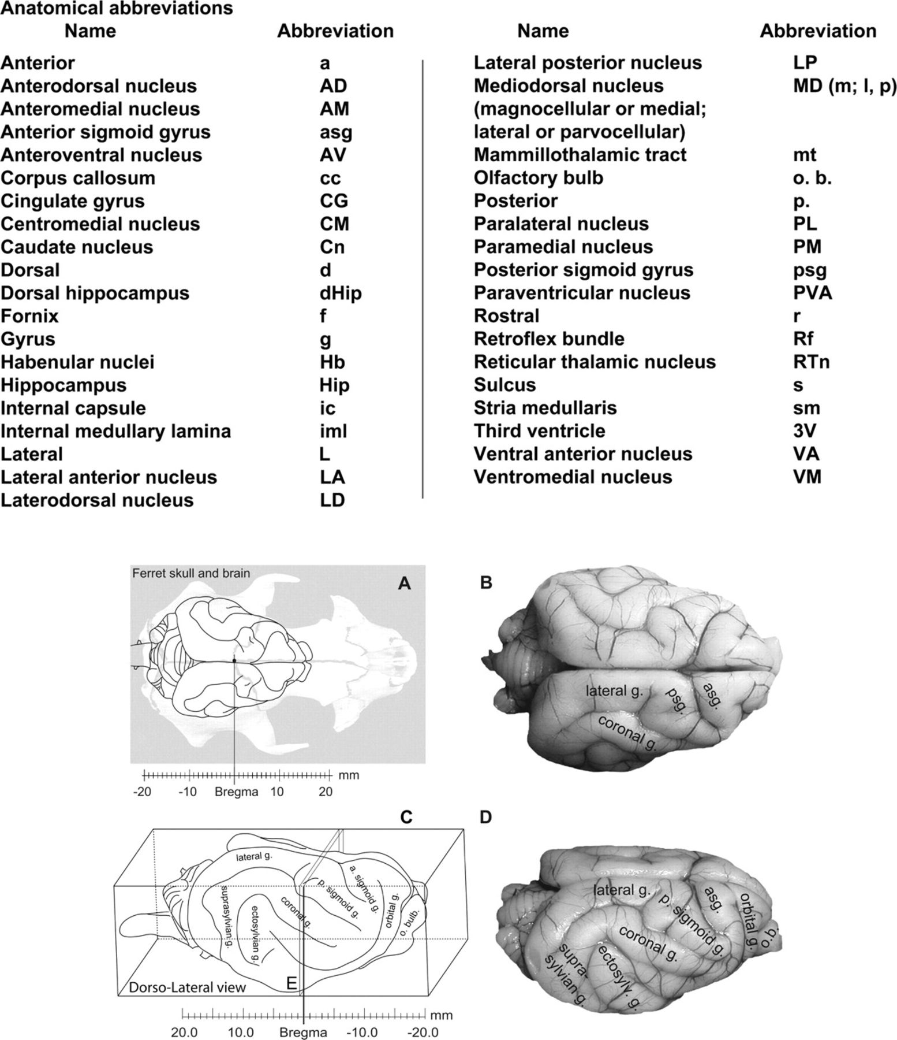
Figure 1. Overview of the major gyri of the ferret cerebral cortex. (A) Localization of the ferret brain in the skull ...
Notes:
Figure 1. Overview of the major gyri of the ferret cerebral cortex. (A) Localization of the ferret brain in the skull with reference to Bregma. (B, C, D) Dorsal and lateral views of the brain, indicating the names of the main cortical gyri. (C) Dorsolateral view of the brain indicating the relative coronal plane for Figure 2A.
Unless provided in the caption above, the following copyright applies to the content of this slide: © The Author 2009. Published by Oxford University Press. All rights reserved. For permissions, please e-mail: journals.permissions@oxfordjournals.org

Slide 2
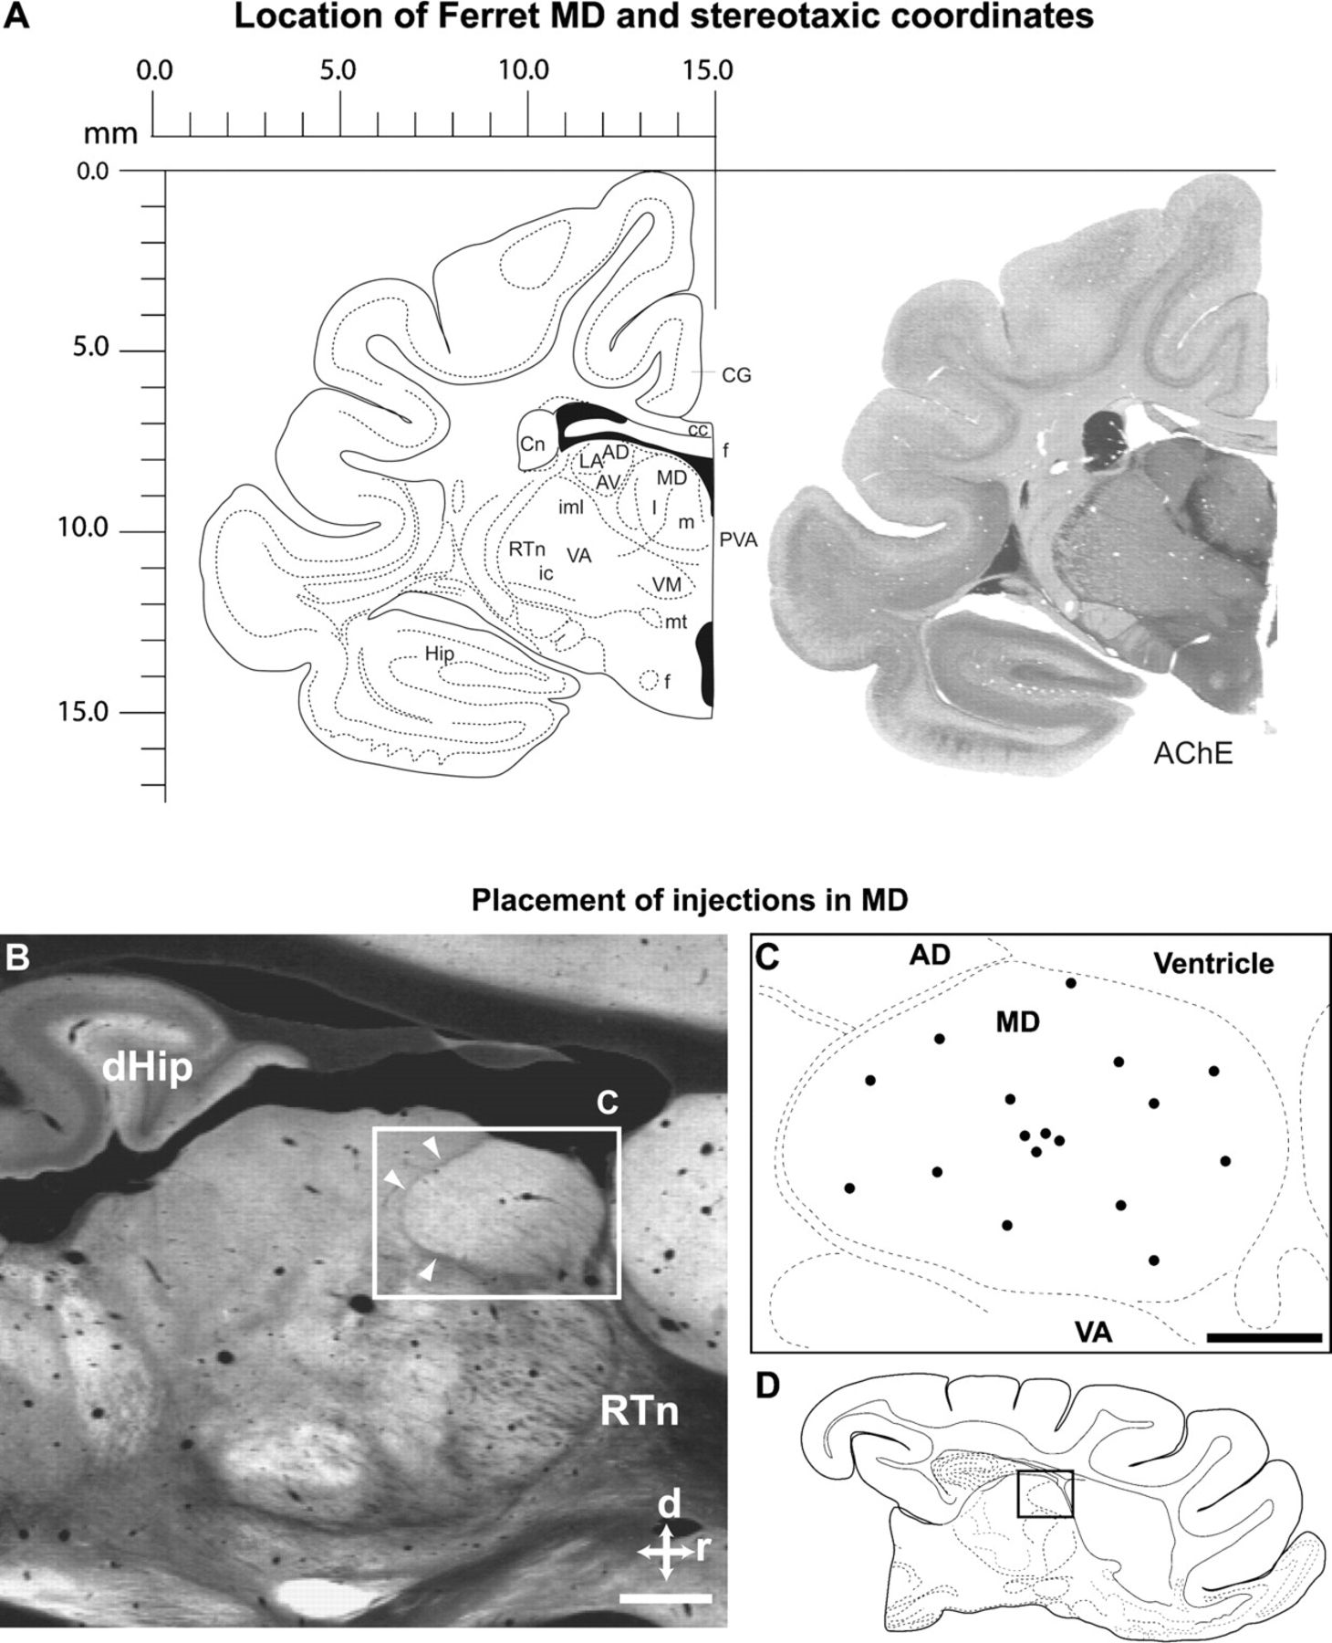
Figure 2. (A) Hemicoronal view 0.8 mm caudal to Bregma where the thalamus of the ferret can be appreciated. Section ...
Notes:
Figure 2. (A) Hemicoronal view 0.8 mm caudal to Bregma where the thalamus of the ferret can be appreciated. Section counterstained with acetylcholinesterase (AChE). Approximate stereotaxic coordinates are given. (B) Parasagittal section (AChE) through the ferret thalamus at approximately the middle of the MD. White arrowheads point to the internal medullary lamina which at this level separates the MD from more caudal and ventral nuclei. For reference, the dorsal hippocampus (dHip) and the reticular thalamic nucleus (RTn) are labeled. (C) Diagram of MD inset to illustrate approximate rostrocaudal and dorsoventral extent of injections placed in the MD. (D) Schematic of parasagittal section to facilitate orientation. Scale bar: 1 mm.
Unless provided in the caption above, the following copyright applies to the content of this slide: © The Author 2009. Published by Oxford University Press. All rights reserved. For permissions, please e-mail: journals.permissions@oxfordjournals.org

Slide 3
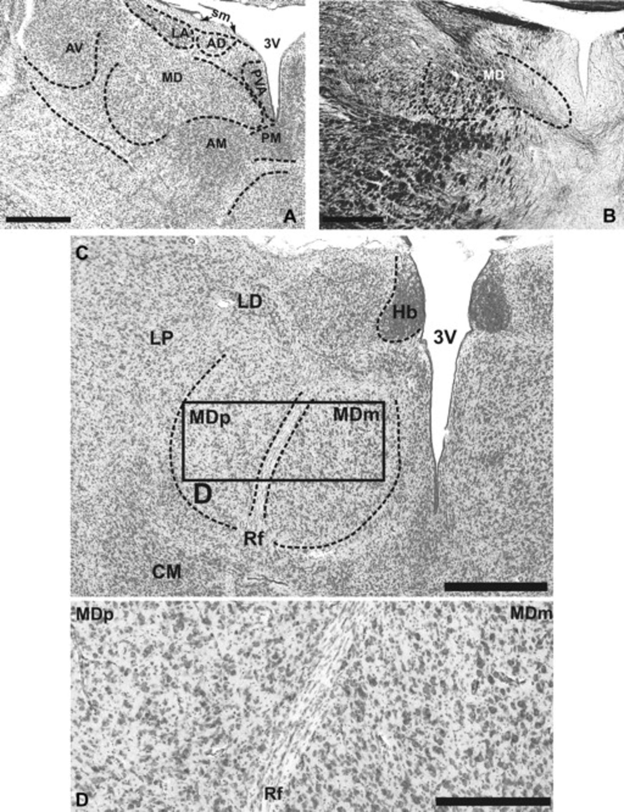
Figure 3. (A) Nissl staining at the level of the rostral MD nucleus of the thalamus. At this level the larger and more ...
Notes:
Figure 3. (A) Nissl staining at the level of the rostral MD nucleus of the thalamus. At this level the larger and more intensely stained cells of the LA nucleus are easy to distinguish. Cells of the PVA, AM, and PM nuclei are also more intensely stained than those of the MD. (B) Myelin staining at this level shows a gradient medial to lateral from lighter to darker, indicating that more laterally myelinated fibers form bundles. These fibers give a patchy appearance to the lateral and ventral MD. (C) Nissl staining at a more caudal level of MD where it is easier to distinguish the darkly stained habenular nuclei and the habenulo-peduncular tract or Retroflex bundle, which traverses the MD more or less through the medial part of the nucleus. The CM nucleus appears more intensely stained than the MD. The inset (D) shows bigger cells in the medial MD as compared with more lateral areas. It is the complementary information provided by different types of stainings what allows the demarcation of different thalamic nuclei or the distinction of cytoarchitectural differences within a single nucleus in an otherwise continuum of cells which do not always present abrupt, clear borders. Scale bar, 500 μm (A, B, C) and 250 μm (D).
Unless provided in the caption above, the following copyright applies to the content of this slide: © The Author 2009. Published by Oxford University Press. All rights reserved. For permissions, please e-mail: journals.permissions@oxfordjournals.org

Slide 4
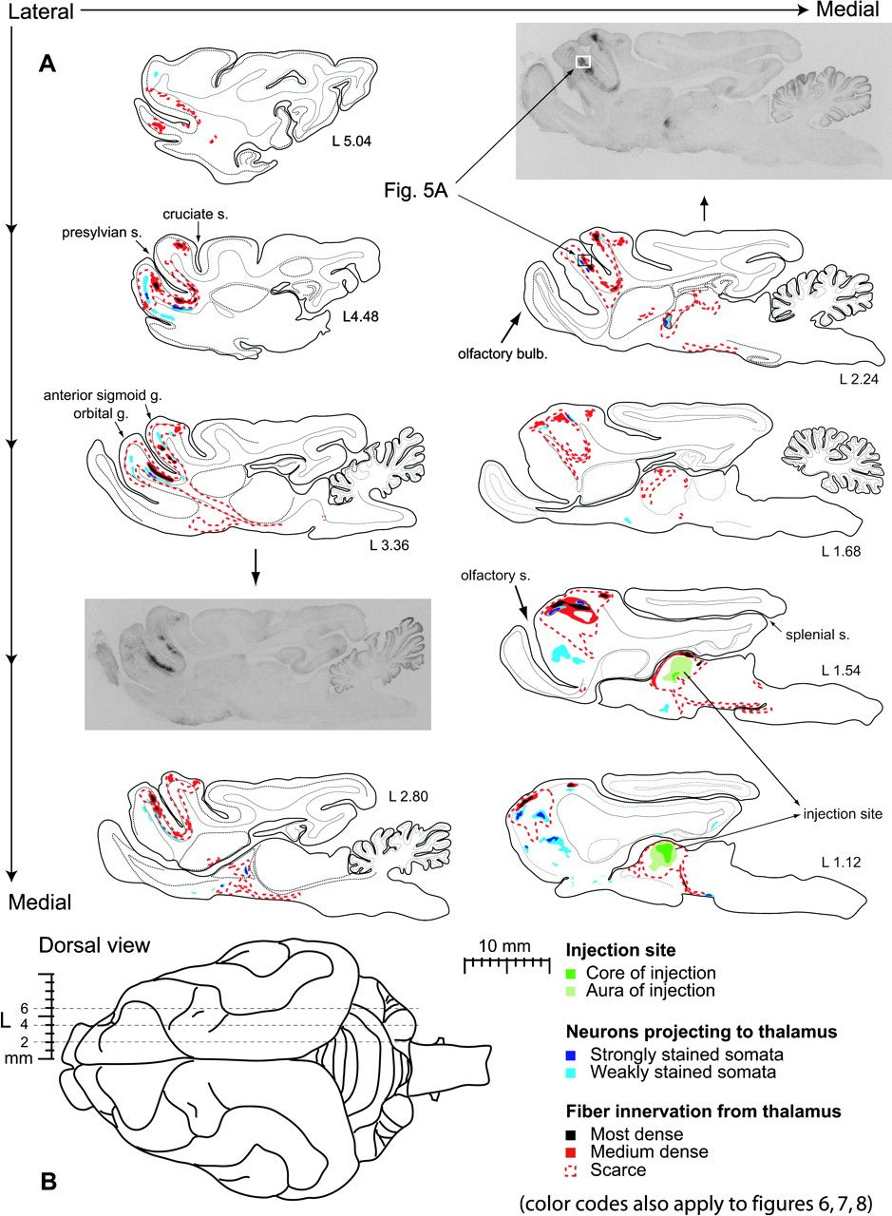
Figure 4. (A) Sagittal view of results obtained with a large BDA tracer injection into ferret MD. This case is similar ...
Notes:
Figure 4. (A) Sagittal view of results obtained with a large BDA tracer injection into ferret MD. This case is similar to those illustrated in the coronal plane in Figures 6 and 7. The tissue injected occupied a volume of 7.6 mm3. From top to bottom and left to right the parasagittal diagrams illustrate the extent of the anterograde projections and the location of retrogradely labeled neurons. The approximately lateral level from the midline is indicated in mm for each section. The 2 most medial parasagittal diagrams (L 1.12 and L 1.54 mm) show the extent of the tracer injection in MD as well as the corresponding projections to the frontal pole. Tracer did not infiltrate lateral nuclei but was restricted to MD in its mediolateral extent. Only one hemisphere is shown because in all cases the thalamocortical projections were restricted to the hemisphere of the injection. (B) A dorsal view with annotated mediolateral coordinates is provided to facilitate locating the parasagittal planes. For disambiguation of the terms “most dense, medium dense and scarce” see Supplementary Figure 1.
Unless provided in the caption above, the following copyright applies to the content of this slide: © The Author 2009. Published by Oxford University Press. All rights reserved. For permissions, please e-mail: journals.permissions@oxfordjournals.org

Slide 5
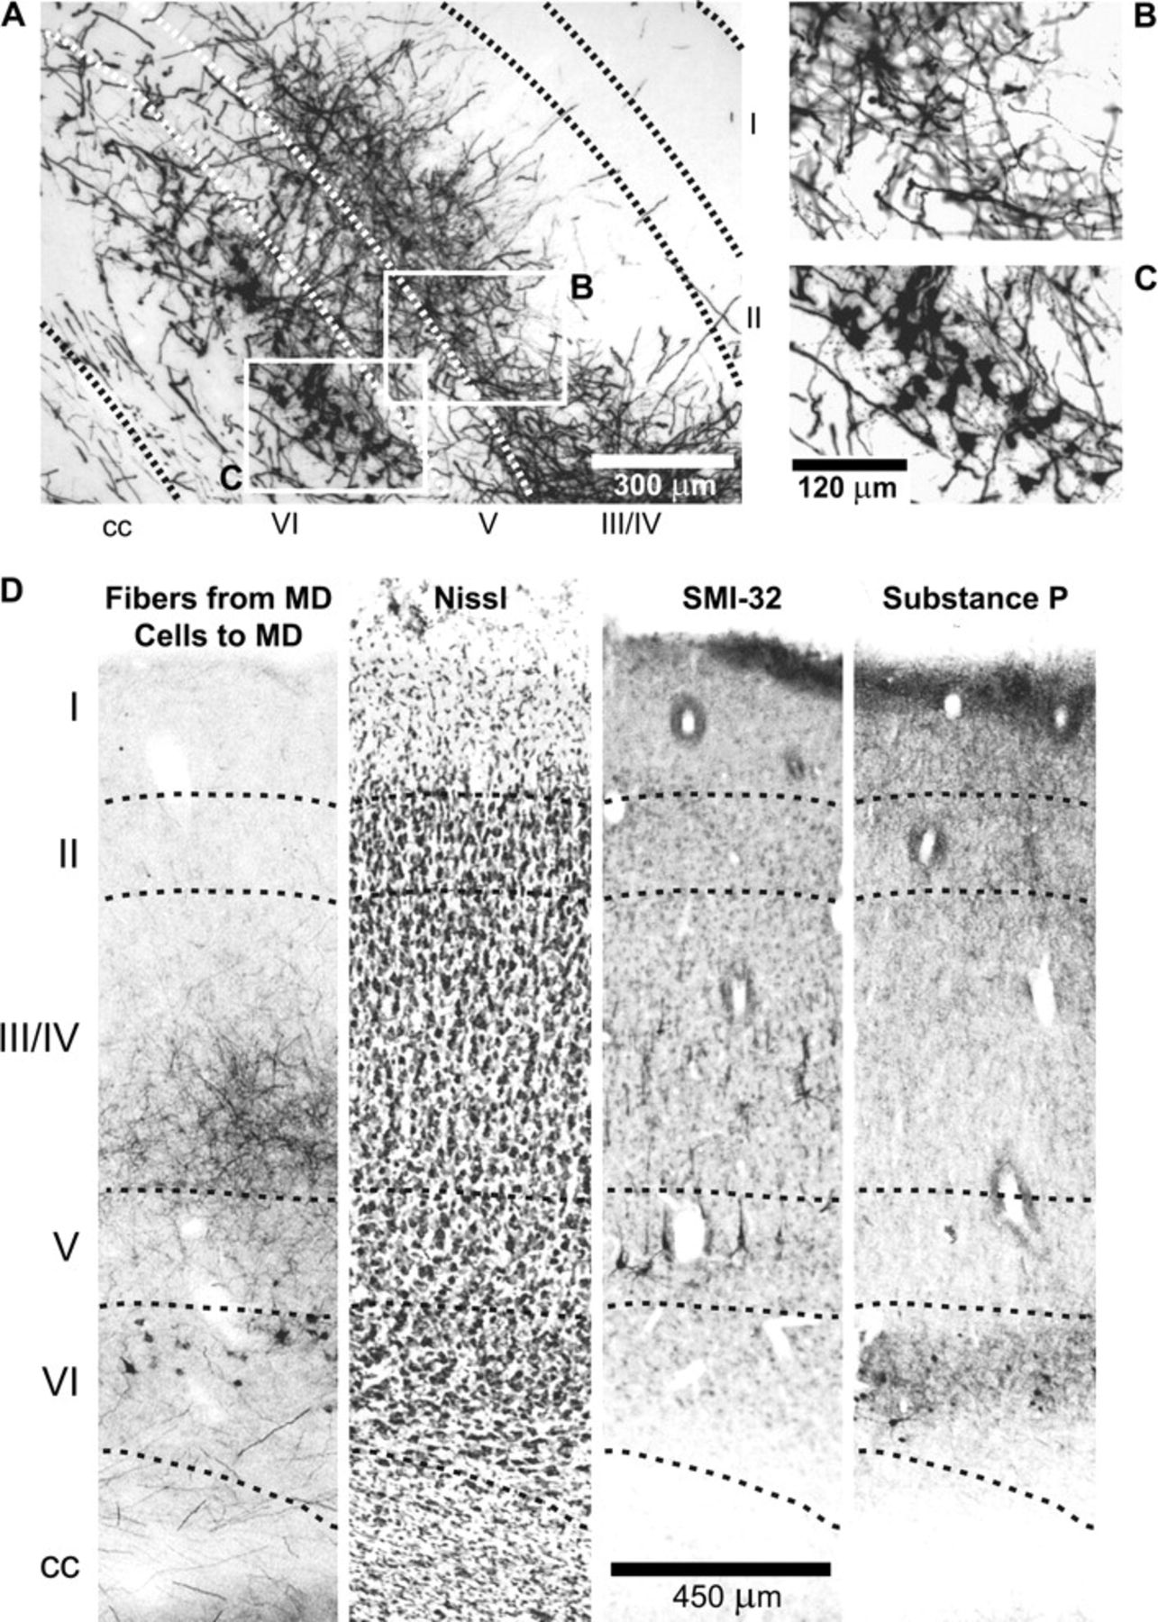
Figure 5. (A) Photomicrograph showing anterogradely labeled fibers terminating in upper layers of the cortex, ...
Notes:
Figure 5. (A) Photomicrograph showing anterogradely labeled fibers terminating in upper layers of the cortex, particularly layer IV, and retrogradely labeled neurons in layer VI. As indicated in Figure 4, this representative area was taken from the orbital gyrus—ventral wall of the presylvian sulcus. (B) Magnification of lamina receiving fiber innervation. (C) Magnification of lamina containing neurons that project to MD. (D) Localization of fibers and retrogradely labeled cells in comparison to Nissl stain, SMI-32, and Substance P labeling, which are convenient markers of cortical lamina.
Unless provided in the caption above, the following copyright applies to the content of this slide: © The Author 2009. Published by Oxford University Press. All rights reserved. For permissions, please e-mail: journals.permissions@oxfordjournals.org

Slide 6
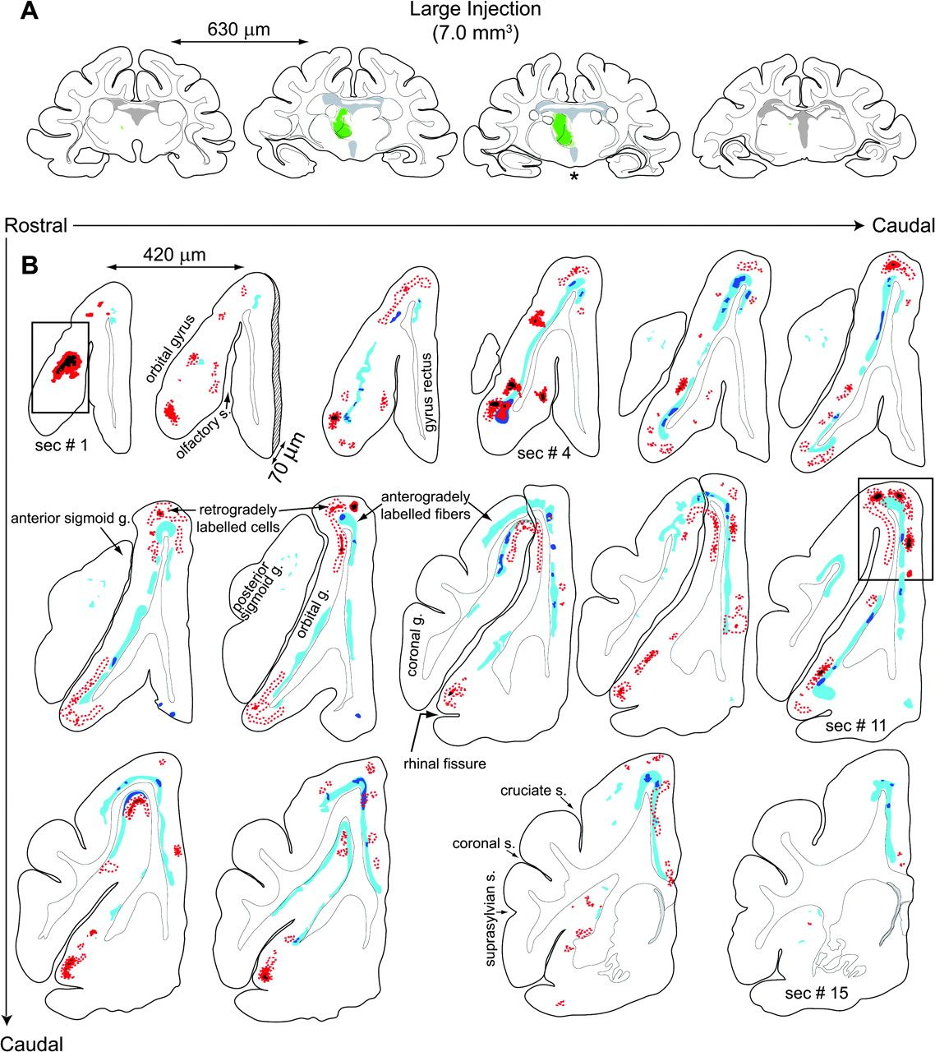
Figure 6. (A) Large BDA tracer injection in ferret thalamus and corresponding labeling in PFC. Four (of 22) 70 μm thick ...
Notes:
Figure 6. (A) Large BDA tracer injection in ferret thalamus and corresponding labeling in PFC. Four (of 22) 70 μm thick coronal sections at the level of the thalamus illustrate the extent of an injection which covered 7.0 mm3 of tissue. Both hemispheres are drawn to show that the tracer did not infiltrate the contralateral hemisphere. This large injection covered most of the MD in the dorsal to ventral axis and leaked minimally into the centrolateral complex and the dorsalmost edge of the ventromedial nucleus. The asterisk denotes the center of the injection in the rostrocaudal axis and the area where the tracer leaked into other nuclei. (B) Illustrates the corresponding coronal sections with anterogradely labeled fibers and retrogradely labeled neurons in the PFC. Color codes as in Figure 4. Approximate rostrocaudal levels given in Figure 7C. The boxed areas in sections 1 and 11 correspond approximately to injections in PFC illustrated in Figure 9A and C correspondingly.
Unless provided in the caption above, the following copyright applies to the content of this slide: © The Author 2009. Published by Oxford University Press. All rights reserved. For permissions, please e-mail: journals.permissions@oxfordjournals.org

Slide 7
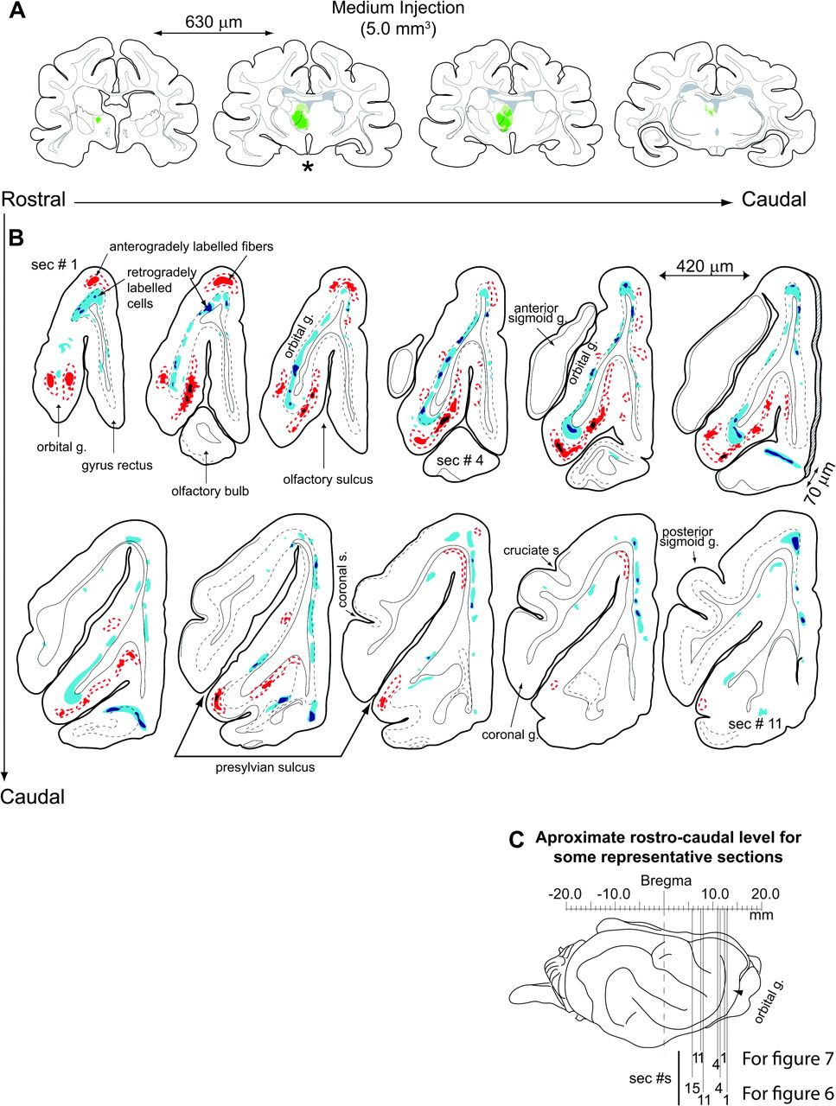
Figure 7. (A, B) Similar case to the one shown in Figure 6 but injection is smaller (5 mm³) and centered ...
Notes:
Figure 7. (A, B) Similar case to the one shown in Figure 6 but injection is smaller (5 mm3) and centered more rostrally. Notice that this injection covered more ventral MD as opposed to dorsal MD. Coronal sections illustrating the extent of the injection are 4 out of 20. Asterisk marks injection center. (B) Illustrates the corresponding anterogradely labeled fibers and retrogradely labeled neurons in the PFC. Sections 1, 2, and 3 show more extensive ventral labeling as compared with corresponding levels in case shown in Figure 6. Also, notice the difference in dorsal and medial labeling between the 2 sections that are at a similar level and are marked as section number 11 in both this figure and Figure 6. Although this section shows labeling in case illustrated in Figure 6, it lacks labeling in this case. (C) Illustrates approximate rostrocaudal coordinates for representative sections shown in this and Figure 6.
Unless provided in the caption above, the following copyright applies to the content of this slide: © The Author 2009. Published by Oxford University Press. All rights reserved. For permissions, please e-mail: journals.permissions@oxfordjournals.org

Slide 8
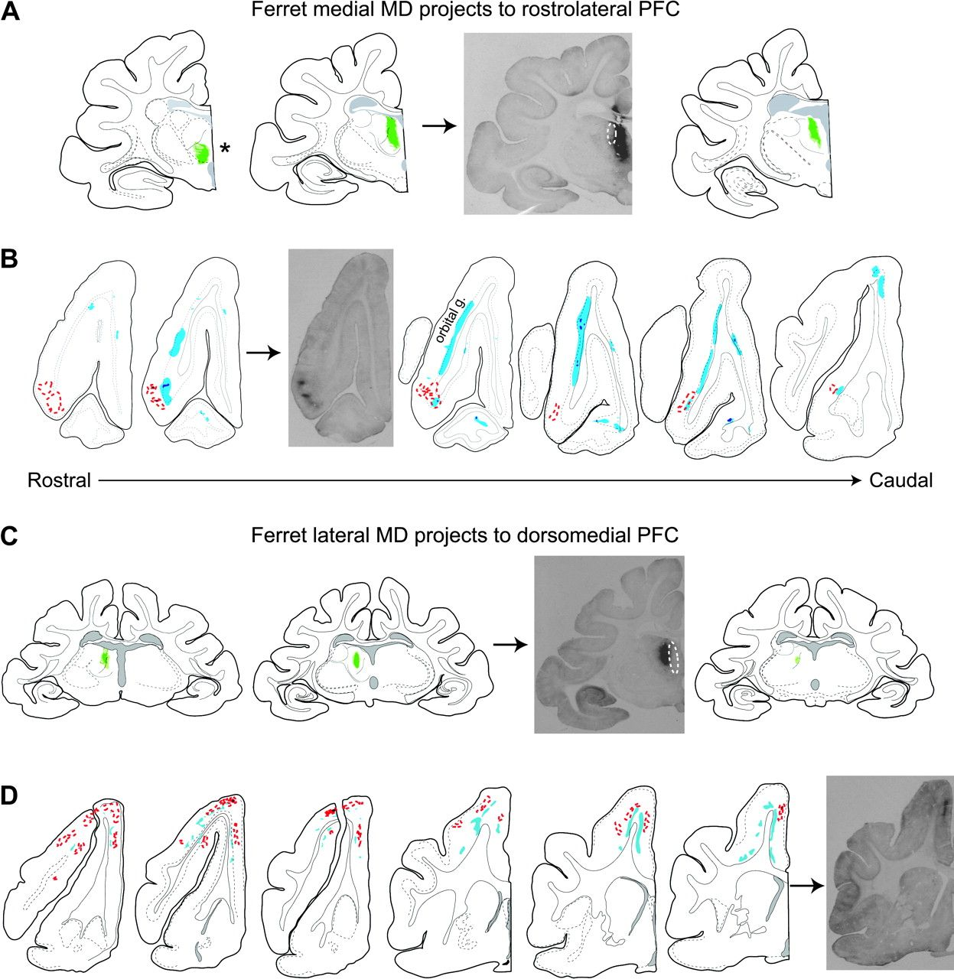
Figure 8. (A) Smaller BDA tracer injection mainly into the ferret magnocellular MD. In this case, the injection covered ...
Notes:
Figure 8. (A) Smaller BDA tracer injection mainly into the ferret magnocellular MD. In this case, the injection covered a total of 3.33 mm3 of tissue. The center of this injection was at approximately the center of the rostrocaudal extent of MD as can be observed from the diagrams of the hemicoronal sections depicting the extent of the injection. Asterisk denotes minimal leak into ventral nuclei. This and other injections into the magnocellular division of MD resulted in projections exclusively to the most rostral and lateral aspects of the frontal cortex, into the orbital gyrus, where they were more prominent on the ventral side (B). No fibers were encountered at more caudal and mediodorsal areas of the frontal pole. The area enclosed in the dotted oval corresponds to the aura of a more lateral injection shown in (C). (C) Small BDA tracer injection mostly in the ferret parvocellular MD. In this case, the injection occupied 0.98 mm3 of tissue. This injection and other injections into the parvocellular moiety of the MD resulted in projections exclusively to more caudal and dorsomedial areas of the frontal pole (D). The area enclosed in the dotted oval corresponds to the aura of the more medial injection shown in (A). Approximate coordinates for the coronal sections can be estimated by comparison to previous figures.
Unless provided in the caption above, the following copyright applies to the content of this slide: © The Author 2009. Published by Oxford University Press. All rights reserved. For permissions, please e-mail: journals.permissions@oxfordjournals.org

Slide 9
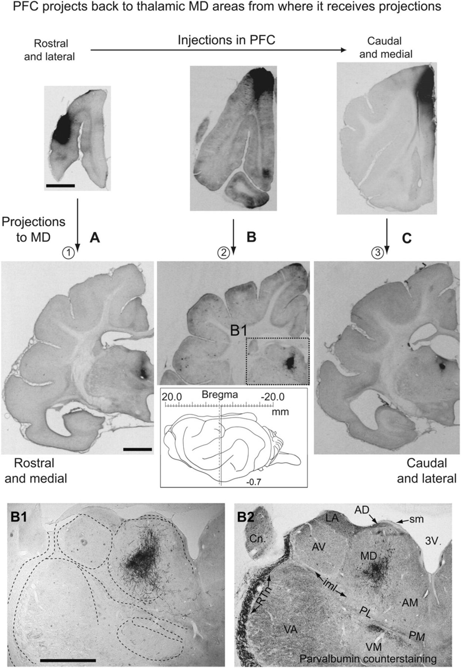
Figure 9. Tracer injections into PFC and corresponding projections to MD of the thalamus. The 3 cases (3 different ...
Notes:
Figure 9. Tracer injections into PFC and corresponding projections to MD of the thalamus. The 3 cases (3 different animals) illustrated in this figure indicate that, in general, the different PFC areas project back to the MD moieties from which they receive the bulk of their afferents. The injections progress from rostral and lateral in (A) which project to the magnocellular portion of MD, to the more caudal and dorsomedial injection in (C), which projects to the parvocellular MD moiety. Stereotaxic coordinates are provided for the level of the thalamic projections shown in (B) together with a magnified view of the fiber innervation (B1). (B2) Shows the section adjacent to (B1) counterstained with parvalbumin to allow easy visualization of different thalamic nuclei. The numbers inside the circles serve to correlate this figure to summary Figure 10.
Unless provided in the caption above, the following copyright applies to the content of this slide: © The Author 2009. Published by Oxford University Press. All rights reserved. For permissions, please e-mail: journals.permissions@oxfordjournals.org

Slide 10
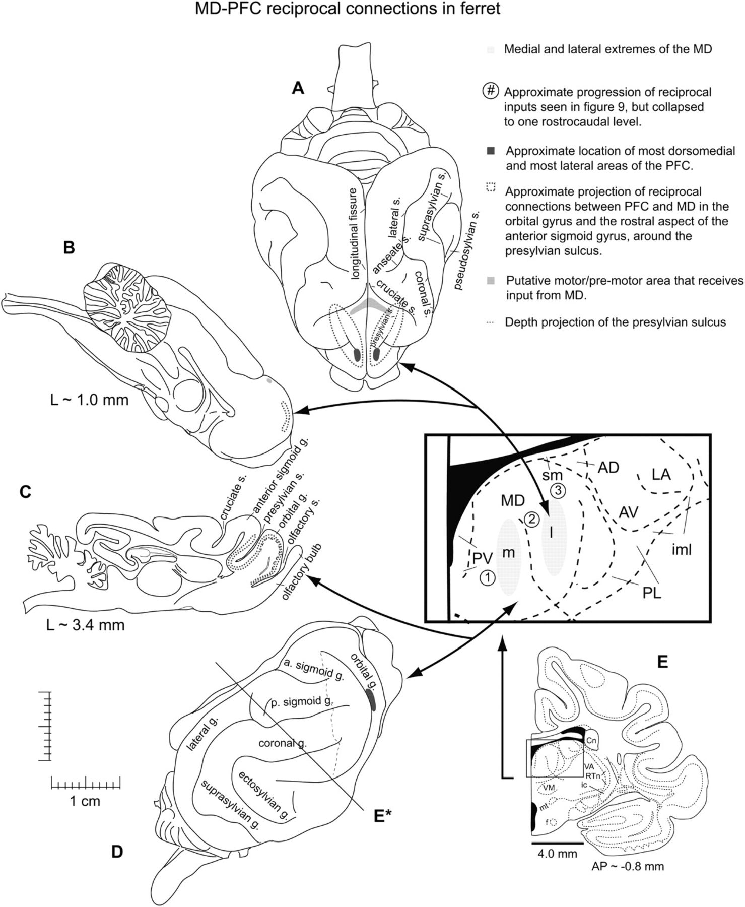
Figure 10. Summary of the extent and location of the ferret PFC with respect to its reciprocal connections with MD. (A), ...
Notes:
Figure 10. Summary of the extent and location of the ferret PFC with respect to its reciprocal connections with MD. (A), Dorsal, (B) midsagittal, (C) parasagittal, and (D) side views of the ferret brain. The black dotted line indicates the approximate depth of the presylvian sulcus (see also Fig. 11). The filled dark gray spots indicate the PFC areas closest to the brain surface, as opposed to deep areas within the banks of the presylvian sulcus, which are indicated by the dotted gray lines, their oval shape indicates that the innervation happens on both walls around the presylvian sulcus. The light gray band in the dorsal aspect of the anterior sigmoid gyrus in (A) likely corresponds to motor areas of the cortex that also receive heavy innervation from MD but which send very sparse connections back. The arrows between the PFC areas and MD simply suggest that the more lateral (or parvocellular) component of MD is closely related to the more medial and dorsal PFC, and that the more ventral and medial (or magnocellular) component of MD is closely related to the more lateral aspects of the PFC. This depiction is an oversimplification intended to aid understanding of the actual continuous PFC–MD–PFC connections. E* indicates the approximate rostrocaudal level from which the hemicoronal section shown in (E) would be obtained and is approximately −0.7 to −0.9 mm posterior to Bregma. The small numbers 1–3 inside of circles correspond approximately to the projections from PFC into MD illustrated in Figure 9.
Unless provided in the caption above, the following copyright applies to the content of this slide: © The Author 2009. Published by Oxford University Press. All rights reserved. For permissions, please e-mail: journals.permissions@oxfordjournals.org

Slide 11
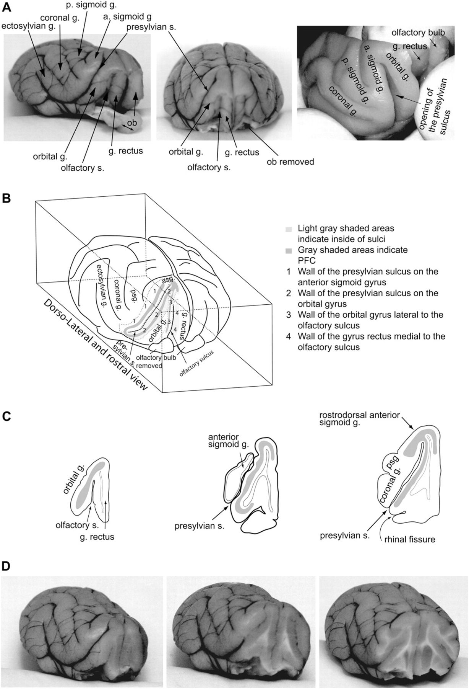
Figure 11. The ferret PFC is located along the walls around the presylvian sulcus on the orbital gyrus side and the ...
Notes:
Figure 11. The ferret PFC is located along the walls around the presylvian sulcus on the orbital gyrus side and the rostralmost tip of the anterior sigmoid gyrus. (A) Illustrates rostrolateral and frontal views of the presylvian sulcus and orbital gyrus as well as a view of the opening of the sulcus. (B) Illustrates a dorsolateral and rostral view of the anterior sigmoid, orbital, and rectus gyri with the relative location of the PFC (gray) inside of the presylvian sulcus (light gray). The walls of the orbital and rostralmost anterior sigmoid gyrus are reciprocally heavily innervated with the MD as indicated in previous figures. (C) Three coronal sections through PFC areas with approximate corresponding cuts illustrated in (D).
Unless provided in the caption above, the following copyright applies to the content of this slide: © The Author 2009. Published by Oxford University Press. All rights reserved. For permissions, please e-mail: journals.permissions@oxfordjournals.org

