Slide 1
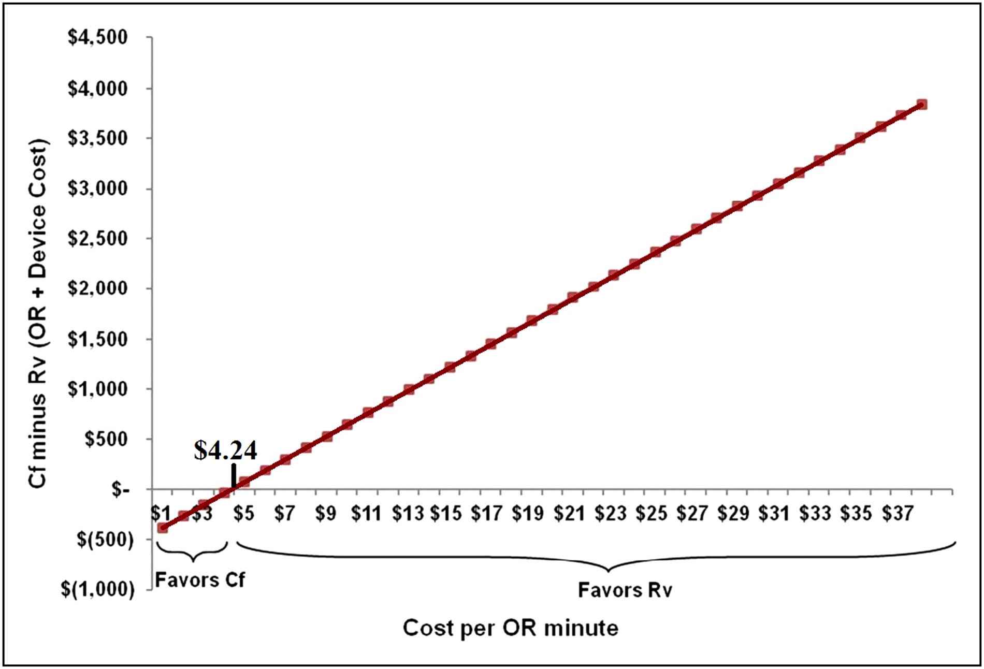
Figure 1. Breakeven point for operating room (OR) cost per minute.
Notes:
Figure 1. Breakeven point for operating room (OR) cost per minute.
Unless provided in the caption above, the following copyright applies to the content of this slide: © 2016 The American Society for Aesthetic Plastic Surgery, Inc.This is an Open Access article distributed under the terms of the Creative Commons Attribution Non-Commercial License (http://creativecommons.org/licenses/by-nc/4.0/), which permits non-commercial re-use, distribution, and reproduction in any medium, provided the original work is properly cited. For commercial re-use, please contact journals.permissions@oup.com.

Slide 2
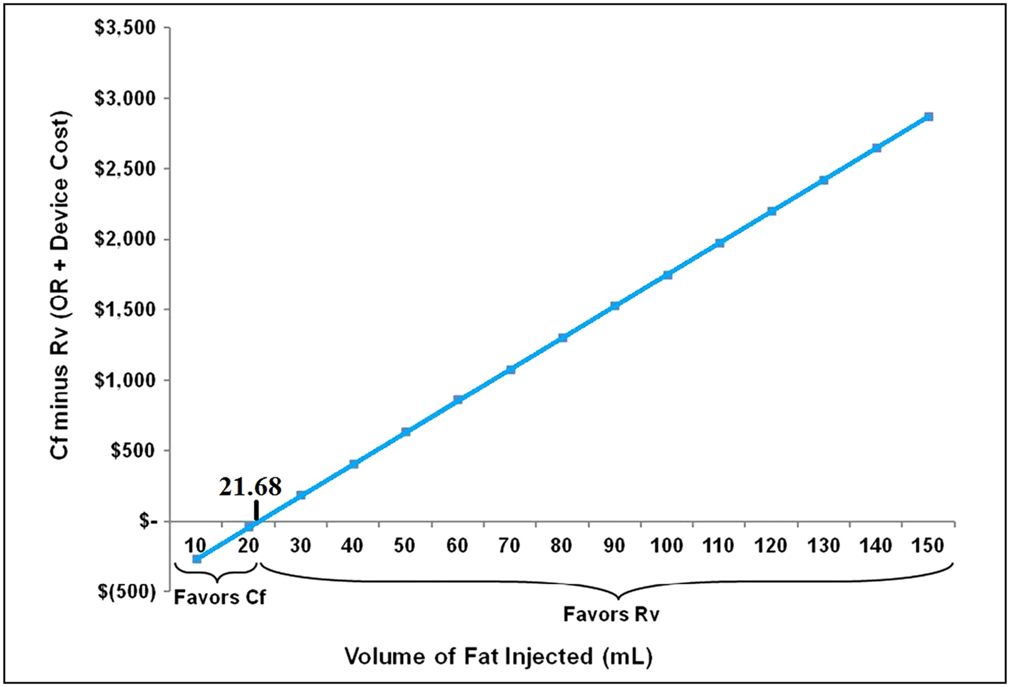
Figure 2. Breakeven point for volume of fat injected.
Notes:
Figure 2. Breakeven point for volume of fat injected.
Unless provided in the caption above, the following copyright applies to the content of this slide: © 2016 The American Society for Aesthetic Plastic Surgery, Inc.This is an Open Access article distributed under the terms of the Creative Commons Attribution Non-Commercial License (http://creativecommons.org/licenses/by-nc/4.0/), which permits non-commercial re-use, distribution, and reproduction in any medium, provided the original work is properly cited. For commercial re-use, please contact journals.permissions@oup.com.

