Slide 1
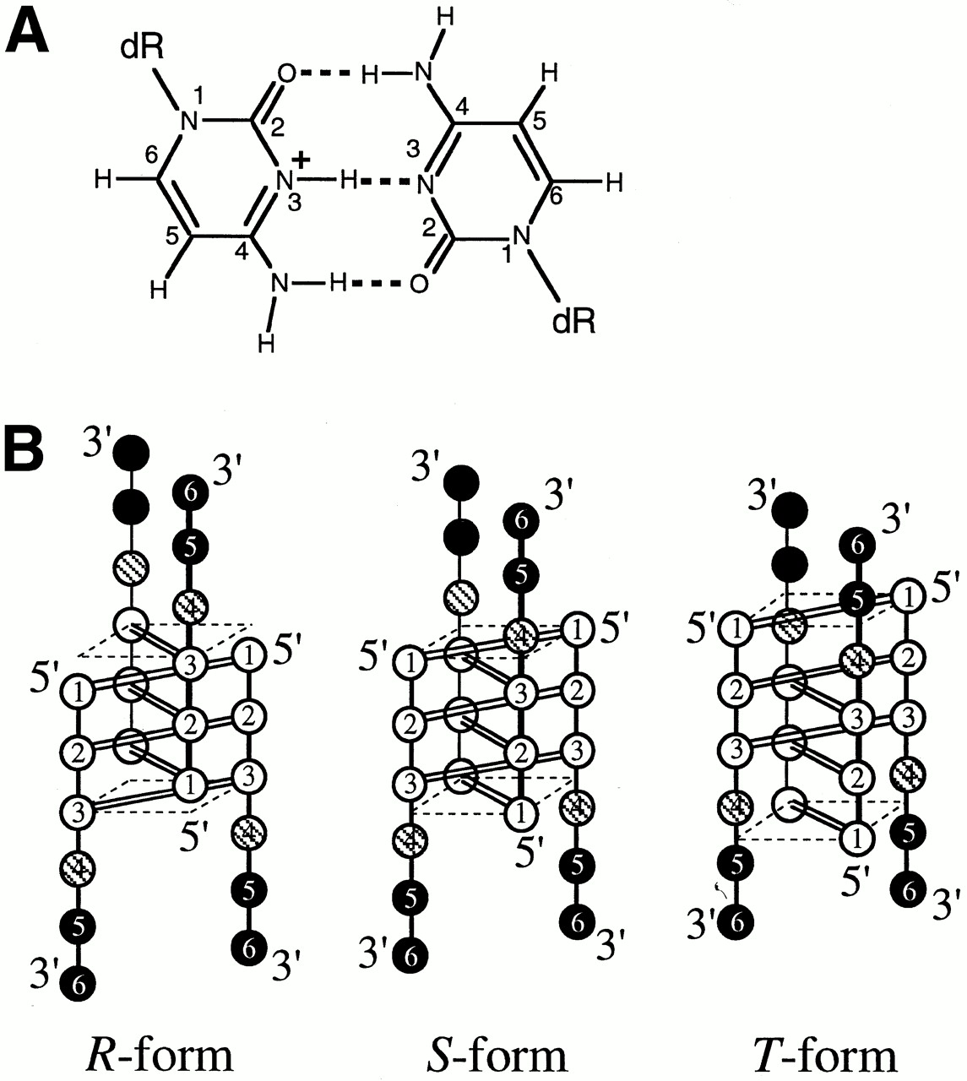
Figure 1. (A) Chemical structure of the C·C⁺ base pair. dR indicates a deoxyribose moiety. (B) ...
Notes:
Figure 1. (A) Chemical structure of the C·C+ base pair. dR indicates a deoxyribose moiety. (B) Schematic drawings of NMR-observable i-motif topologies of d(CCCTAA): R-form (left), S-form (middle) and T-form (right). Cytidine, thymidine and adenosine residues are symbolized by open, shaded and closed circles, respectively. C·C+ base pairs are formed in the parallel duplexes for all the topologies, indicated by double lines between open circles, and the plane formed by the outermost C1·C1+ pair is indicated by broken lines.
Unless provided in the caption above, the following copyright applies to the content of this slide:

Slide 2
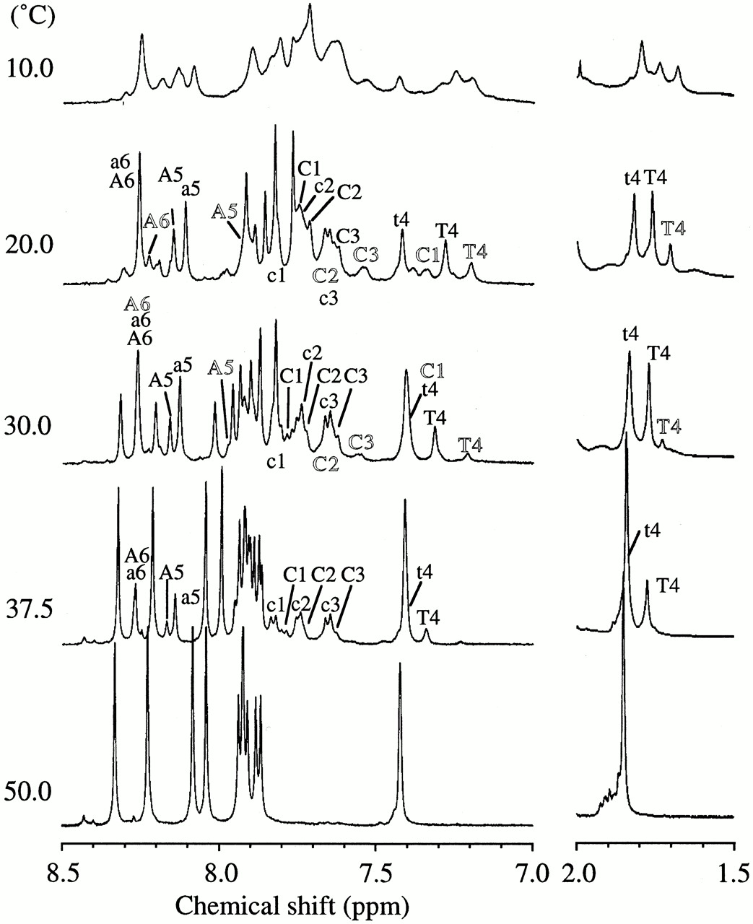
Figure 2. Temperature dependence of 1D ¹H NMR spectra of the aromatic proton region of d(CCCTAA) ...
Notes:
Figure 2. Temperature dependence of 1D 1H NMR spectra of the aromatic proton region of d(CCCTAA) in D2O. Conditions: strand concentration, 10 mM, pH 4.5. Lowercase, capital and outlined letters represent residues of R-, S- and T-form, respectively.
Unless provided in the caption above, the following copyright applies to the content of this slide:

Slide 3
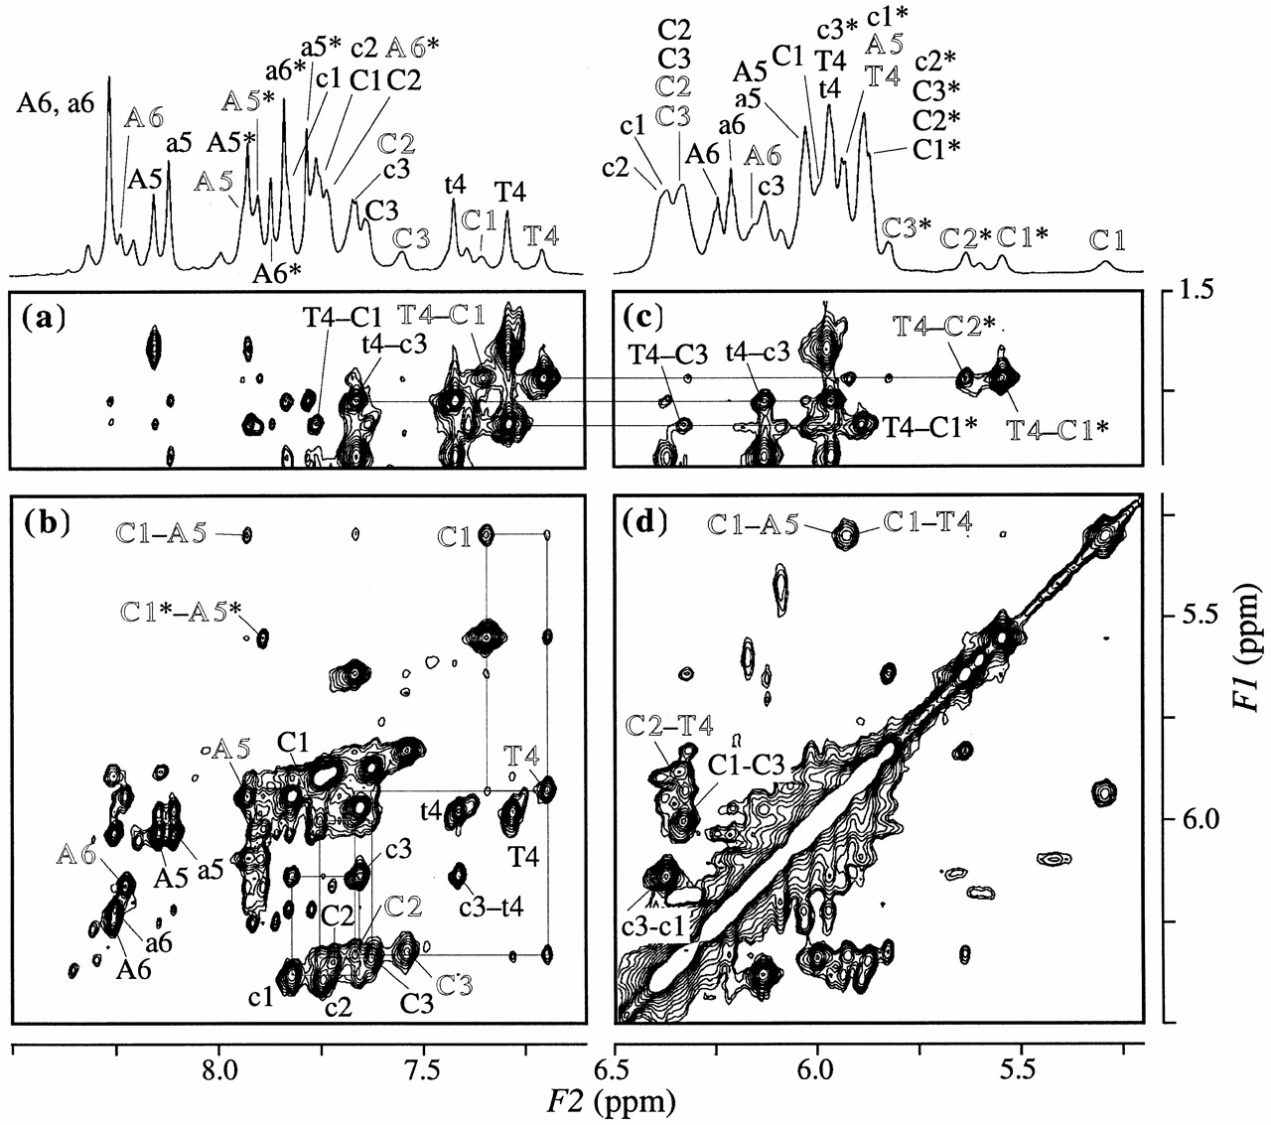
Figure 3. The 200 ms NOESY spectra for d(CCCTAA) measured at 20°C and pH 4.5 in D₂O. The regions ...
Notes:
Figure 3. The 200 ms NOESY spectra for d(CCCTAA) measured at 20°C and pH 4.5 in D2O. The regions of (a) T4 CH3–H8/H6/H2, (b) H1′/H5–H8/H6, (c) T4 CH3–H1′/H5 and (d) H1′/H5–H1′/H5 are displayed with 1D spectra with 1H assignment. Lowercase, capital and outlined letters represent residues of R-, S- and T-form respectively. Asterisks (e.g. C1*, A1*) indicate a cytidine H5 and adenosine H2 proton. Intra-residue NOE connectivities between H1′ and H8/H6 in (B) are indicated by residue names, and inter-residue NOEs are indicated by hyphenated residue names. The rectangular patterns are indicated in (B).
Unless provided in the caption above, the following copyright applies to the content of this slide:

Slide 4
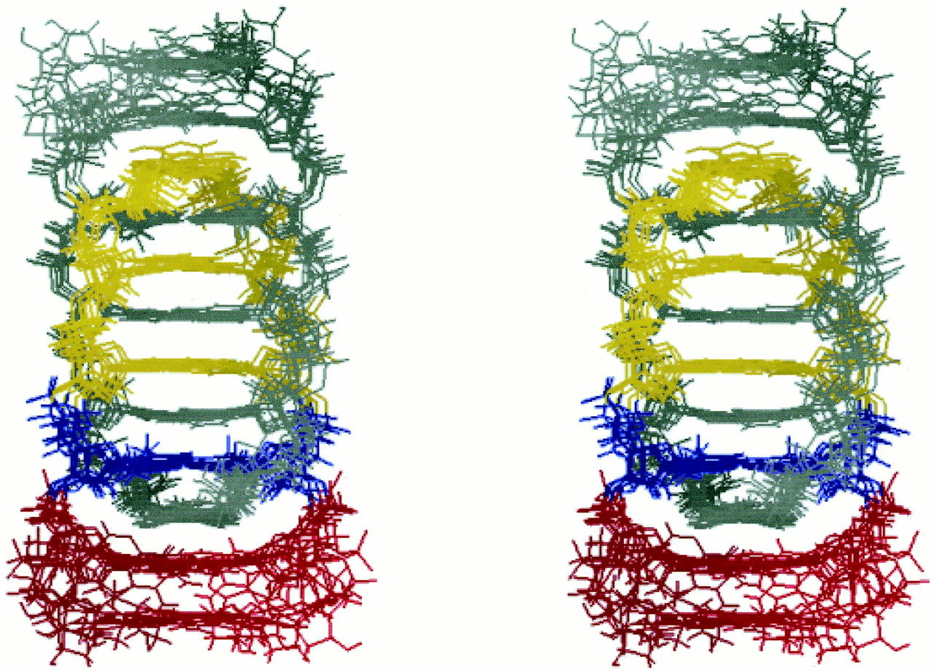
Figure 4. Stereoview of superposition of the seven lowest-energy structures of the T-form viewed from a wide ...
Notes:
Figure 4. Stereoview of superposition of the seven lowest-energy structures of the T-form viewed from a wide groove. C1′ atoms of C1–A5 residues were superimposed. For one parallel duplex, cytidine residues are in yellow, thymidine in blue and adenosines in red. The other parallel duplex is in gray.
Unless provided in the caption above, the following copyright applies to the content of this slide:

Slide 5
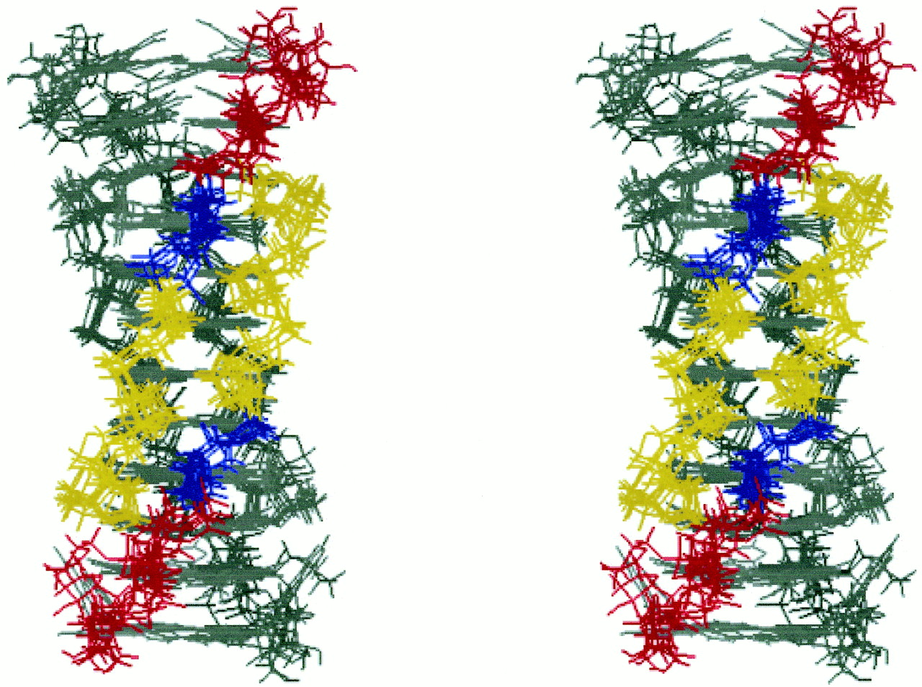
Figure 5. Stereoview of superposition of the seven lowest-energy structures of the T-form viewed from a ...
Notes:
Figure 5. Stereoview of superposition of the seven lowest-energy structures of the T-form viewed from a narrow groove. C1′ atoms of C1–A5 residues were superimposed. For one anti-parallel duplex, the bases are in gray, and the sugar–phosphate backbones are colored depending on the residue: yellow for cytidine, blue for thymidine and red for adenosine. The other anti-parallel duplex is in gray.
Unless provided in the caption above, the following copyright applies to the content of this slide:

