Slide 1
1 Schematic representation of the HPI region. Genes are indicated by large black arrows (HPI section) or by ...
Notes:
1 Schematic representation of the HPI region. Genes are indicated by large black arrows (HPI section) or by open arrows (K12-like section). The PCR primers used for the study are indicated by small arrows: 1, asnT; 2, int.2; 3, irp2.1; 4, irp2.2; 5, fyuA.1; 6, fyuA.2; and 7, yeeJ (see Table 1).
Unless provided in the caption above, the following copyright applies to the content of this slide: © 2001 Federation of European Microbiological Societies

Slide 2
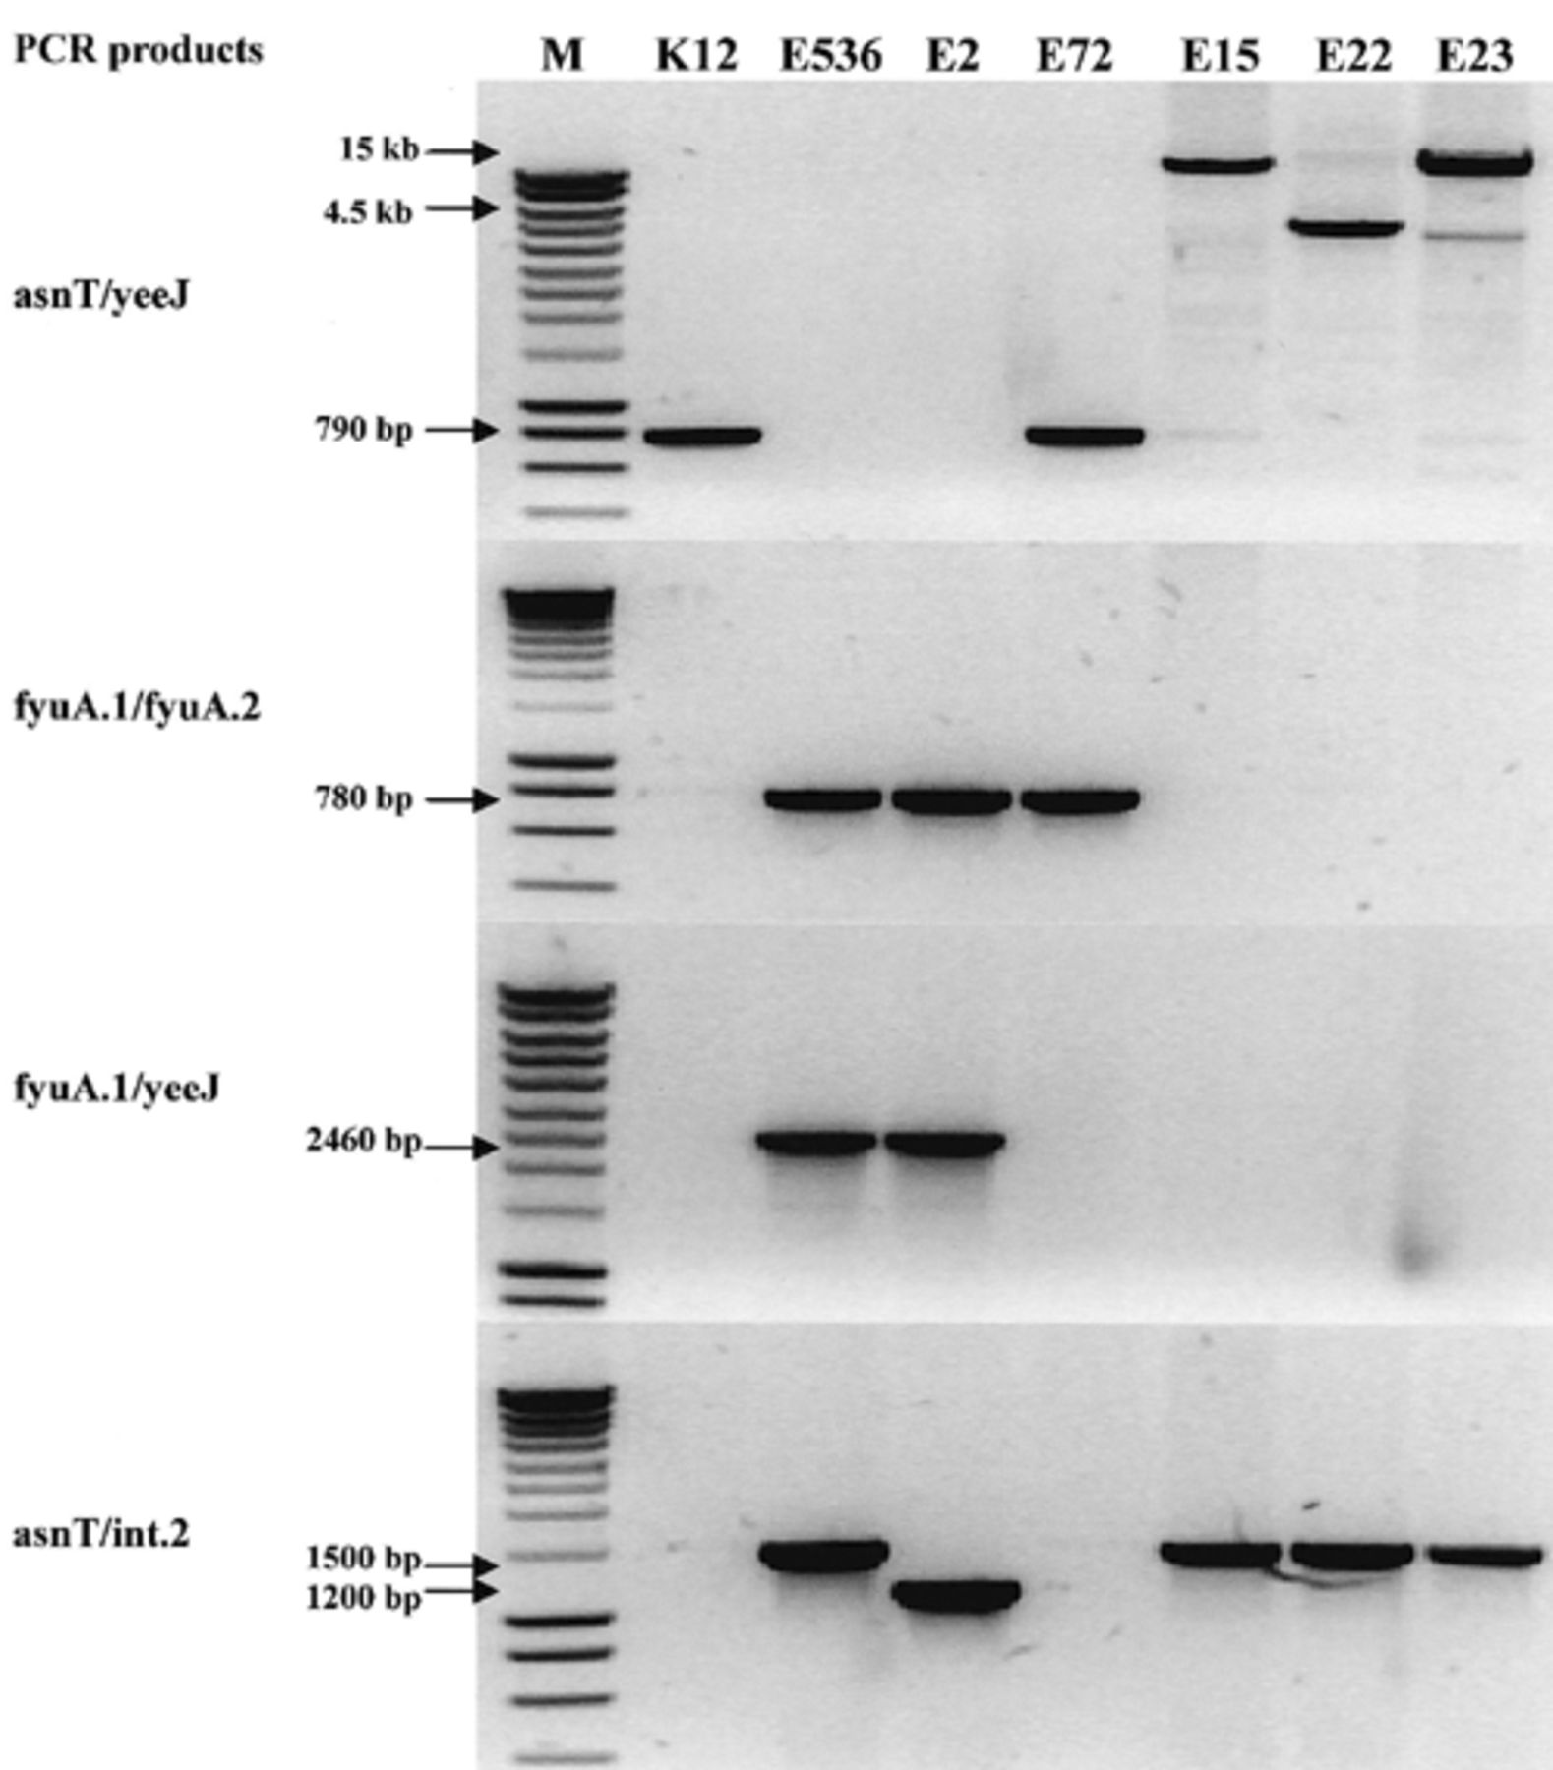
2 Agarose gel showing PCR products from representative strains. K12, E. coli K12 strain MG1655 (HPI−, ...
Notes:
2 Agarose gel showing PCR products from representative strains. K12, E. coli K12 strain MG1655 (HPI−, asnT/yeeJ+); E536, E. coli strain 536 (HPI+, asnT/yeeJ −); E2, ECOR 2 (HPI+, asnT/yeeJ −, truncated integrase); E72, ECOR 72 (HPI+, asnT/yeeJ+); E15, ECOR 15; E22, ECOR 22; E23, ECOR 23; M, molecular mass marker. AsnT/yeeJ PCR products were obtained by long-range PCR (see Section 2).
Unless provided in the caption above, the following copyright applies to the content of this slide: © 2001 Federation of European Microbiological Societies

