Slide 1
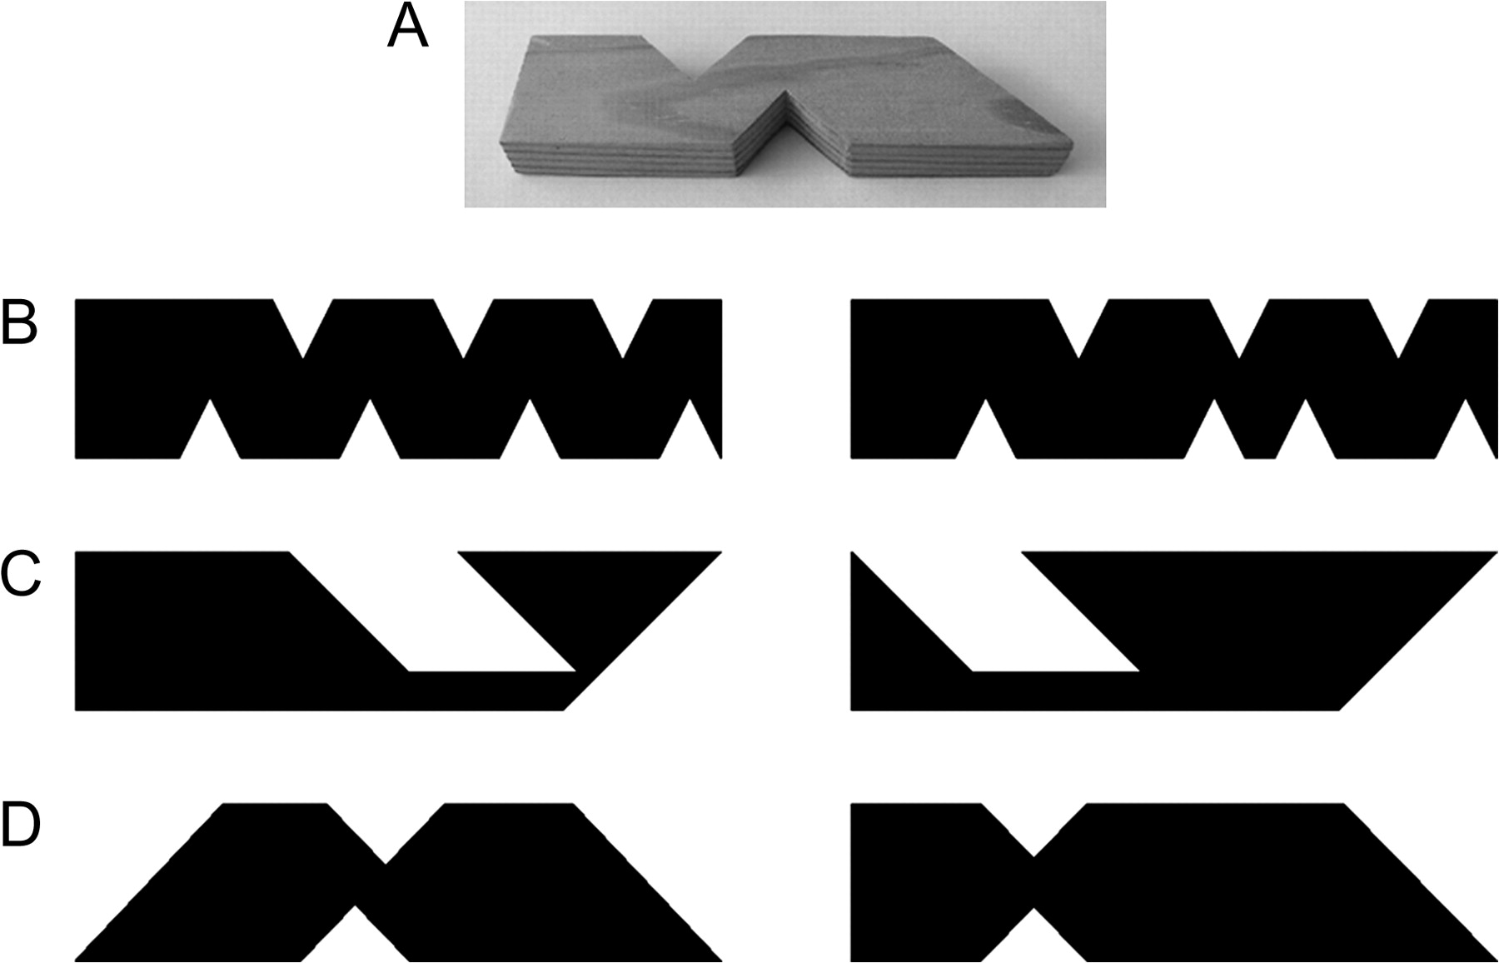
Figure 1. Example stimuli. (A) Photograph of a tactile stimulus; (B–D) examples of stimulus pairs from an incongruent ...
Notes:
Figure 1. Example stimuli. (A) Photograph of a tactile stimulus; (B–D) examples of stimulus pairs from an incongruent visual–visual trial, an incongruent tactile–tactile trial, and an incongruent visual–tactile trial, respectively.
Unless provided in the caption above, the following copyright applies to the content of this slide: © 2009 The AuthorsThis is an Open Access article distributed under the terms of the Creative Commons Attribution Non-Commercial License (http://creativecommons.org/licenses/by-nc/2.0/uk/) which permits unrestricted non-commercial use, distribution, and reproduction in any medium, provided the original work is properly cited.

Slide 2
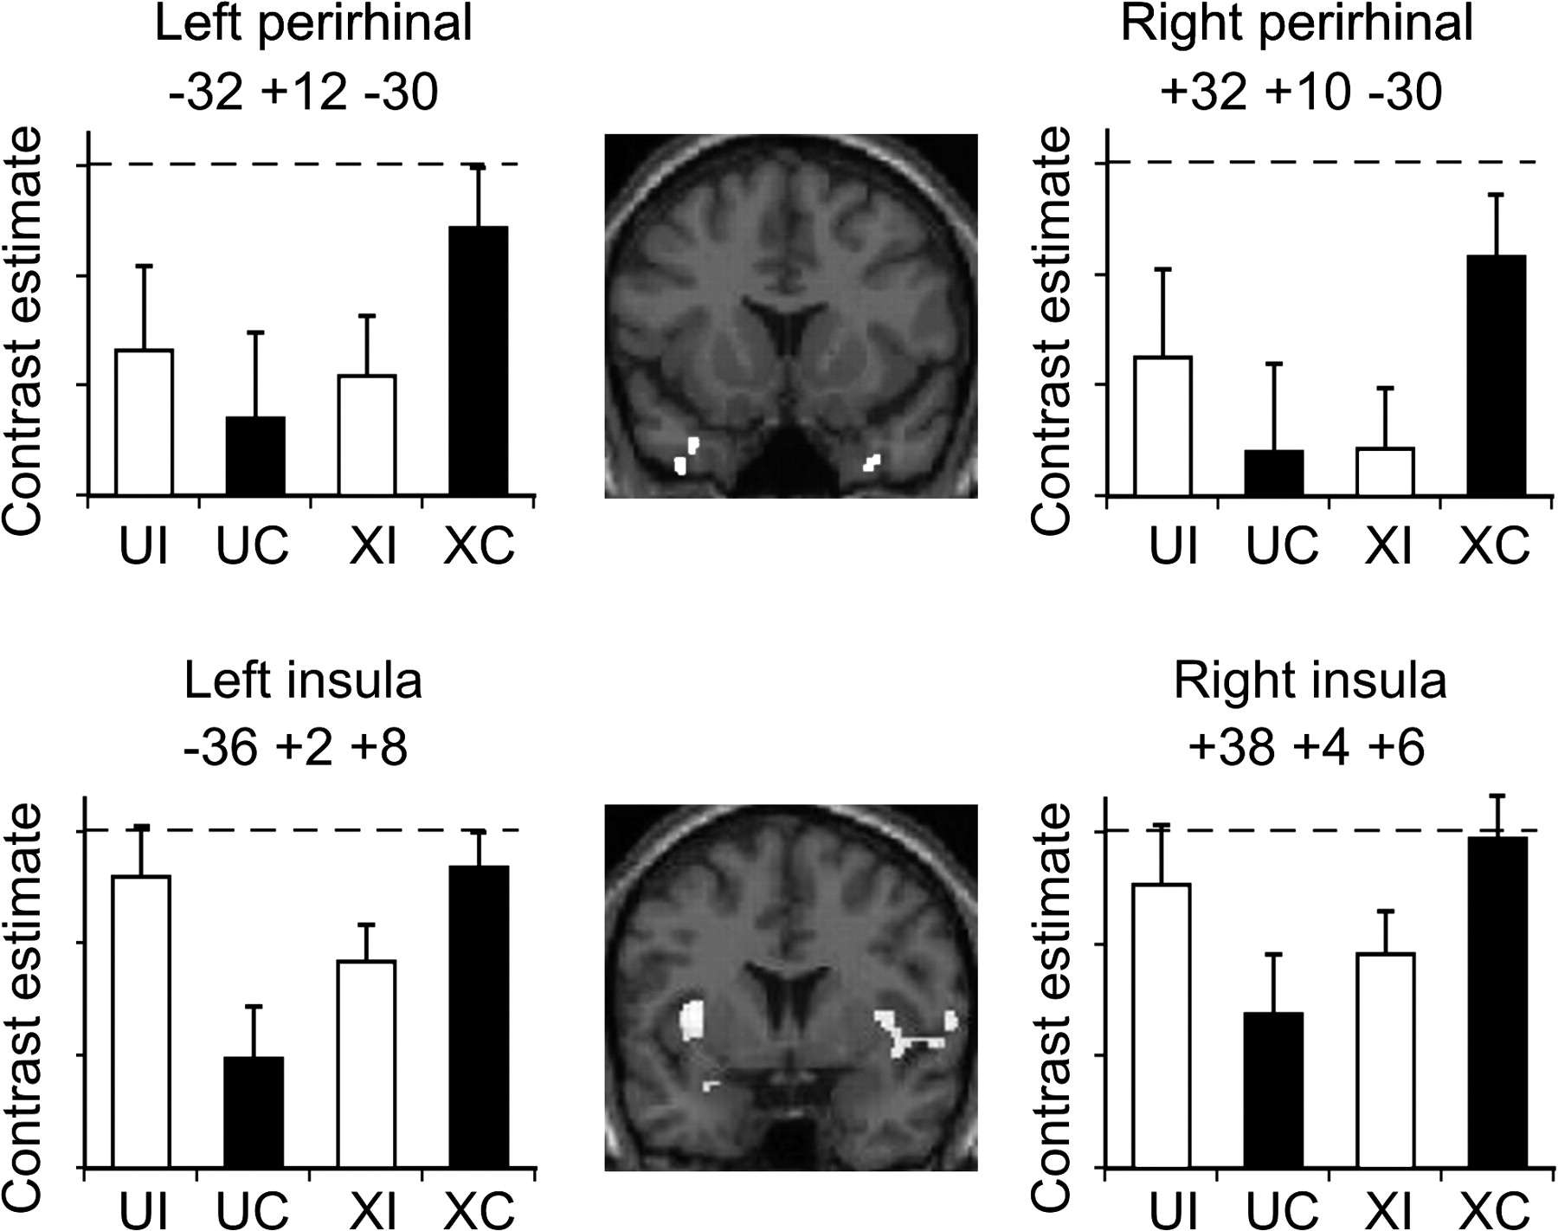
Figure 2. Perirhinal and insula activations from the group analysis. Central panels show coronal slices of group ...
Notes:
Figure 2. Perirhinal and insula activations from the group analysis. Central panels show coronal slices of group perirhinal (y = +14) and insula (y = +4) activations for cross-modal versus unimodal matching. The adjacent plots show estimates of the effect size for perirhinal and insular cortex activations in both left and right hemispheres for unimodal incongruent (UI), unimodal congruent (UC), cross-modal incongruent (XI), and cross-modal congruent (XC) conditions, with the ceiling condition indicated by the dashed line. The comparison of the cross-modal congruent condition with each of the other 3 conditions (XI, UC, and UI) was significant at P < 0.05 in both the left and right perirhinal cortices.
Unless provided in the caption above, the following copyright applies to the content of this slide: © 2009 The AuthorsThis is an Open Access article distributed under the terms of the Creative Commons Attribution Non-Commercial License (http://creativecommons.org/licenses/by-nc/2.0/uk/) which permits unrestricted non-commercial use, distribution, and reproduction in any medium, provided the original work is properly cited.

Slide 3
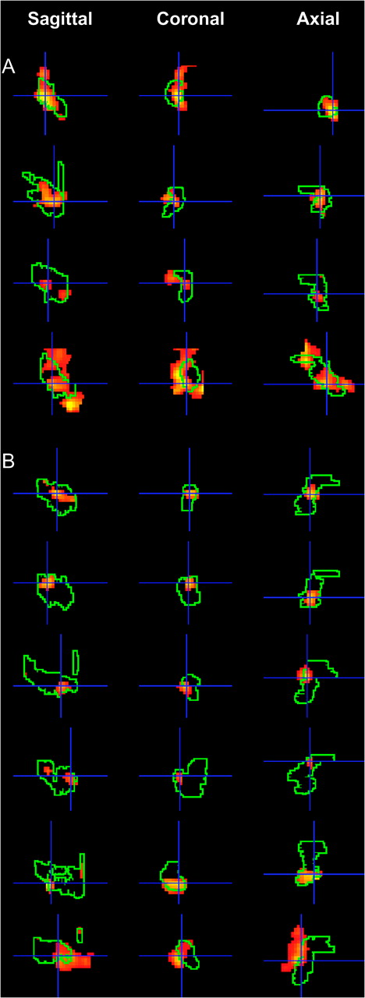
Figure 3. Perirhinal activations from the individual subject analysis. Subject-specific perirhinal activation for ...
Notes:
Figure 3. Perirhinal activations from the individual subject analysis. Subject-specific perirhinal activation for congruent visual–tactile trials relative to congruent unimodal trials superimposed onto subject-specific perirhinal masks in the sagittal, coronal, and axial planes. Each row shows activation in 1 hemisphere for 1 subject. Panel (A) shows activation of the right perirhinal cortex for subjects numbered 1–4 in Table 2. Panel (B) shows activation in the left perirhinal cortex for subjects numbered 5–10 in Table 2.
Unless provided in the caption above, the following copyright applies to the content of this slide: © 2009 The AuthorsThis is an Open Access article distributed under the terms of the Creative Commons Attribution Non-Commercial License (http://creativecommons.org/licenses/by-nc/2.0/uk/) which permits unrestricted non-commercial use, distribution, and reproduction in any medium, provided the original work is properly cited.

