Slide 1
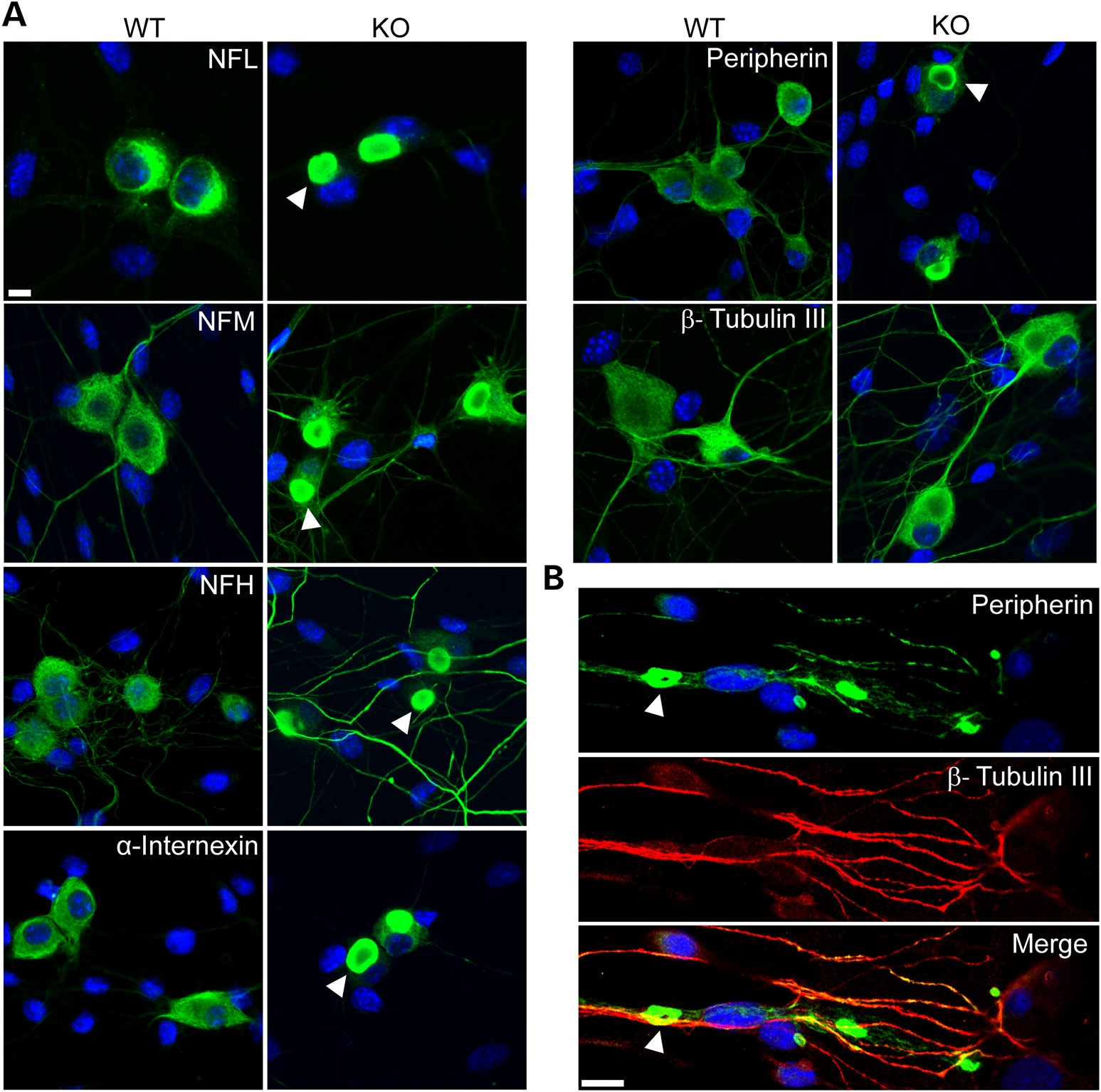
Figure 1. Neuronal IFs aggregate in DRG neurons from GAN KO mice. (A) DRG neurons show perinuclear accumulations of all ...
Notes:
Figure 1. Neuronal IFs aggregate in DRG neurons from GAN KO mice. (A) DRG neurons show perinuclear accumulations of all neuronal IF subtypes (green) including NFL, NFM, NFH, α-internexin and peripherin at 7 days culture. Note that no aggregation of β-tubulin III was detected. (B) Peripherin IF (green) aggregates can be seen in neurites in older culture of 21 days. Nuclei stained with DAPI (blue). IF inclusions are indicated with arrowheads in both A and B. Scale bar: 10 µm.
Unless provided in the caption above, the following copyright applies to the content of this slide: © The Author 2016. Published by Oxford University Press. All rights reserved. For Permissions, please email: journals.permissions@oup.com

Slide 2
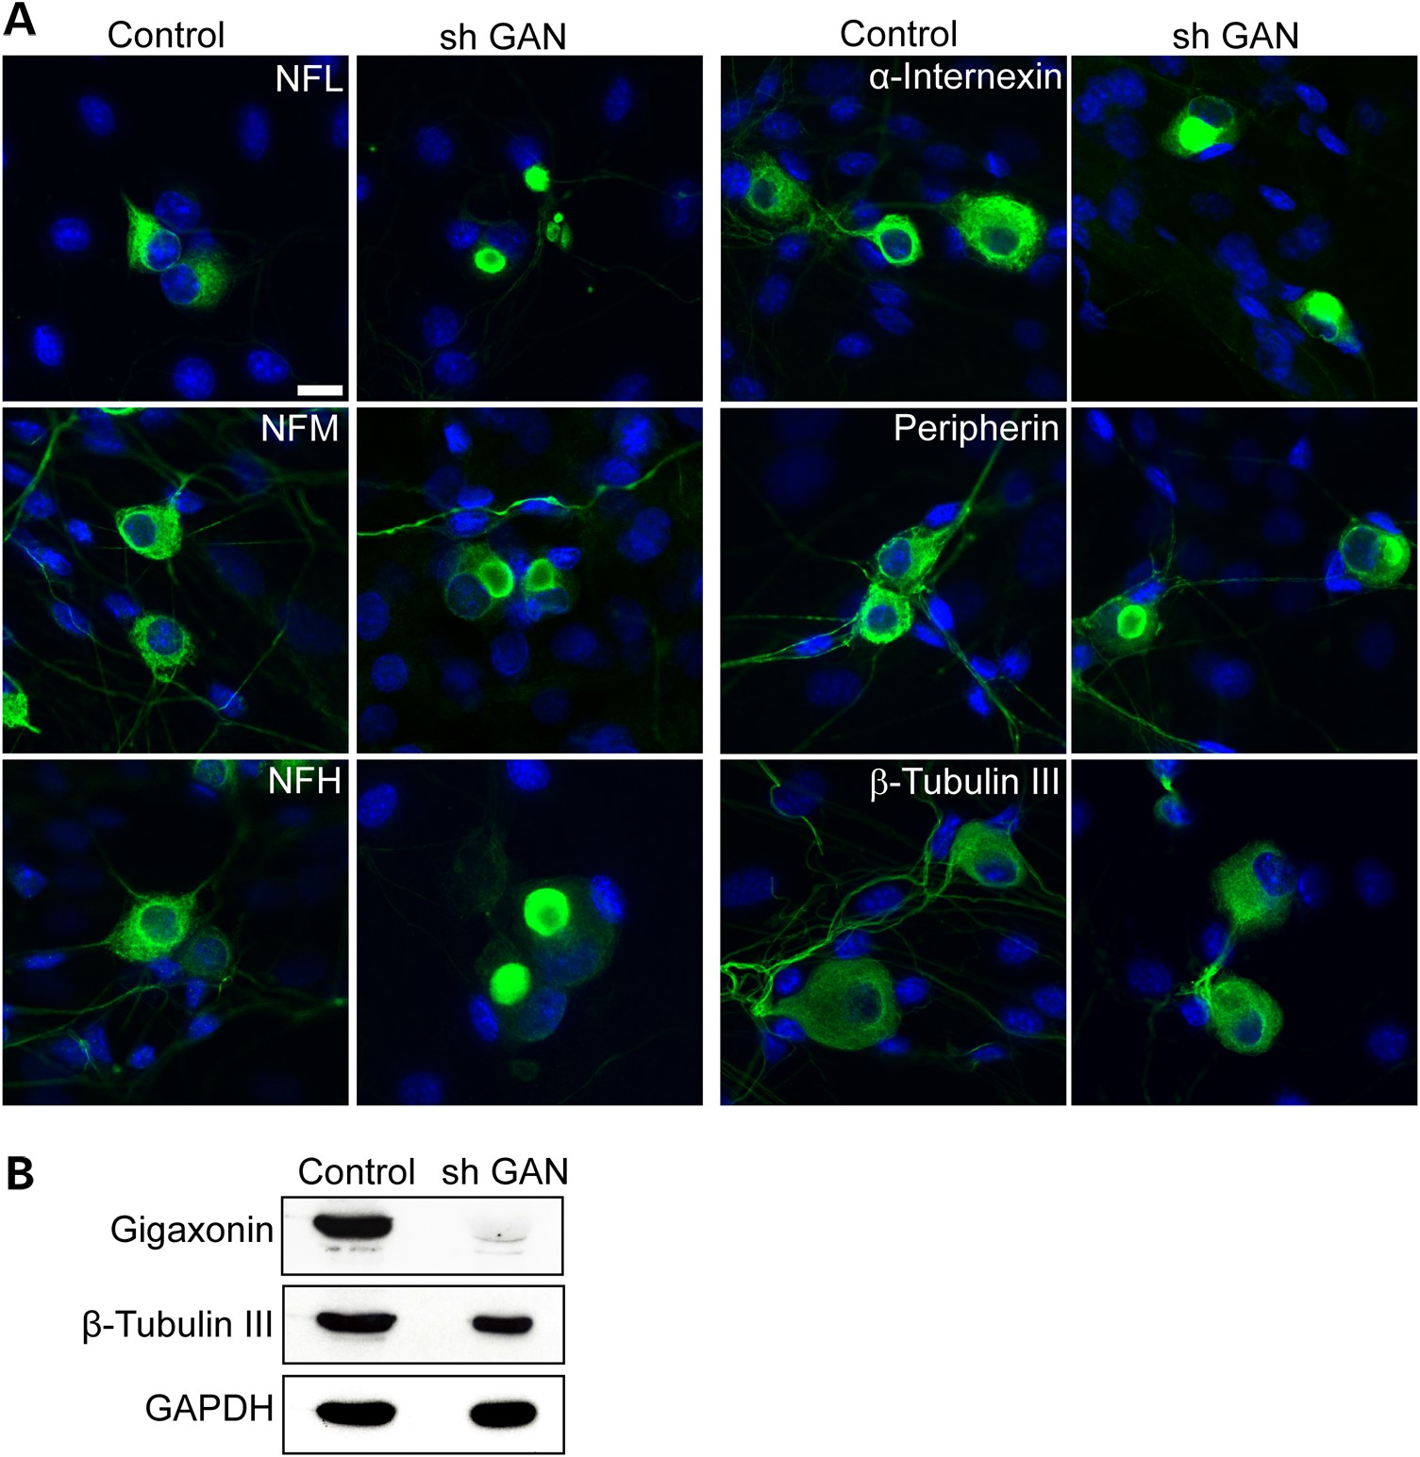
Figure 2. Silencing GAN by shRNA produces IF aggregation in WT neurons. (A) Silencing of gigaxonin by shRNA GAN in ...
Notes:
Figure 2. Silencing GAN by shRNA produces IF aggregation in WT neurons. (A) Silencing of gigaxonin by shRNA GAN in cultured WT DRG neurons leads to aggregate formation of all neuronal IF (green) compared with Sh RNA control. Nuclei stained with DAPI. Scale bar: 10 µm. (B) Western blot of lysate from WT DRG culture overexpressed with shRNA GAN, showing the level of gigaxonin reduction ∼90% of 7 days post infection. β-Tubulin III and GAPDH were used as loading controls.
Unless provided in the caption above, the following copyright applies to the content of this slide: © The Author 2016. Published by Oxford University Press. All rights reserved. For Permissions, please email: journals.permissions@oup.com

Slide 3
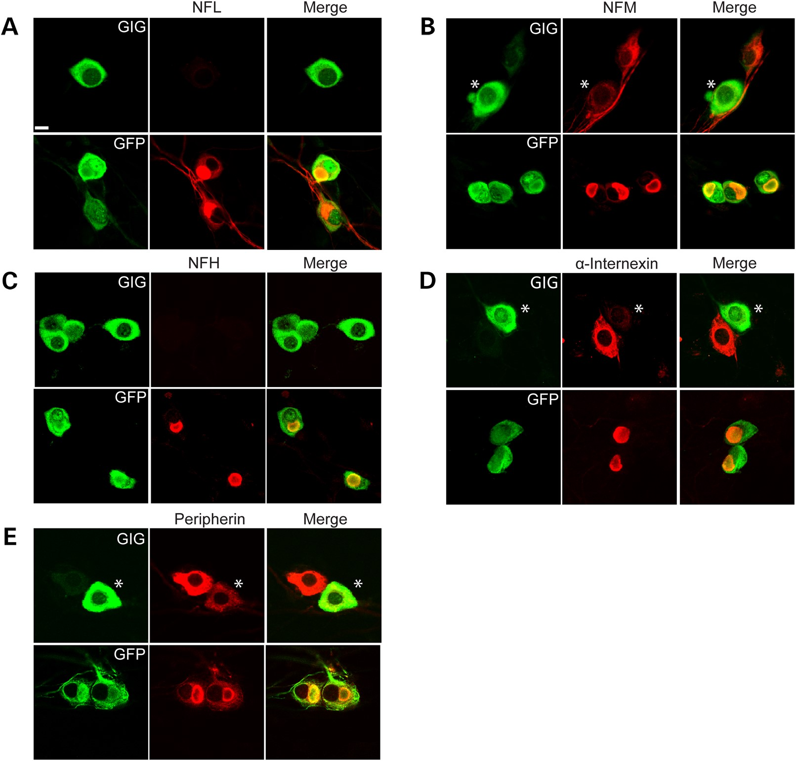
Figure 3. Overexpression of gigaxonin clears neuronal IF aggregation in GAN KO neurons. DRG neurons were transduced ...
Notes:
Figure 3. Overexpression of gigaxonin clears neuronal IF aggregation in GAN KO neurons. DRG neurons were transduced with lentiviruses that express either FLAG-tagged gigaxonin or GFP (as a control). There was a significant reduction in the levels of all subtypes of neuronal IF: NFL (A), NFM (B), NFH (C), α-internexin (D) and peripherin (E). Note that when cells expressed different levels of gigaxonin, then the cell with a greater expression of gigaxonin (asterisks) show decreased levels of the neuronal IF, as shown in B, D and E. Scale bar: 10 µm.
Unless provided in the caption above, the following copyright applies to the content of this slide: © The Author 2016. Published by Oxford University Press. All rights reserved. For Permissions, please email: journals.permissions@oup.com

Slide 4
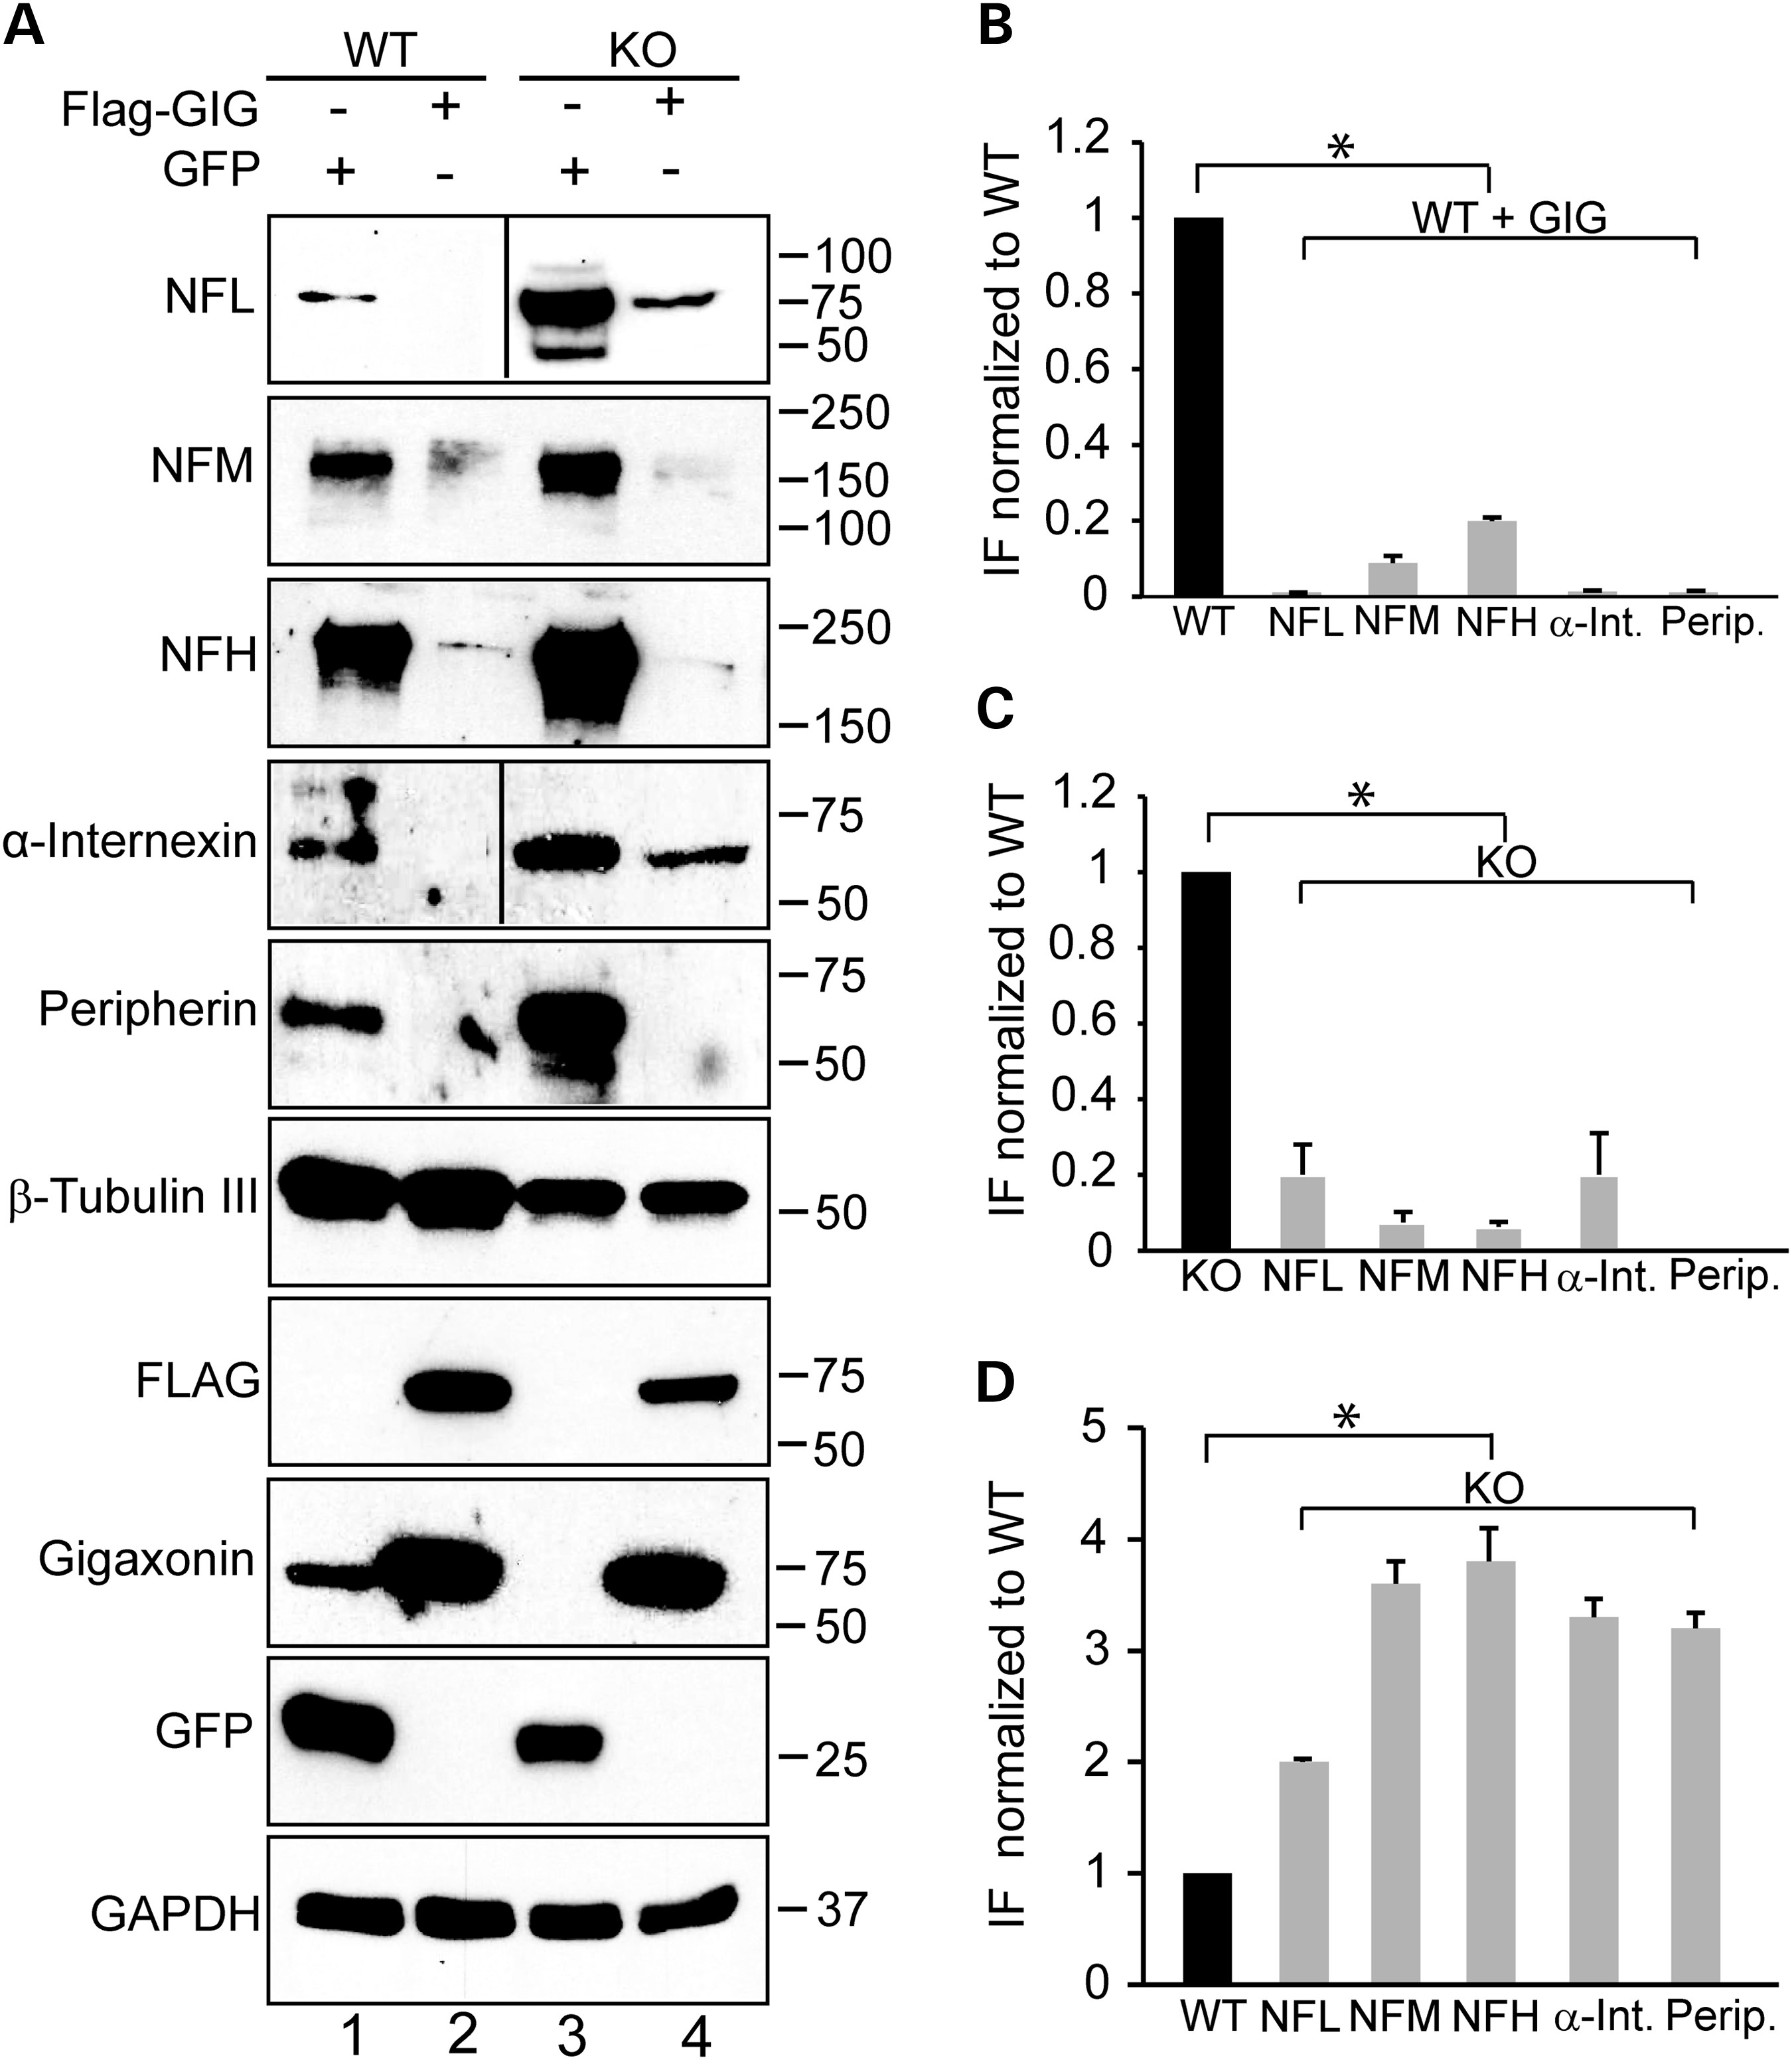
Figure 4. Quantification of IF levels in GAN KO and WT overexpressing gigaxonin. (A) Immunoblot analysis of IF levels ...
Notes:
Figure 4. Quantification of IF levels in GAN KO and WT overexpressing gigaxonin. (A) Immunoblot analysis of IF levels in DRG from WT and GAN KO mice overexpressing GFP as control neurons (lanes 1 and 3) or FLAG-gigaxonin (lanes 2 and 4). (B) IF levels are significantly reduced in DRG from WT mice when gigaxonin is overexpressed (comparison between lanes 1 and 2). (C) IF levels are significantly reduced in DRG from KO mice when gigaxonin is overexpressed (comparison between lanes 3 and 4). (D) Neuronal IF accumulates in DRG neurons of GAN KO mice (compare lanes 1 and 3). The levels of IF in all experiments were normalized to the levels of β-tubulin III. Experiments were conducted three times for each group. Data are represented as mean ± SEM.
Unless provided in the caption above, the following copyright applies to the content of this slide: © The Author 2016. Published by Oxford University Press. All rights reserved. For Permissions, please email: journals.permissions@oup.com

Slide 5
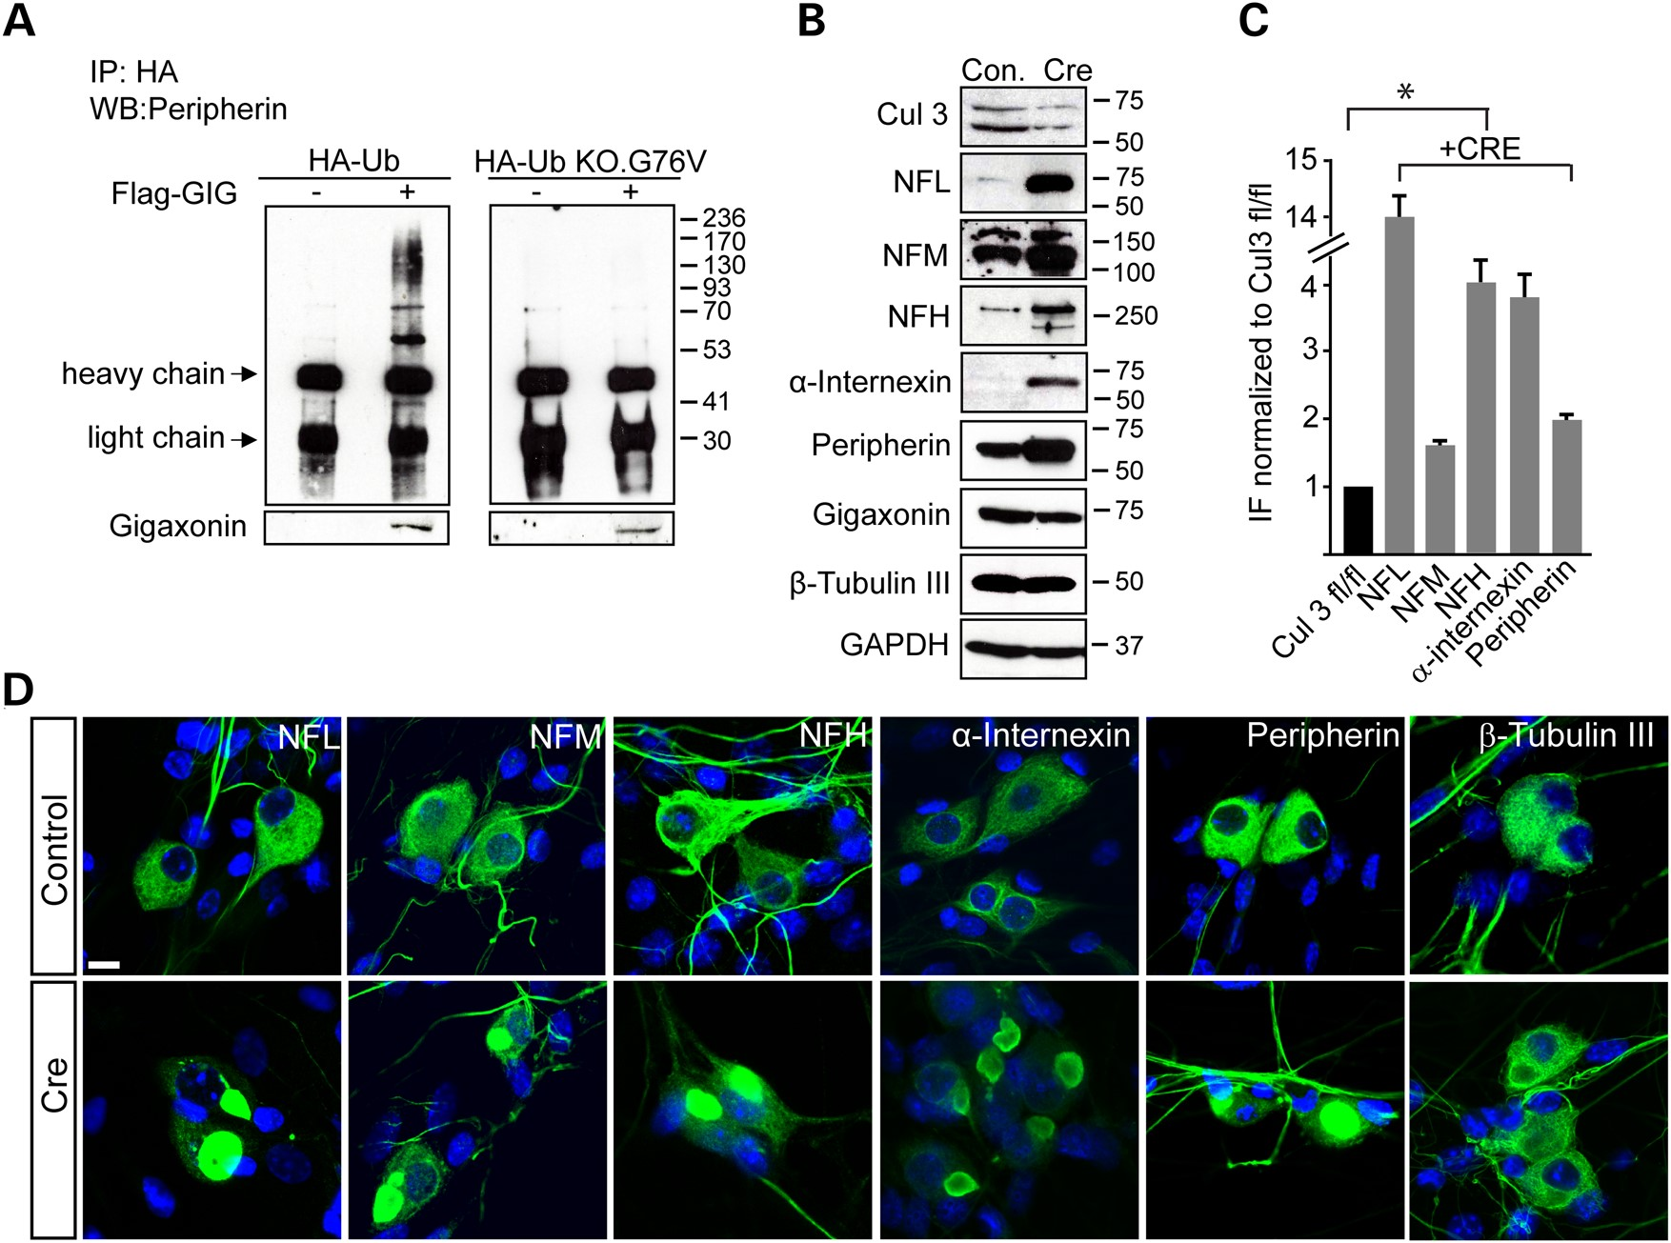
Figure 5. Intermediate filaments are ubiquitinated and degraded through a gigaxonin- Cul3 ubiquitin dependent pathway. ...
Notes:
Figure 5. Intermediate filaments are ubiquitinated and degraded through a gigaxonin- Cul3 ubiquitin dependent pathway. (A) DRG cultures of GAN KO mice were transduced with HA-Ub (left panel) or HA-Ub KO.G76 V (right panel), with or without co-expression of FLAG-gigaxonin in the presence of the proteasomal inhibitor ALLN. Immunoprecipitation was performed by anti-HA antibody and western blot with anti-peripherin antibodies. (B) DRG from Cul3 fl/fl mice were cultured and infected with LV-CRE virus to deplete Cul3 (detected as a doublet protein between 50–75 kDa). Reduction of ∼70% in Cul3 level resulted in a significant elevation of all neuronal IF; β-tubulin III and GAPDH were used as loading controls. (C) Quantification of IF protein levels detected in western blot. Experiments were conducted three times for each group. Data are represented as mean ± SEM. (D) Depletion of Cul3 (Cre) results in IF accumulations by immunofluorescence reminiscent to that seen in DRG neurons of GAN KO mice. Controls represent un-infected Cul3 fl/fl DRG neurons. Scale bar: 10 µm.
Unless provided in the caption above, the following copyright applies to the content of this slide: © The Author 2016. Published by Oxford University Press. All rights reserved. For Permissions, please email: journals.permissions@oup.com

Slide 6
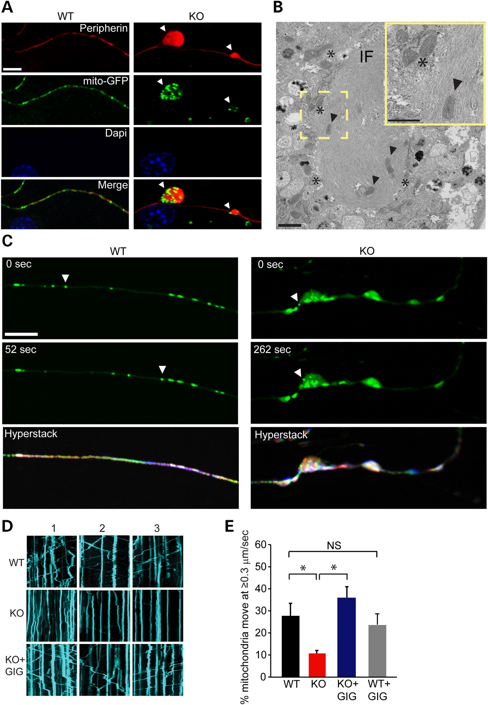
Figure 6. Mitochondria are enriched at sites of IF accumulation and their motility is reduced in axons of GAN KO ...
Notes:
Figure 6. Mitochondria are enriched at sites of IF accumulation and their motility is reduced in axons of GAN KO neurons. (A) DRG neurons cultured for 21 days and infected with mito-GFP lentivirus were fixed for Peripherin (red), GFP (mitochondria, green) and DAPI stained nuclei (blue). Scale bar: 10 µm. (B) TEM analysis of DRG cultures showing IF bundle with embedded (arrow heads) or clustered mitochondria (asterisks). Scale bar: 1 µm. Higher magnitude is shown in the yellow frame. Scale bar: 0.5 µm. (C) Arbitrary frames from movies of mitochondrial movement are shown as examples. In GAN KO neurons mitochondria particle were detected in axonal inclusion showing slow or no motility of mitochondria. All frames were stacked in ImageJ software and encoded with rainbow colour setting. Owing to the superposition of multiple colours, stationary mitochondria particles appear white, whereas moving mitochondria particles appear as rainbow-coloured paths at the end of seven minutes' exposure (hyperstack) Scale bar: 10 µm. (D) Representative tracking of mitochondria movement were also described as Kymographs. Straight kymographs indicate static mitochondria (higher level in KO) and moving mitochondria are described as diagonal kymographs. Replenishing gigaxonin by viral delivery of FLAG-gigaxonin restores mitochondrial movement (E) The percentage of mitochondria that show rapid movement (≥0.3 µm/s) was 28% (±5.6%) in WT axons (162 cells, 1562 mitochondria) compared with only 10% (±1.35%) in the GAN KO (134 cells, 2044 mitochondria). Replenishing gigaxonin by virally introducing FLAG-gigaxonin in GAN KO culture (KO + GIG) significantly increases the percentage of mitochondria that move 34% (±4.9%) (132 cells, 2028 mitochondria). No significant change (NS) in mitochondrial movement was detected between WT overexpressing FLAG-gigaxonin (WT + GIG, 87 cells, 1029 mitochondria) compare to mitochondrial movement in WT neurons. Experiments were conducted at least three times for each group. Data are represented as mean ± SEM. *P < 0.05.
Unless provided in the caption above, the following copyright applies to the content of this slide: © The Author 2016. Published by Oxford University Press. All rights reserved. For Permissions, please email: journals.permissions@oup.com

Slide 7
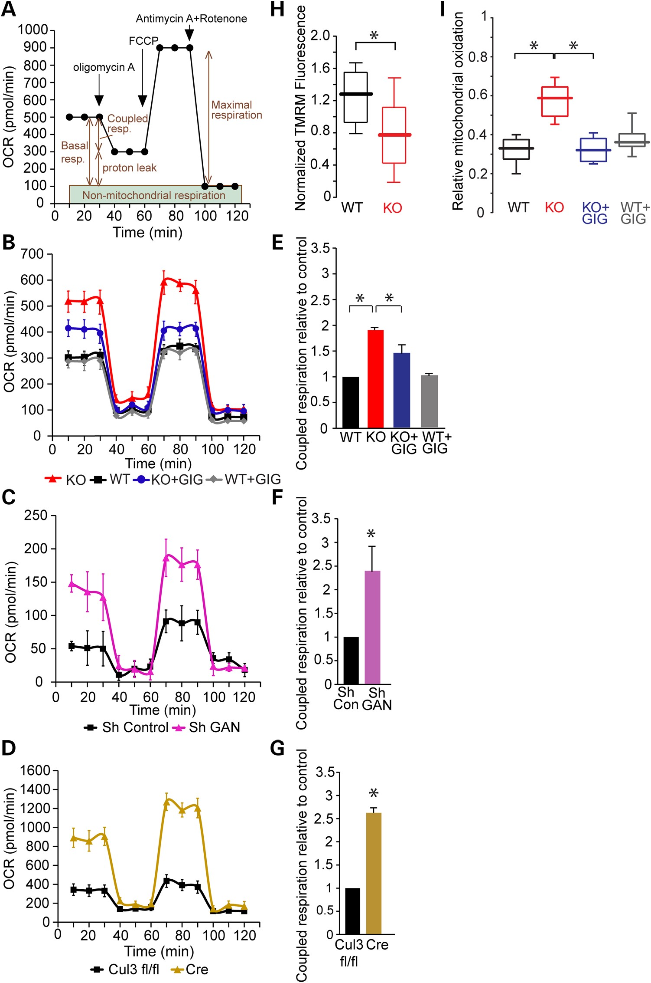
Figure 7. Mitochondria bioenergetics are altered in GAN KO cultures and accompanied by elevation in oxidative stress. ...
Notes:
Figure 7. Mitochondria bioenergetics are altered in GAN KO cultures and accompanied by elevation in oxidative stress. (A) OCR was measured using XF24 Seahorse Biosciences Extracellular Flux Analyzer (see Materials and Methods). (B) OCR measurements of GAN KO and WT DRG cultures at baseline and after expression of FLAG-gigaxonin. (C) OCR measurements of WT DRG cultures after depleting gigaxonin by shRNA (Sh GAN) compared with Sh RNA control (Sh Control). (D) OCR measurements of Cul3-deficient DRG cultures (neurons from Cul3 fl/fl mice infected by lentivirus expressing Cre) compared with uninfected control (Cul3 fl/fl). (E) Coupled respiration rates of cultures described in B. Rates were normalized to WT control and plotted in graph. WT: 1; KO: 1.9 (±0.02); KO + GIG: 1.48 (±0.17): WT + GIG: 1 (±0.02). (F) Coupled respiration rates of cultures described in C normalized to Sh RNA control and plotted in graph. Sh Control: 1; sh GAN: 2.4 (±0.54). (G) Coupled respiration rates of cultures described in D normalized to Cul3 fl/fl-control and plotted in graph. Cul3 fl/fl:1 ; Cre: 2.62 (±0.11). (H) Mitochondrial membrane potential, as measured by TMRM fluorescence, was reduced in DRG neurons from GAN KO mice. Data are presented as box and whisker plots: WT: median 1.28, n = 16; GAN KO: median 0.77, n = 16; KO + GIG median 0.76, n = 19; WT + GIG median 1.14, n = 13. Statistical significance was determined by Mann–Whitney test. *P < 0.05. (I) DRG cultures were infected with adeno-viruses expressing mito-roGFP and oxidative stress was tested by ratiometric measurement of mitochondrial-ro-GFP signal. Relative mitochondrial oxidation presented as box and whisker plots shows approximately two times higher levels in GAN KO neurons compare with WT (WT: median 0.33, n = 21; KO: median 0.59, n = 18). Expression of FLAG-gigaxonin in GAN KO neurons reduced mitochondrial oxidation by ∼2-fold (KO + GIG: median 0.32, n = 20) to levels similar to WT neurons with no effect of expression on WT (WT + GIG: median 0.36, n = 13). Experiments were performed at least four times for each group and statistical significance was determined by Mann–Whitney test. *P < 0.05.
Unless provided in the caption above, the following copyright applies to the content of this slide: © The Author 2016. Published by Oxford University Press. All rights reserved. For Permissions, please email: journals.permissions@oup.com

Slide 8
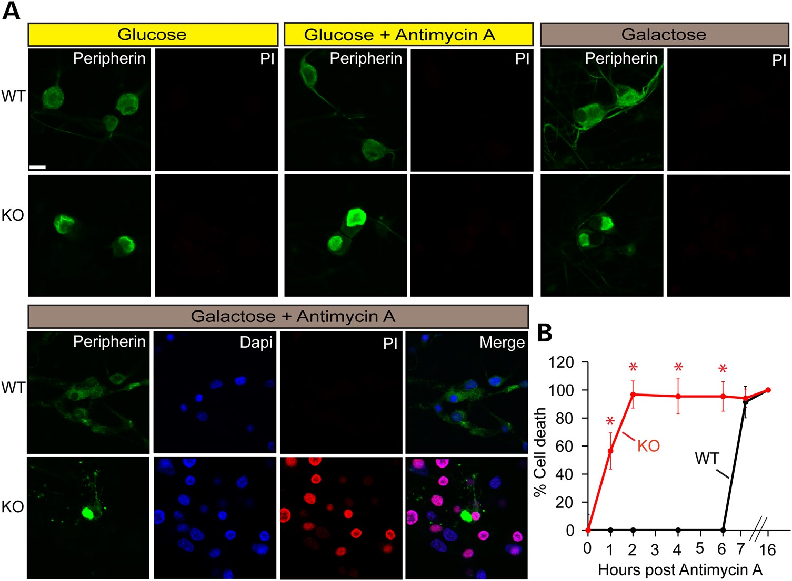
Figure 8. Cell death assessment of GAN KO cells upon different metabolic conditions. Cell death of DRG cultures from WT ...
Notes:
Figure 8. Cell death assessment of GAN KO cells upon different metabolic conditions. Cell death of DRG cultures from WT and GAN KO mice was measured at different metabolic states by propidium iodide assay. (A) Metabolic media used were: regular Neurobasal medium (Glucose), Neurobasal medium with 100 µm antimycin A (glucose + antimycin A) added for 4 h, Neurobasal medium with neither glucose nor pyruvate but with galactose without (galactose) or with antimycin A (galactose + antimycin A). Medium with galactose (25 mm) was added to cultures 48 h before cell death assay. Cells were fixed and stained with anti-peripherin (green), propidium iodide (PI, red), and DAPI (blue). Scale bar: 10 µm. (B) Cell death assay of DRG cultures maintained in galactose medium after different time points post treatment with antimycin A. Experiments were performed three times. Data are represented as mean ± SEM and statistical significance was determined by t-test. *P < 0.05.
Unless provided in the caption above, the following copyright applies to the content of this slide: © The Author 2016. Published by Oxford University Press. All rights reserved. For Permissions, please email: journals.permissions@oup.com

