Slide 1
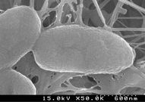
1 Scanning electron micrographs of the isolate PA3.
Notes:
1 Scanning electron micrographs of the isolate PA3.
Unless provided in the caption above, the following copyright applies to the content of this slide: © 2003 Federation of European Microbiological Societies. Published by Elsevier Science B.V. All rights reserved.

Slide 2
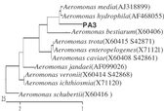
2 Phylogenetic position of the isolate Aeromonas sp. PA3 with the related taxa. Similarity and distance ...
Notes:
2 Phylogenetic position of the isolate Aeromonas sp. PA3 with the related taxa. Similarity and distance matrices were calculated with Clustal W (version 1.8). The phylogenetic tree was constructed based on available 16S rRNA sequences. The scale bar represents the expected number of changes per sequence position.
Unless provided in the caption above, the following copyright applies to the content of this slide: © 2003 Federation of European Microbiological Societies. Published by Elsevier Science B.V. All rights reserved.

Slide 3
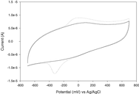
3 CVs of an A. hydrophila PA3 cell suspension grown under anaerobic conditions with (dotted line) or without ...
Notes:
3 CVs of an A. hydrophila PA3 cell suspension grown under anaerobic conditions with (dotted line) or without (solid line) ferric citrate as an electron acceptor.
Unless provided in the caption above, the following copyright applies to the content of this slide: © 2003 Federation of European Microbiological Societies. Published by Elsevier Science B.V. All rights reserved.

Slide 4
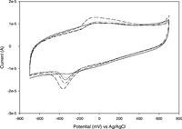
4 CVs of anaerobically grown A. hydrophila PA3 cell suspension treated under different conditions after 30 min ...
Notes:
4 CVs of anaerobically grown A. hydrophila PA3 cell suspension treated under different conditions after 30 min exposure to air. Full line, aeration for 30 min; dotted line, 20 min N2 gassing after aeration; small-dash line, incubation for 20 min with 20 mM NaNO3 after aeration; dash-dotted line, incubation for 20 min with 20 mM NaNO3 and 20 mM glycerol after aeration; and long-dash line, incubation for 20 min with 20 mM NaNO3 and 20 mM glycerol in an electrochemical cell poised at 200 mV after aeration.
Unless provided in the caption above, the following copyright applies to the content of this slide: © 2003 Federation of European Microbiological Societies. Published by Elsevier Science B.V. All rights reserved.

Slide 5
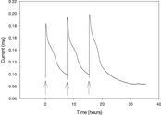
5 Current generation of single-strain isolate PA3 in an MFC. The fuel cell was connected through a resistance ...
Notes:
5 Current generation of single-strain isolate PA3 in an MFC. The fuel cell was connected through a resistance of 500 Ω. Yeast extract with a COD value of 250 mg l−1was injected as fuel at the points indicated by arrows.
Unless provided in the caption above, the following copyright applies to the content of this slide: © 2003 Federation of European Microbiological Societies. Published by Elsevier Science B.V. All rights reserved.

Slide 6
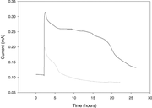
6 Current generation by cell suspension of A. hydrophila PA3 in MFCs with different fuel concentrations. The ...
Notes:
6 Current generation by cell suspension of A. hydrophila PA3 in MFCs with different fuel concentrations. The fuel cell was run with a resistance of 500 Ω. Yeast extract with a COD value of 250 mg l−1 (dotted line) or 1260 mg l−1 (solid line) was injected as fuel to monitor the current generation.
Unless provided in the caption above, the following copyright applies to the content of this slide: © 2003 Federation of European Microbiological Societies. Published by Elsevier Science B.V. All rights reserved.

Slide 7
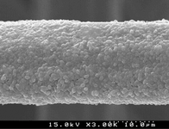
7 Scanning electron micrograph of the anode from the MFC inoculated by cell suspension of A. hydrophila PA3. ...
Notes:
7 Scanning electron micrograph of the anode from the MFC inoculated by cell suspension of A. hydrophila PA3. The electrode was removed after 5 days of operation with yeast extract as fuel.
Unless provided in the caption above, the following copyright applies to the content of this slide: © 2003 Federation of European Microbiological Societies. Published by Elsevier Science B.V. All rights reserved.

