Slide 1
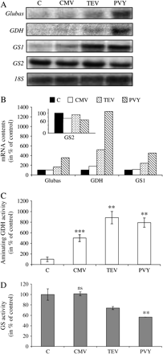
Fig. 1. Effect of virus infections on the nitrogen metabolism in tobacco leaves. Plants were infected or not (C: ...
Notes:
Fig. 1. Effect of virus infections on the nitrogen metabolism in tobacco leaves. Plants were infected or not (C: control) with CMV (Cucumber Mosaic Virus), TEV (Tobacco Etch Virus), and PVY (Potato Virus Y). Three weeks after inoculation, total RNA of fully expanded leaves located at similar positions along the main axis were used for northern blot analysis (A) of Glubas, GDH, GS1, and GS2 expression. Ten micrograms of total RNA were loaded in each lane. An 18S rRNA probe was used as a loading control. Transcripts were quantified (B) by densitometry and each value was corrected according to the 18S signal and expressed as a percentage of the control. Changes in GDH (C) and GS (D) activities are expressed as a percentage of the control. Values are means ±SE of three measurements. Two independent biological experiments were performed and showed similar results. Standard errors are not shown when they are smaller than the symbol. Fisher test shows *P <0.05, **P <0.001, and ***P 0.05 (non-significant).
Unless provided in the caption above, the following copyright applies to the content of this slide: © The Author [2005]. Published by Oxford University Press [on behalf of the Society for Experimental Biology]. All rights reserved. For Permissions, please e-mail: journals.permissions@oxfordjournals.org

Slide 2
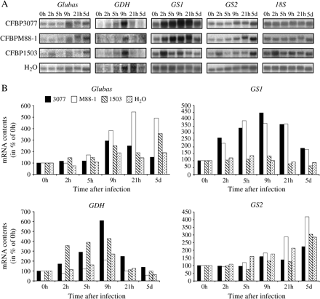
Fig. 2. Time-course of nitrogen metabolism gene expression in response to infection of tobacco leaf tissues with ...
Notes:
Fig. 2. Time-course of nitrogen metabolism gene expression in response to infection of tobacco leaf tissues with Pseudomonas syringae. Tobacco leaves were inoculated with the three strains CFBP3077 (avirulent), CFBPM88-1 (hrp mutant from CFBP3077), and CFBP1503 (virulent) or water as a control. Infected areas were collected at 0 h, 2 h, 5 h, 9 h, 21 h, and 5 d post-inoculation. Northern blot analysis of Glubas, GDH, GS1, and GS2 expression was performed by hybridization of specific 32P-labelled probes (A). An 18S ribosomic probe was used as a loading control. Note that the exposure times were different for each membrane, thus explaining the signal intensity variability in lane ‘0 h’. Transcript accumulation was quantified (B) by densitometry and each value was corrected according to the 18S signal and expressed as a percentage of the control time point at 0 h. Two independent biological experiments were performed and gave similar differential expression of genes. Only the results of one experiment are presented.
Unless provided in the caption above, the following copyright applies to the content of this slide: © The Author [2005]. Published by Oxford University Press [on behalf of the Society for Experimental Biology]. All rights reserved. For Permissions, please e-mail: journals.permissions@oxfordjournals.org

Slide 3
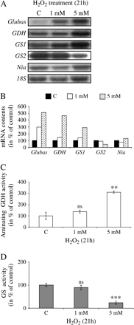
Fig. 5. Effect of oxidative stress on the nitrogen metabolism markers. Leaf discs floated on buffer solution ...
Notes:
Fig. 5. Effect of oxidative stress on the nitrogen metabolism markers. Leaf discs floated on buffer solution containing 1 mM or 5 mM of H2O2 for 21 h. Controls (C) were the carrying solutions without the biological molecules tested. The expression of Glubas, GDH, GS1, GS2, and Nia genes (A), quantification of the transcripts (B) and changes in GDH (C) and GS (D) activities are expressed as in Fig. 3. Note that the exposure times were different for each membrane, thus explaining the signal intensity variability in lane ‘C’. Values are means ±SE of three measurements. Standard errors are not shown when they are smaller than the symbol. Two independent biological experiments were performed and showed similar results. Fisher test shows *P <0.05, **P <0.001 and ***P 0.05 (non-significant).
Unless provided in the caption above, the following copyright applies to the content of this slide: © The Author [2005]. Published by Oxford University Press [on behalf of the Society for Experimental Biology]. All rights reserved. For Permissions, please e-mail: journals.permissions@oxfordjournals.org

Slide 4
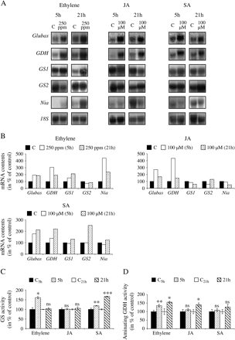
Fig. 4. Effect of ethylene, jasmonic acid, and salicylic acid on nitrogen metabolism markers. Leaf discs were floated ...
Notes:
Fig. 4. Effect of ethylene, jasmonic acid, and salicylic acid on nitrogen metabolism markers. Leaf discs were floated on buffer solution containing 100 μM of jasmonic acid (JA), 100 μM of salicylic acid (SA), or equal volume of water as a control (C) for 5 h and 21 h. Ethylene treatment was performed using confined flasks containing 0 M (control, C) or 1 M (250 ppm) ethephon as the ethylene donor. Note that the exposure times were different for each membrane, thus explaining the signal intensity variability in lane ‘C’. The expression of Glubas, GDH, GS1, GS2, and Nia genes (A), quantification of the transcripts (B), and changes in GDH (C) and GS (D) activities are expressed as in Fig. 3. Values are means ±SE of three measurements. Standard errors are not shown when they are smaller than the symbol. Two independent biological experiments were performed and showed similar results. Fisher test shows *P <0.05, **P <0.001 and ***P 0.05 (non-significant).
Unless provided in the caption above, the following copyright applies to the content of this slide: © The Author [2005]. Published by Oxford University Press [on behalf of the Society for Experimental Biology]. All rights reserved. For Permissions, please e-mail: journals.permissions@oxfordjournals.org

Slide 5
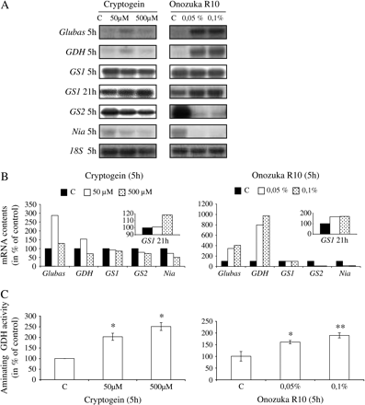
Fig. 3. Changes in nitrogen metabolism markers in leaf discs treated with the cryptogein and Onozuka R10 elicitors. ...
Notes:
Fig. 3. Changes in nitrogen metabolism markers in leaf discs treated with the cryptogein and Onozuka R10 elicitors. Controls are the same carrying solutions without the signalling molecules. Northern blot (A) analysis of Glubas, GDH, GS1, GS2, and Nia expression. An 18S rRNA probe was used as a loading control. Note that the exposure times were different for each membrane, thus explaining the signal intensity variability in lane ‘C’. Quantification (B) of the accumulation of transcripts; each value was corrected according to the 18S control and expressed as a percentage of the control (discs floated without elicitor, lane ‘C’). The change in GDH activity (C) was investigated and expressed as a percentage of the control. Values are means ±SE of three measurements. Standard errors are not shown when they are smaller than the symbol. Two to three independent experiments were performed and gave similar results, only the results of one are presented. Fisher test shows *P <0.05, **P <0.001, and ***P 0.05 (non significant).
Unless provided in the caption above, the following copyright applies to the content of this slide: © The Author [2005]. Published by Oxford University Press [on behalf of the Society for Experimental Biology]. All rights reserved. For Permissions, please e-mail: journals.permissions@oxfordjournals.org

