Slide 1
Rice circRNA: 5 circRNAs for validation
Rice-circRNA | ID | Width | Tissue | Detection score | Junction validation
1 | chr6:28834663-28834788_- | 126 | Multiple Tissue | 4.95 | -
2 | chr4:33459707-33459826_+ | 120 | Multiple Tissue | 2.31 | Yes
5 | chr5:18013434-18013558_+ | 125 | Multiple Tissue | 11.221 | -
6 | chr11:26511777-26511905_- | 129 | Multiple Tissue | 10.231 | -
7 | chr7:25315053-25315176_- | 124 | Multiple Tissue | 8.581 | -
:Validated circRNA

Slide 2
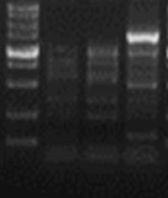
CircRNA validation by sanger sequencing-chr4:33459707-33459826_+
chr4:33459707-33459826_+
N F R
1000bp
750bp
500bp
250bp
2
100bp
2
1
1
divergent
N: The reverse transcription primers were random primers
F: The reverse transcription primers were F
R: The reverse transcription primers were R
: Sequence mismatched sequences

