Slide 1
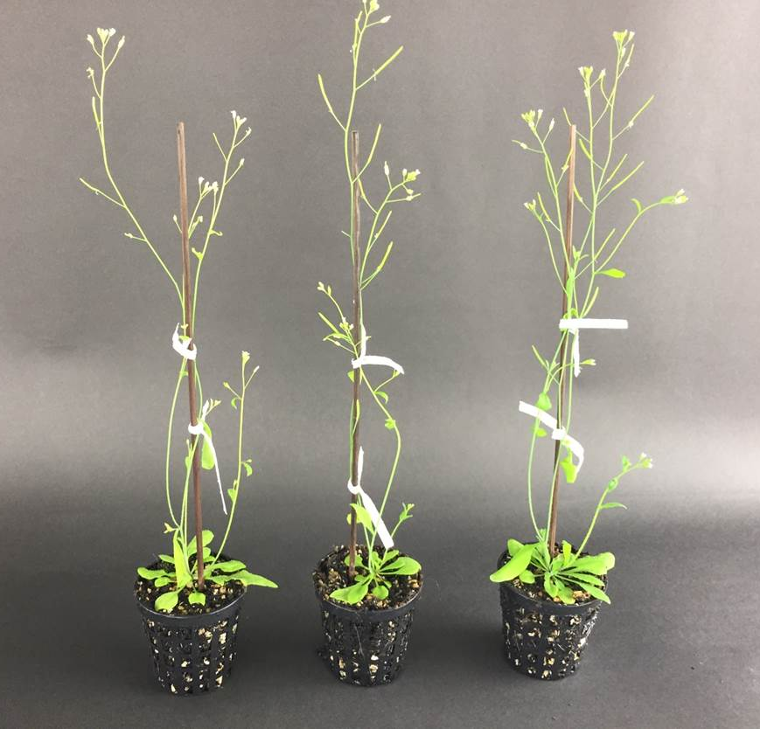
T
prp18a-1
+ PRP18a
prp18a-1
Figure S3: Phenotypes of adult plants
Adult plants of the wild-type T line, the prp18a-1 mutant, and a complemented line (prp18a-1 + PRP18a) have a similar overall appearance. When photographed, the plants were the same age and growing under identical conditions.
Figure S3 Kanno et al

