Slide 1
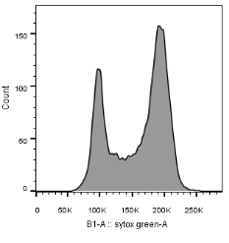
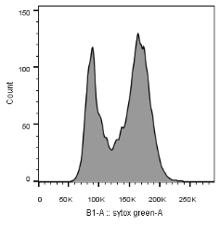
0 min EdU 25µM
5 min EdU 25µM
10 min EdU 25µM
wild-type
Δset1
Figure S3. Reduced levels of cells in S-phase in the ∆set1 mutant.
Exponentially growing wild-type and ∆set1 strains harbouring TK-hENT1 cassettes were incubated with 25 µM of EdU for 0, 5, or 10 min (left panel). Highly selective ‘click’ reaction allowed to measure incorporation of EdU (Talarek, et al., 2015). Bivariate EdU Alexa 647 versus propidium iodide dot plot allowed to determine the number of cells in the indicated cell cycle phases (Table 1). A classical FACS analysis is shown on the right.

