Slide 1
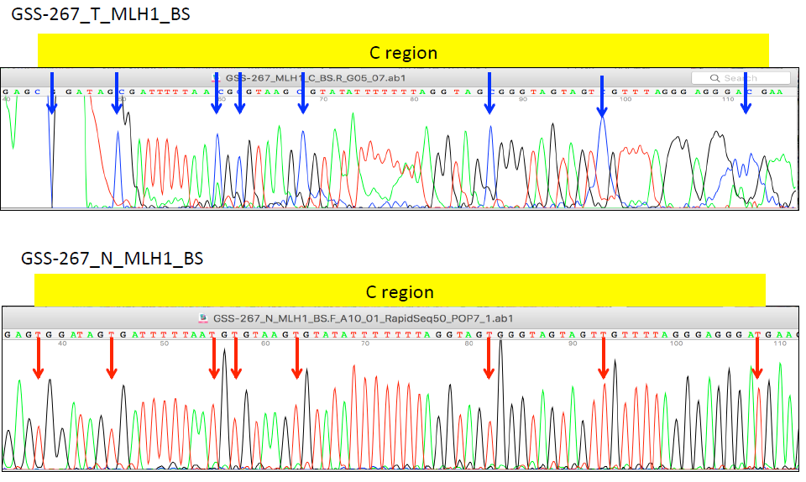
Supplementary Figure 1
Cancer tissue from cases 5
White blood cells from cases 5

