Slide 1
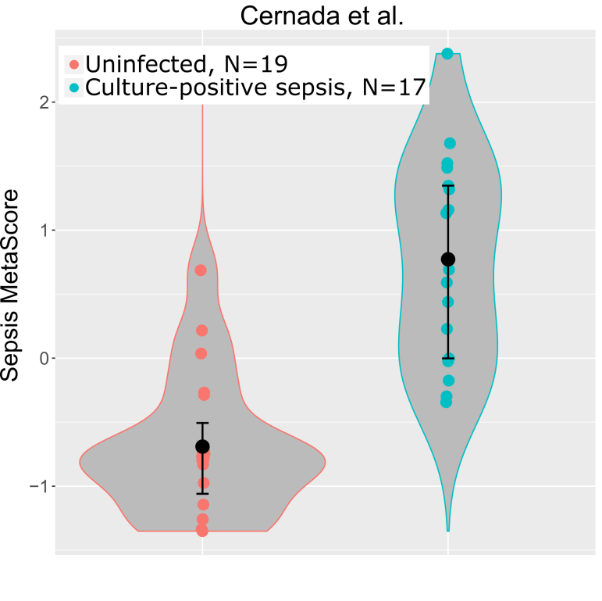
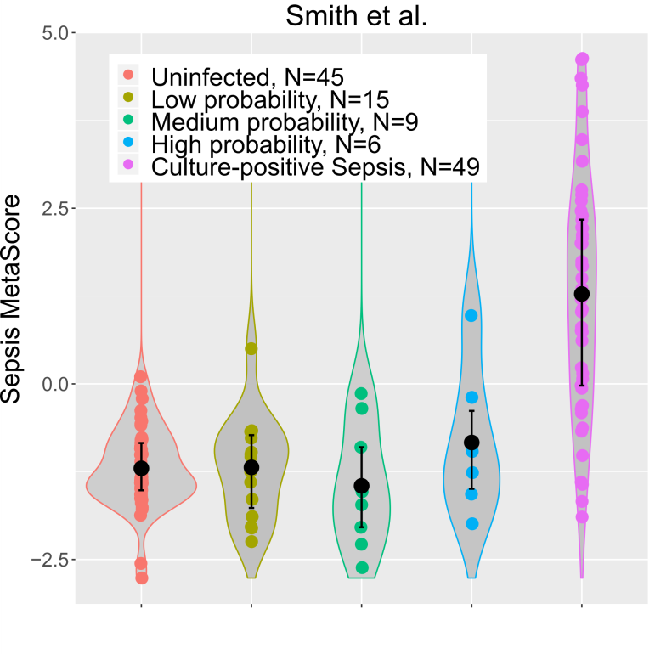
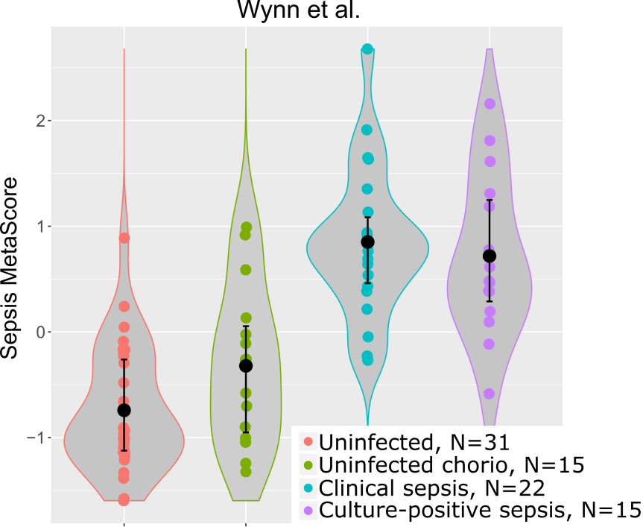
A
B
C
Supplemental Figure 1. Violin plots of the SMS distribution across all patients for each cohort.

Slide 2
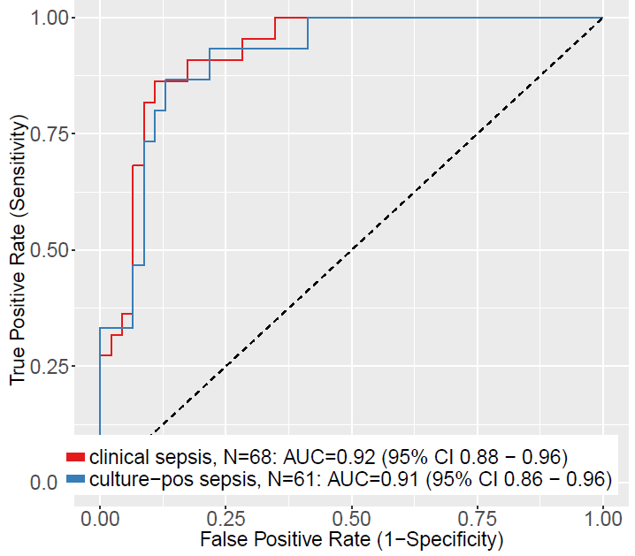
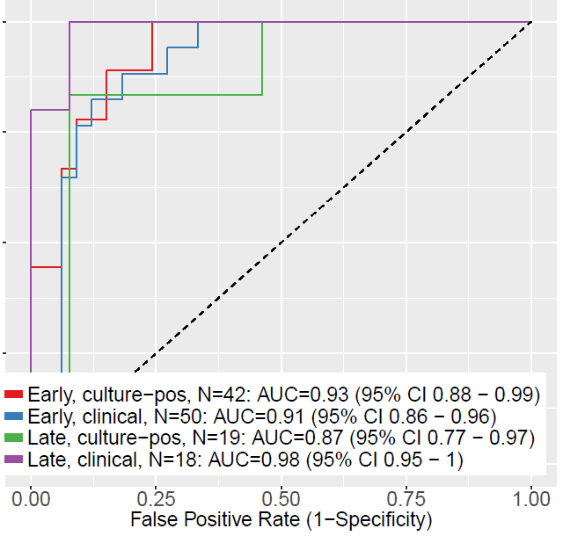
Supplemental Figure 2. The SMS shows no substantial differences depending on culture status of a carefully-defined sepsis cohort, nor on time since birth. Note that group size drop substantially in the split cohorts. Controls are time-matched (early with early, late with late), and are identical in comparisons of culture status. Thus, the same controls are counted twice in their respective comparison groups.

Slide 3
A: Two different methods for estimating optimal test characteristics (one optimized for sensitivity, the other (Youden) jointly optimized for sensitivity and specificity):
 |  |  | Set at sensitivity = 95% |  |  |  | Set at Youden optima
 |  |  | sensitivity | specificity |  |  | Sensitivity |  | specificity
Smith et al. | N=94 |  | 0.959 | 0.356 |  |  | 0.837 |  | 0.933
Wynn et al. | N=84 |  | 0.946 | 0.717 |  |  | 0.865 |  | 0.870
Cernada et al. | N=36 |  | 0.941 | 0.737 |  |  | 1 |  | 0.737
mean: |  |  | 0.949 | 0.603 |  |  | 0.901 |  | 0.847
B: Evaluation of test characteristics at the mean outcome for a sensitivity near 95%: Sensitivity = 94.9%, Specificity = 60.3%, prevalence = 8.9% NPV = 99.2%, PPV = 18.9%
 |  | true positive |  |  | true negative |  |  | total
test positive |  | 844.6 |  |  | 3616.7 |  |  | 4461.3
test negative |  | 45.4 |  |  | 5493.3 |  |  | 5538.7
total |  | 890.0 |  |  | 9110.0 |  |  | 10000
C: Evaluation of test characteristics at the mean outcome at the Youden optima: Sensitivity = 90.1%, Specificity = 84.7%, prevalence = 8.9% NPV = 98.9%, PPV = 36.5%
 |  | true positive |  |  | true negative |  |  | total
test positive |  | 801.9 |  |  | 1393.8 |  |  | 2195.7
test negative |  | 88.1 |  |  | 7716.2 |  |  | 7804.3
total |  | 890.0 |  |  | 9110.0 |  |  | 10000
Supplemental Table 1. Point estimates of sensitivity and specificity of the SMS in the three cohorts. Two methods for choosing an optimal point are used: a minimum sensitivity (95%) and the Youden joint maximization. In B and C, test estimates for the mean performance at both points is calculated using the assumption of prevalence of 10% in a VLBW or pre-term neonatal cohort.

Slide 4
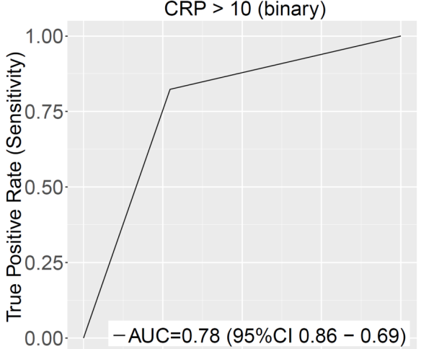
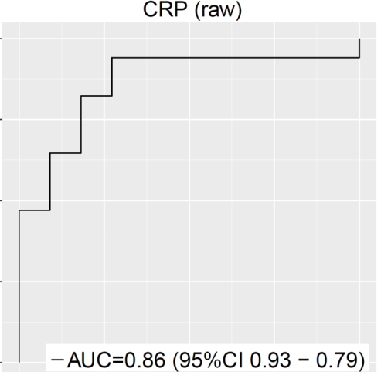
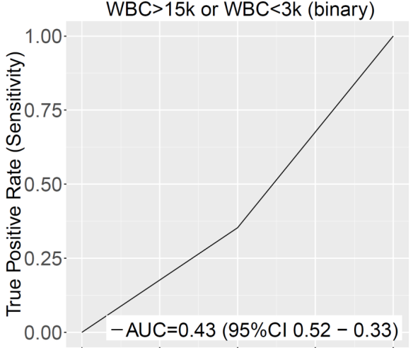
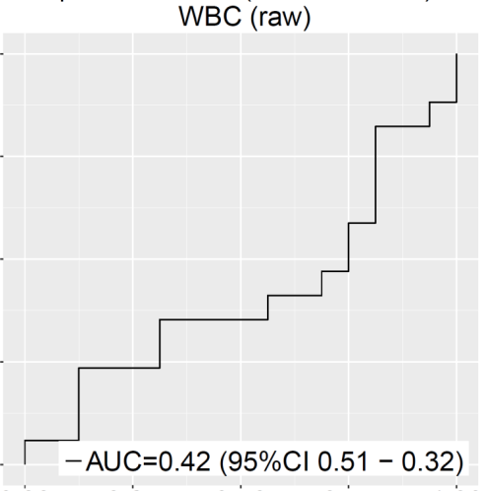
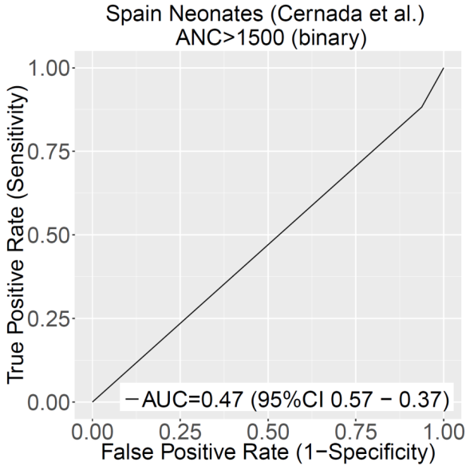
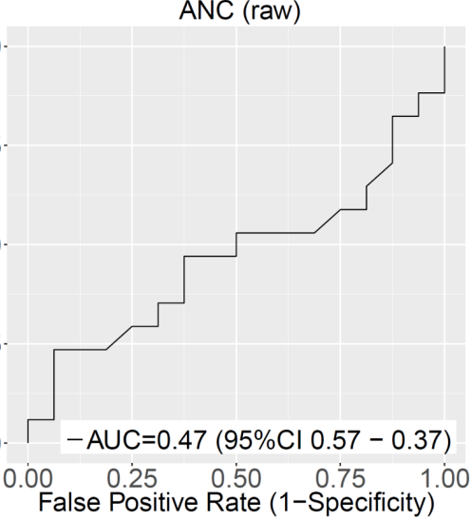
Supplemental Figure 3. Diagnostic performance of clinical labs from Cernada et al. comparing controls to sepsis. Only N=36 patients had these data available.

Slide 5
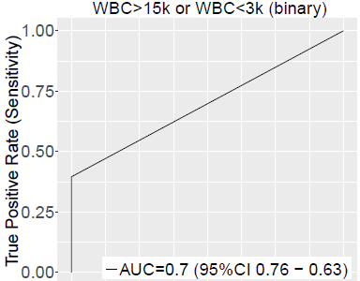
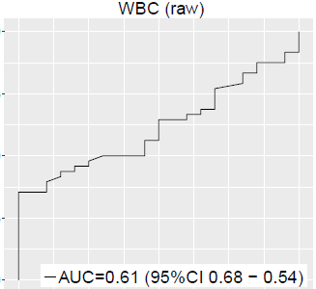
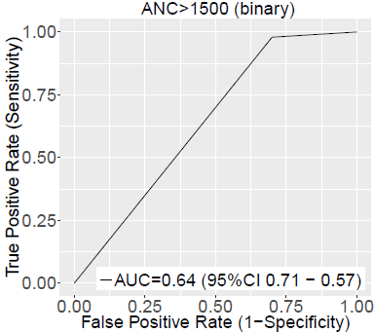
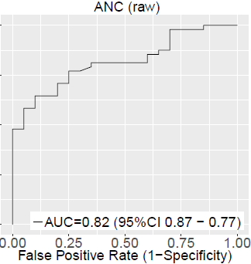
Supplemental Figure 4. Diagnostic performance of clinical labs from Smith et al. comparing controls to sepsis. Only N=68 patients had these data available.

Slide 6
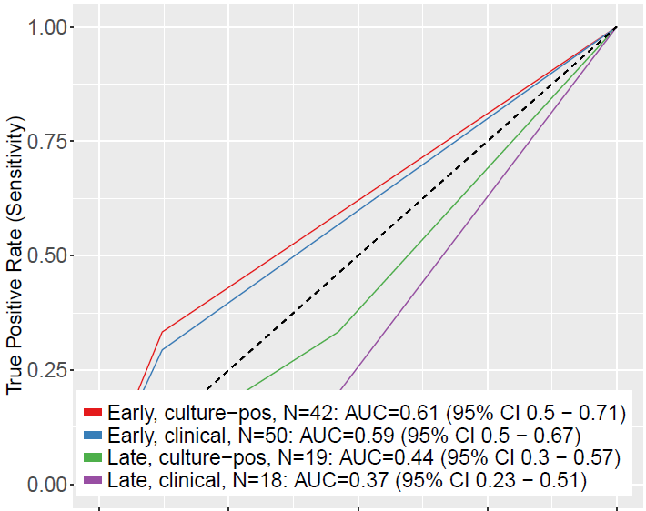
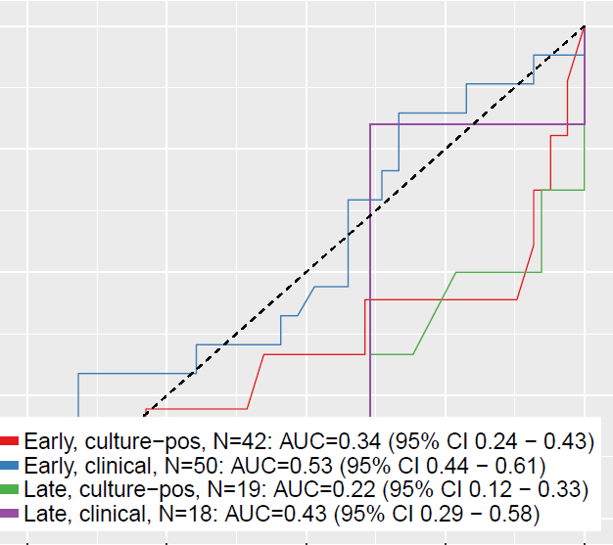
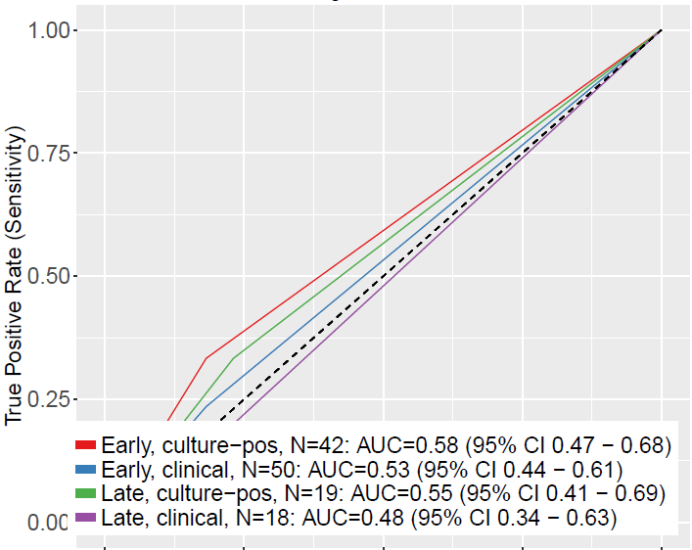
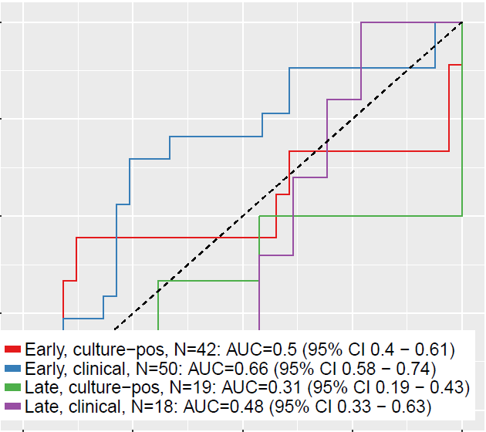
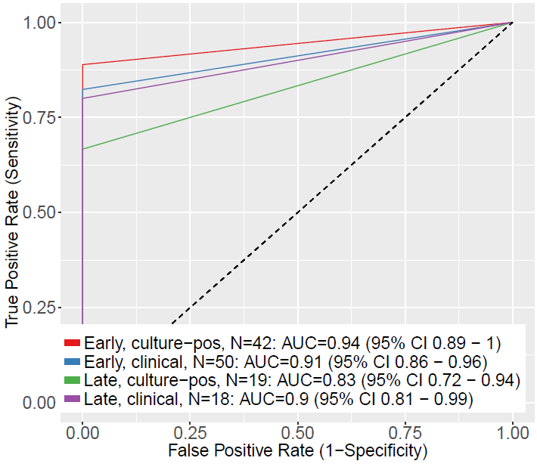
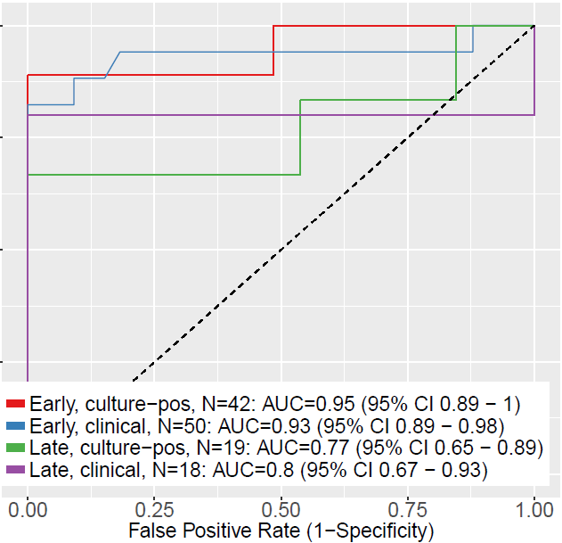
WBC>15 or WBC<3k (binary)
WBC (raw)
Supplemental Figure 5. Diagnostic performance of clinical labs from Wynn et al. in each of the four subgroups (early vs. late onset, clinical vs. culture-positive sepsis). N for each subgroup is listed in the legend of each graph.
ANC>1500
ANC (raw)
CRP>10
CRP (raw)

Slide 7
Cernada et al. Cohort
Initial model: binary labs alone |  |  |  |  |  | Initial model: continuous (raw) labs alone
Updated model: binary labs + SMS |  |  |  |  |  | Updated model: continuous (raw) + SMS
Outcome: absent |  |  |  |  |  | Outcome: absent
 | Updated Model |  |  |  |  |  | Updated Model
Initial Model | [0,0.01) | [0.01,0.15) | [0.15,1] | % reclassified |  | Initial Model | [0,0.01) | [0.01,0.15) | [0.15,1] | % reclassified
[0,0.01) | 0 | 0 | 0 | 0 |  | [0,0.01) | 0 | 0 | 0 | 0
[0.01,0.15) | 0 | 0 | 0 | 0 |  | [0.01,0.15) | 1 | 3 | 0 | 25
[0.15,1] | 0 | 4 | 7 | 36 |  | [0.15,1] | 1 | 2 | 4 | 43
Outcome: present |  |  |  |  |  | Outcome: present
 | Updated Model |  |  |  |  |  | Updated Model
Initial Model | [0,0.01) | [0.01,0.15) | [0.15,1] | % reclassified |  | Initial Model | [0,0.01) | [0.01,0.15) | [0.15,1] | % reclassified
[0,0.01) | 0 | 0 | 0 | 0 |  | [0,0.01) | 0 | 0 | 0 | 0
[0.01,0.15) | 0 | 0 | 0 | 0 |  | [0.01,0.15) | 0 | 0 | 0 | 0
[0.15,1] | 0 | 0 | 17 | 0 |  | [0.15,1] | 0 | 0 | 17 | 0
Combined Data |  |  |  |  |  | Combined Data
 | Updated Model |  |  |  |  |  | Updated Model
Initial Model | [0,0.01) | [0.01,0.15) | [0.15,1] | % reclassified |  | Initial Model | [0,0.01) | [0.01,0.15) | [0.15,1] | % reclassified
[0,0.01) | 0 | 0 | 0 | 0 |  | [0,0.01) | 0 | 0 | 0 | 0
[0.01,0.15) | 0 | 0 | 0 | 0 |  | [0.01,0.15) | 1 | 3 | 0 | 25
[0.15,1] | 0 | 4 | 24 | 14 |  | [0.15,1] | 1 | 2 | 21 | 12
_________________________________________ |  |  |  |  |  | _________________________________________
NRI(Categorical) [95% CI]: 0.3636 [ 0.0794 - 0.6479 ] ; p-value: 0.01217 |  |  |  |  |  | NRI(Categorical) [95% CI]: 0.3636 [ 0.0794 - 0.6479 ] ; p-value: 0.01217
NRI(Continuous) [95% CI]: 1.4652 [ 0.9684 - 1.962 ] ; p-value: 0 |  |  |  |  |  | NRI(Continuous) [95% CI]: 1.2299 [ 0.6794 - 1.7805 ] ; p-value: 1e-05
Supplemental Table 2. Cernada et al. net reclassification of labs alone vs. labs plus SMS, testing either binary or continuous lab values.

Slide 8
Smith et al. Cohort
Initial model: binary labs alone |  |  |  |  |  | Initial model: continuous (raw) labs alone
Updated model: binary labs + SMS |  |  |  |  |  | Updated model: continuous (raw) + SMS
Outcome: absent |  |  |  |  |  | Outcome: absent
 | Updated Model |  |  |  |  |  | Updated Model
Initial Model | [0,0.01) | [0.01,0.15) | [0.15,1] | % reclassified |  | Initial Model | [0,0.01) | [0.01,0.15) | [0.15,1] | % reclassified
[0,0.01) | 0 | 0 | 0 | 0 |  | [0,0.01) | 0 | 0 | 0 | 0
[0.01,0.15) | 0 | 0 | 0 | 0 |  | [0.01,0.15) | 0 | 3 | 0 | 0
[0.15,1] | 0 | 3 | 17 | 15 |  | [0.15,1] | 0 | 6 | 11 | 35
Outcome: present |  |  |  |  |  | Outcome: present
 | Updated Model |  |  |  |  |  | Updated Model
Initial Model | [0,0.01) | [0.01,0.15) | [0.15,1] | % reclassified |  | Initial Model | [0,0.01) | [0.01,0.15) | [0.15,1] | % reclassified
[0,0.01) | 0 | 0 | 0 | 0 |  | [0,0.01) | 0 | 0 | 0 | 0
[0.01,0.15) | 0 | 0 | 0 | 0 |  | [0.01,0.15) | 0 | 0 | 0 | 0
[0.15,1] | 0 | 1 | 47 | 2 |  | [0.15,1] | 0 | 0 | 48 | 0
Combined Data |  |  |  |  |  | Combined Data
 | Updated Model |  |  |  |  |  | Updated Model
Initial Model | [0,0.01) | [0.01,0.15) | [0.15,1] | % reclassified |  | Initial Model | [0,0.01) | [0.01,0.15) | [0.15,1] | % reclassified
[0,0.01) | 0 | 0 | 0 | 0 |  | [0,0.01) | 0 | 0 | 0 | 0
[0.01,0.15) | 0 | 0 | 0 | 0 |  | [0.01,0.15) | 0 | 3 | 0 | 0
[0.15,1] | 0 | 4 | 64 | 6 |  | [0.15,1] | 0 | 6 | 59 | 9
_________________________________________ |  |  |  |  |  | _________________________________________
NRI(Categorical) [95% CI]: 0.1292 [ -0.0325 - 0.2908 ] ; p-value: 0.11726 |  |  |  |  |  | NRI(Categorical) [95% CI]: 0.3 [ 0.0992 - 0.5008 ] ; p-value: 0.00341
NRI(Continuous) [95% CI]: 1.225 [ 0.8106 - 1.6394 ] ; p-value: 0 |  |  |  |  |  | NRI(Continuous) [95% CI]: 0.7083 [ 0.2386 - 1.178 ] ; p-value: 0.00312
Supplemental Table 3. Smith et al. net reclassification of labs alone vs. labs plus SMS, testing either binary or continuous lab values.

Slide 9
Wynn et al. Cohort
Initial model: binary labs alone |  |  |  |  |  | Initial model: continuous (raw) labs alone
Updated model: binary labs + SMS |  |  |  |  |  | Updated model: continuous (raw) + SMS
Outcome: absent |  |  |  |  |  | Outcome: absent
 | Updated Model |  |  |  |  |  | Updated Model
Initial Model | [0,0.01) | [0.01,0.15) | [0.15,1] | % reclassified |  | Initial Model | [0,0.01) | [0.01,0.15) | [0.15,1] | % reclassified
[0,0.01) | 0 | 0 | 0 | 0 |  | [0,0.01) | 0 | 0 | 0 | 0
[0.01,0.15) | 0 | 0 | 0 | 0 |  | [0.01,0.15) | 19 | 9 | 2 | 70
[0.15,1] | 8 | 25 | 13 | 72 |  | [0.15,1] | 6 | 4 | 6 | 62
Outcome: present |  |  |  |  |  | Outcome: present
 | Updated Model |  |  |  |  |  | Updated Model
Initial Model | [0,0.01) | [0.01,0.15) | [0.15,1] | % reclassified |  | Initial Model | [0,0.01) | [0.01,0.15) | [0.15,1] | % reclassified
[0,0.01) | 0 | 0 | 0 | 0 |  | [0,0.01) | 0 | 0 | 0 | 0
[0.01,0.15) | 0 | 0 | 0 | 0 |  | [0.01,0.15) | 0 | 0 | 3 | 100
[0.15,1] | 0 | 1 | 36 | 3 |  | [0.15,1] | 0 | 0 | 34 | 0
Combined Data |  |  |  |  |  | Combined Data
 | Updated Model |  |  |  |  |  | Updated Model
Initial Model | [0,0.01) | [0.01,0.15) | [0.15,1] | % reclassified |  | Initial Model | [0,0.01) | [0.01,0.15) | [0.15,1] | % reclassified
[0,0.01) | 0 | 0 | 0 | 0 |  | [0,0.01) | 0 | 0 | 0 | 0
[0.01,0.15) | 0 | 0 | 0 | 0 |  | [0.01,0.15) | 19 | 9 | 5 | 73
[0.15,1] | 8 | 26 | 49 | 41 |  | [0.15,1] | 6 | 4 | 40 | 20
_________________________________________ |  |  |  |  |  | _________________________________________
NRI(Categorical) [95% CI]: 0.6904 [ 0.5501 - 0.8306 ] ; p-value: 0 |  |  |  |  |  | NRI(Categorical) [95% CI]: 0.668 [ 0.4803 - 0.8558 ] ; p-value: 0
NRI(Continuous) [95% CI]: 1.2632 [ 0.9264 - 1.6001 ] ; p-value: 0 |  |  |  |  |  | NRI(Continuous) [95% CI]: 0.8637 [ 0.5033 - 1.2241 ] ; p-value: 0
Supplemental Table 4. Wynn et al. net reclassification of labs alone vs. labs plus SMS, testing either binary or continuous lab values.

