Slide 1
Figure S1
A
PA
EP
Meningioma
MB
PNET
PCNSL
AT/RT
GBM
NB
B
Meningioma
SFT
EP
SIX1
SIX2
FOXC1
FOXC2
BNC2
MEOX2
KLF5
GFAP
OLIG2
SOX2
INI1
STAT6
CD34

Slide 2
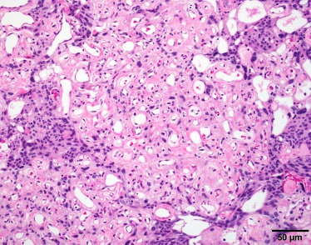
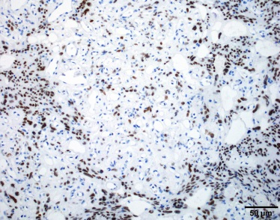
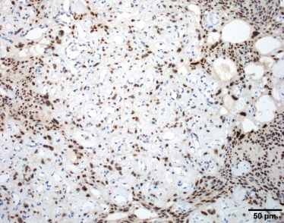
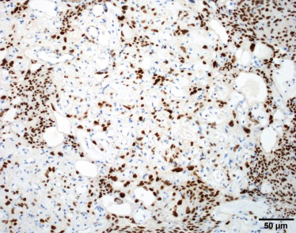
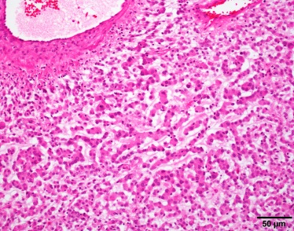
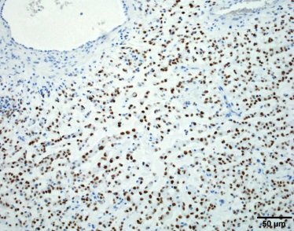
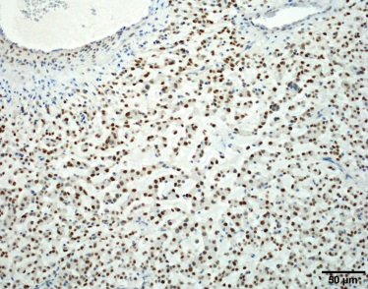
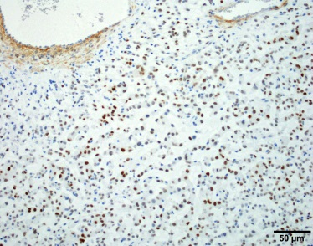
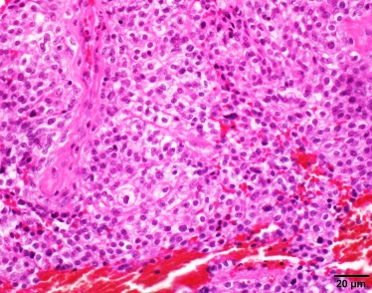
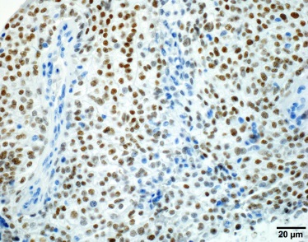
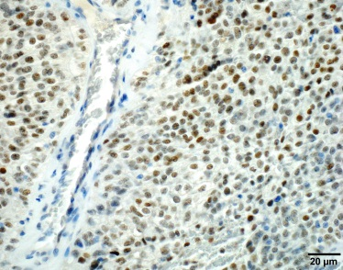
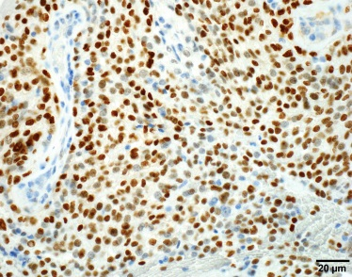
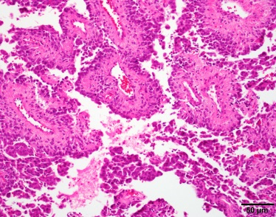
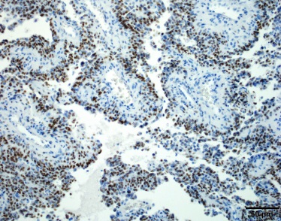
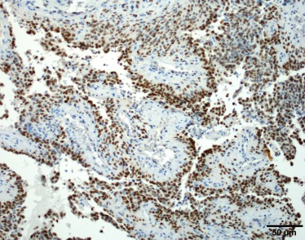
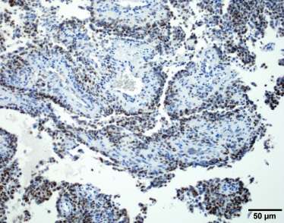
Figure S2
H&E
SIX1
FOXC1
MEOX2
Angiomatous
Chordoid
Clear Cell
Papillary

Slide 3
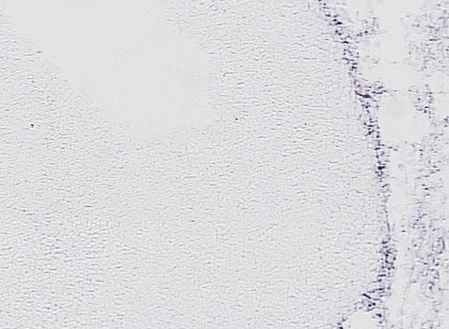
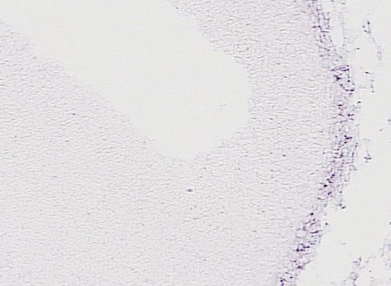
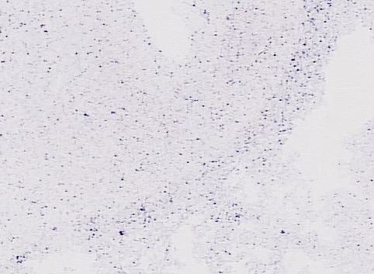
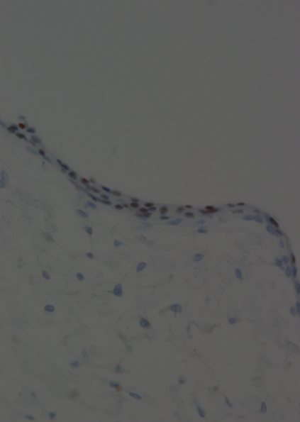
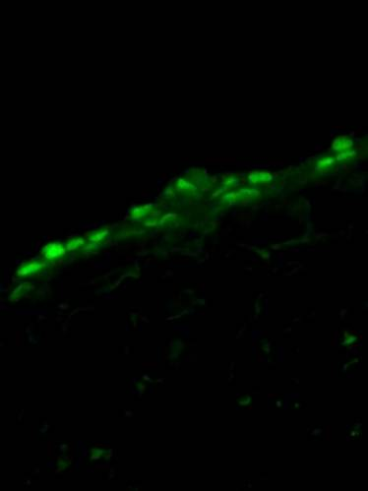
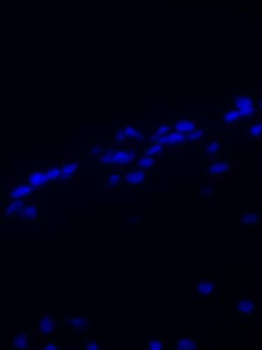
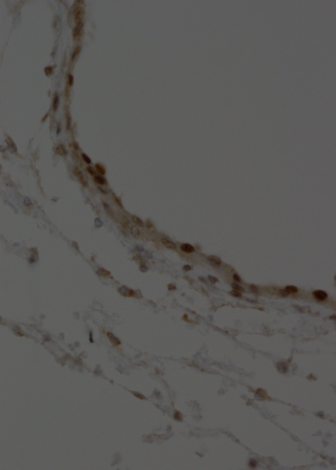
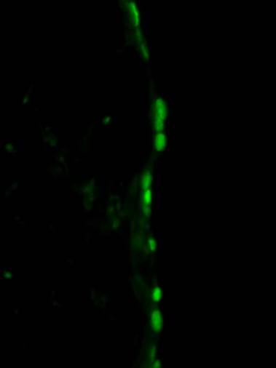
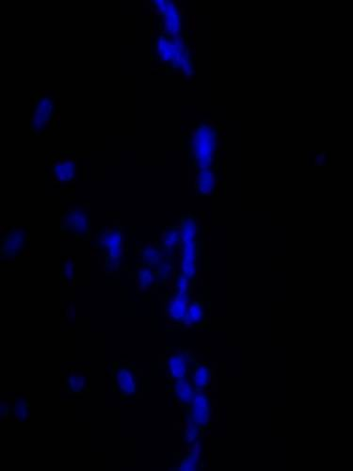
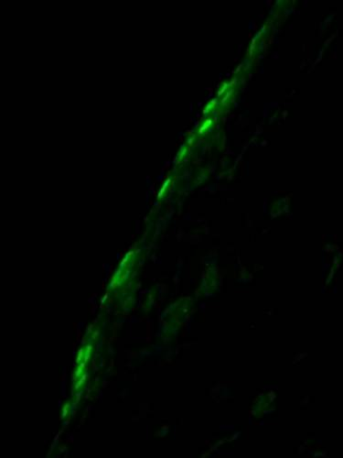
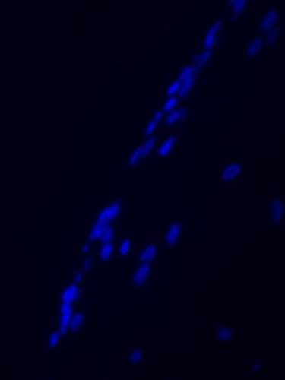
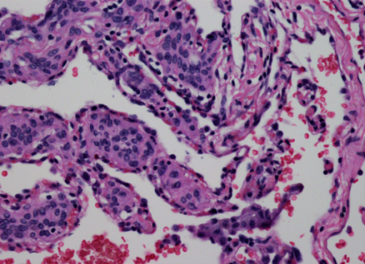
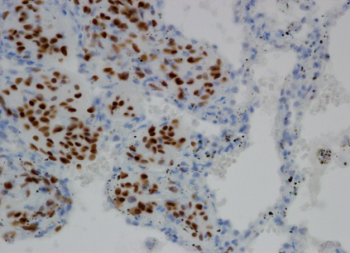
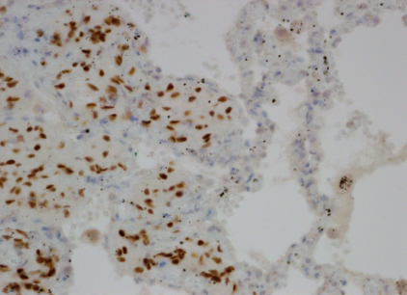
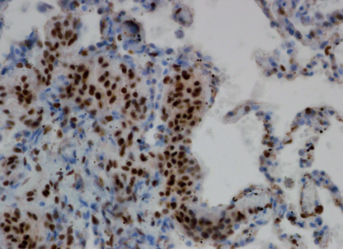
Figure S3
A
Six1
Foxc1
Meox2
B
IHC
IF
DAPI
SIX1
SIX1
FOXC1
FOXC1
MEOX2
MEOX2
C
H&E
SIX1
FOXC1
MEOX2

Slide 4
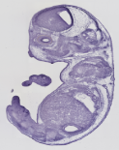
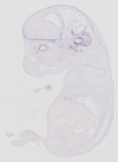
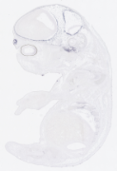
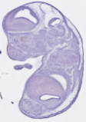
Figure S4
SIX2
FOXC2
BNC2
FOXD1
KLF5

Slide 5
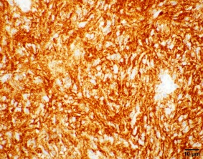
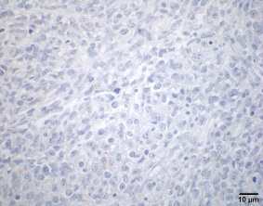
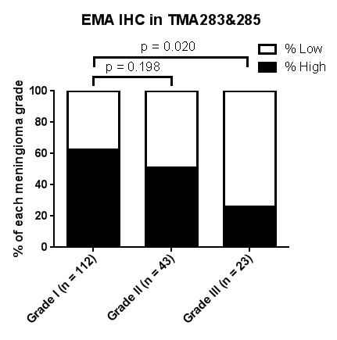
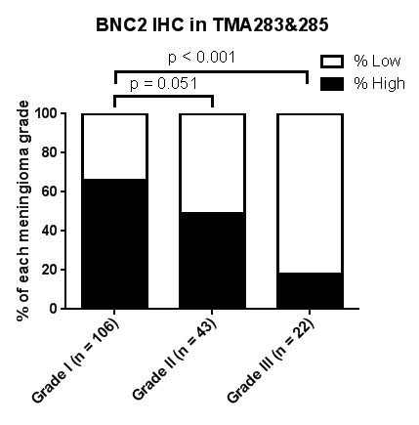
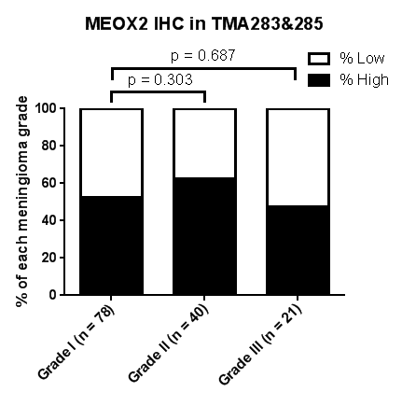
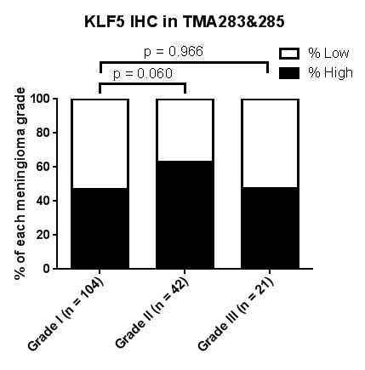
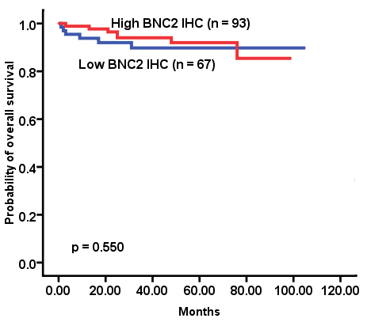
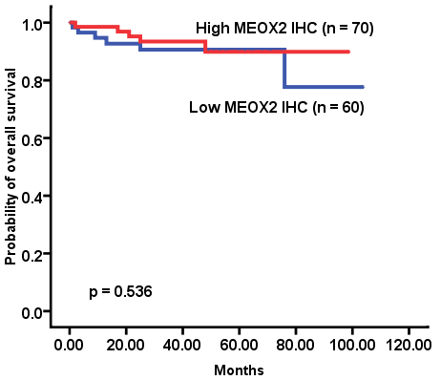
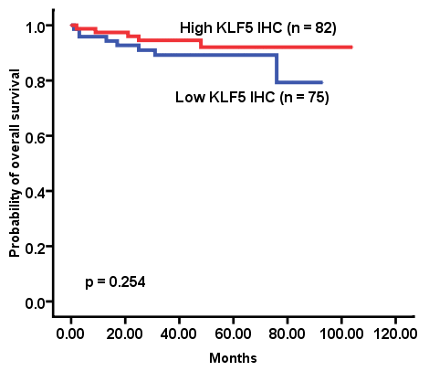
Figure S5
A
Grade I
Grade III
B
C
D

Slide 6
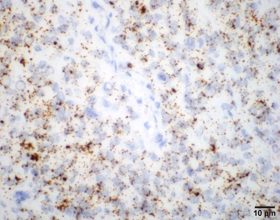
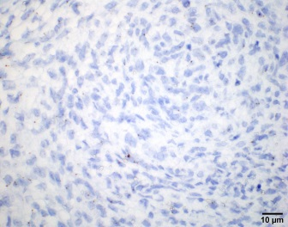
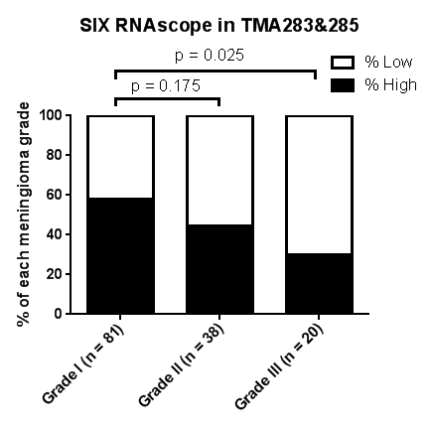
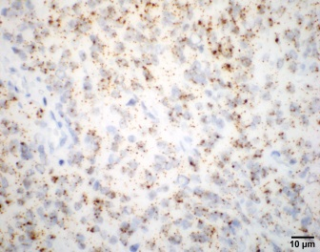
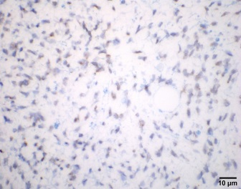
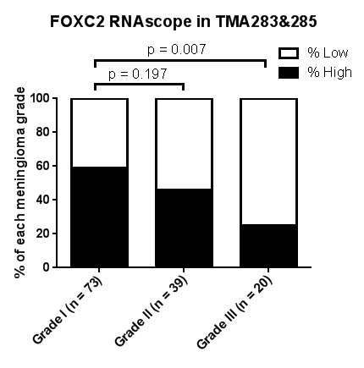
Figure S6
Grade I
Grade III
A
B
C
D

Slide 7
Figure S7
A
B

Slide 8
Figure S8

Slide 9
Figure S9
A
LEPR LONG (Hs00174492_m1) (exon19-20)
LEPR TOTAL (Hs00174497_m1) (exon6-7)
Probe-Hs-LEPR tv1 (exon 20)
Probe-Hs-LEPR alltv (exon10-17)
Variant 1
(NM_002303)
Variant 2
(NM_001003680)
Variant 3
(NM_001003679)
Variant 4
(NM_001198687)
Variant 5
(NM_001198688)
Variant 6
(NM_001198689)
The target region for qPCR primers and TaqMan probe
The target region for RNAscope probe
The common exons shared by all variants
The different exons between all variants
B

Slide 10
Figure S10
A
B

Slide 11
Figure S11
A
B

Slide 12
Figure S12

Slide 13
Figure S13
A
B
MG14
SIX1
FOXC1
FOXC2
MG15
SIX1
FOXC1
FOXC2

Slide 14
Figure S14

Slide 15
Figure S15
A
B

Slide 16
Figure S16
A
B
MG1
SIX1
10μm
FOXC1
FOXC2
MG2
SIX1
FOXC1
FOXC2
MG5
SIX1
FOXC1
FOXC2

Slide 17
Figure S17
SIX1
SIX2
FOXC1
FOXC2
BNC2
MEOX2
KLF5
LEPR
PTGDR
EYA1
EYA2
EYA3
EYA4
MUC1

Slide 18
Figure S18
A
B

Slide 19
Figure S19

Slide 20
Figure S20
A
B
C

